Slide 1
EXCHANGE OF PERSONNEL (access provision)
Thanks to: MYLENE NDISI (ACTRIS), LILITH KUCKERO (SIOS) , ANDERS TJULIN (EISCAT), Robert Huber (UniHB, WP leader)

Slide 2
Staff Exchange program
Multi disciplinary
Outside your own RI
Outside your domain or discipline
Stimulate knowledge exchange
Create networks of people and expertise
Benefit from existing knowledge
Wider use of best practices

Slide 3
The taskforce

Slide 4
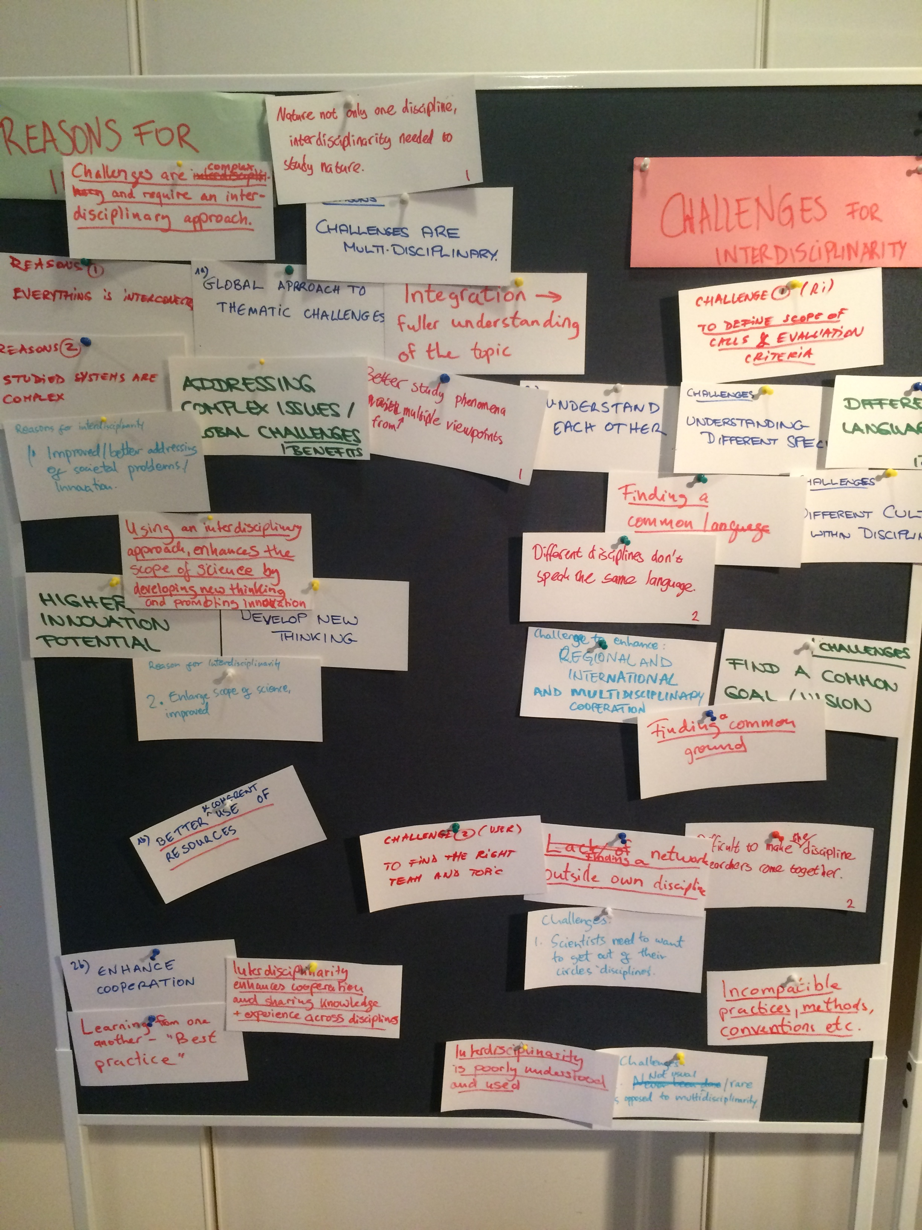
goals
Overall Objective:
Share experiences and thoughts on best governance/management dynamics for interdisciplinary access provision.
Goals of the exchange of personnel:
Sharing knowledge in ways to facilitate interdisciplinary access provision.
Sharing experiences that could lead to policy development for access provision.
Sharing best practices on coordination and communication to attract users.
Sharing ways of engaging users in access provision.

Slide 5
Clermont-Ferrand exchange (actris)
Details on a thought out access process and tools:
      Central access management, Outreach and communication, Application, Selection process, Actual access, Results, Monitoring of access process, Evaluation of performance,
Based on guiding internal documents: the access management plan and the data management plan.
Evaluation of performance through KPIs:
      User metrics,
      Operational metrics,
      Financial metrics,
      Strategic metrics,
Sustainability through possible financial models.

Slide 6
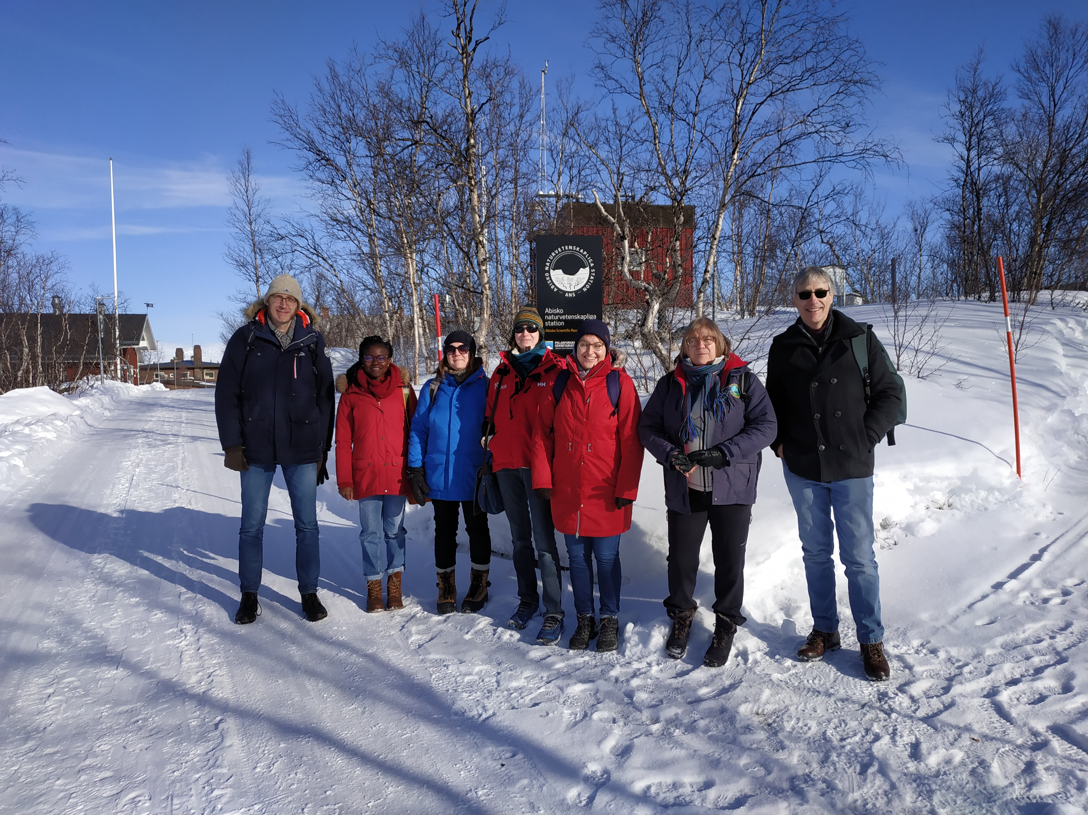
Kiruna exchange
User perspective (access provision)
What is the added value, what is the need for interdisciplinary access provision?
Feedback collection and analysis and incorporation of user needs from feedback collection.
RI perspective (access provision)
Why provide interdisciplinary access?
How to best provide interdisciplinary access?
What is the interdisciplinary integration capacity of ENV RIs?
How can access management (referring to tools) be made more efficient?
How can access provision remain sustainable (financial and costing issues)?

Slide 7
Knowledge exchange in envriplus
Unmanned Vehicle workshop (drones): exchange of technical and theoretical experiences, by ANAEE, JERICO and GROOM
Seismic data integration: integration of EPOS data into the EMSO France node database, by EMSO and EPOS
Funding of Research Infrastructures: visits from PANGEA to EGI, EMSO, ACTRIS and ICOS
Data for Science 'European Tour'
RI-Train Leadership training
Interactive Training platform for the ENVRI community
Outreach to school students and teachers

