Slide 1
ESFRI perspective on the research infrastructures cluster collaboration
Final ENVRIplus event, 4. 6. 2019
JAN HRUŠÁK

Slide 2
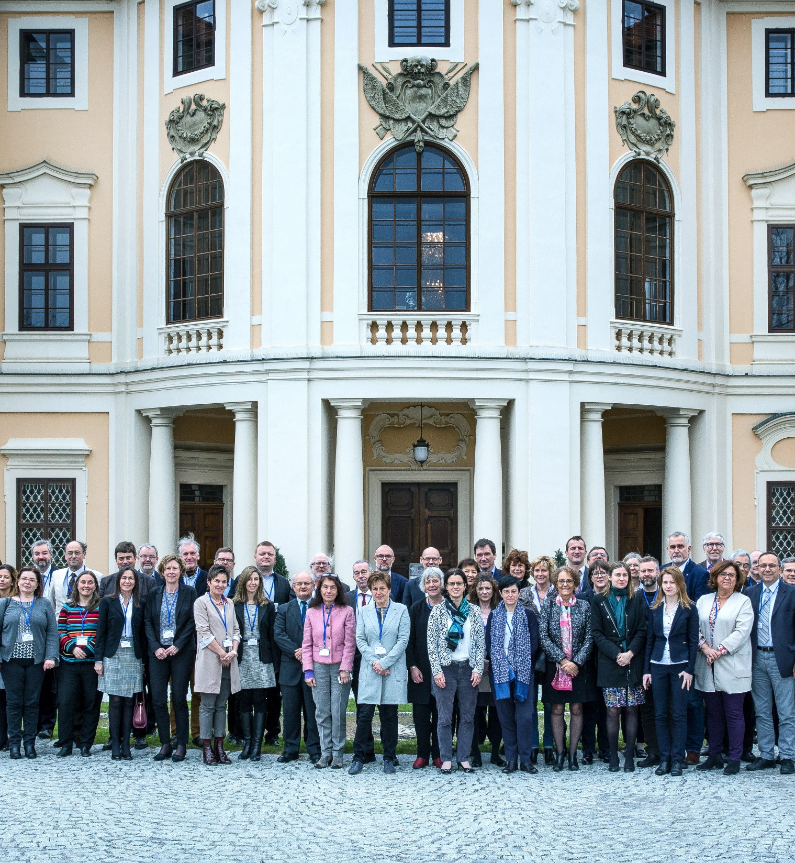
Main objectives of ESFRI
The European Strategy Forum on Research Infrastructures (ESFRI) was established in 2002 with a mandate from the Council of the European Union to:
Support a coherent and strategy-led approach to policy making on RIs in Europe
Facilitate multilateral initiatives leading to better use and development of research infrastructures
Establish a European Roadmap for RIs

Slide 3
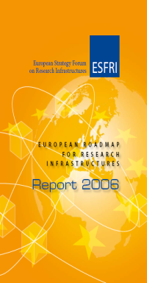
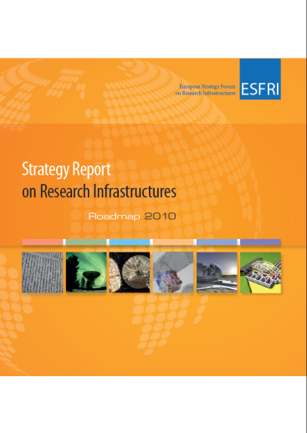
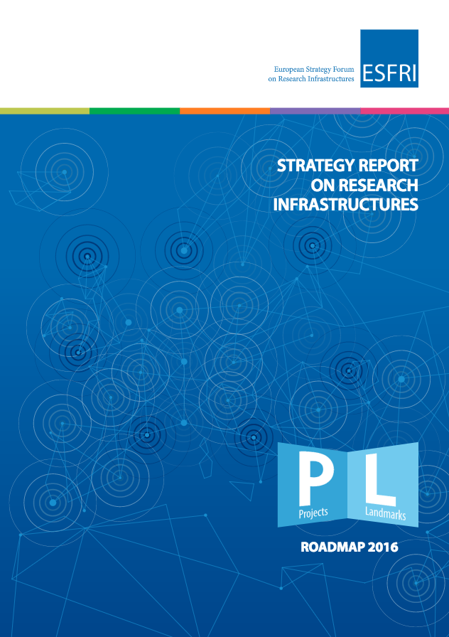
The Fifth ESFRI Roadmap and Strategy Report
2006
2008
2010
2016

Slide 4
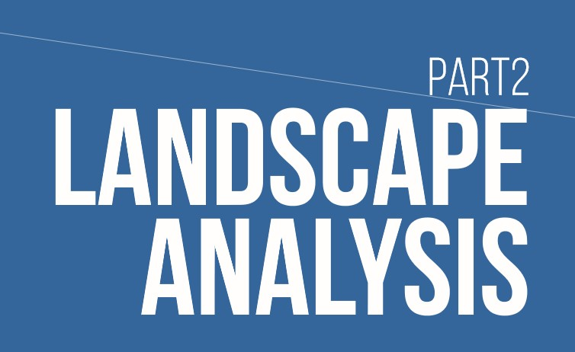

Landscape analysis
The Landscape Analysis gives evidence of the interconnections among the RIs contributing new knowledge in a complementary way.
The RIs while maintaining their own disciplinary-rich diversity portfolio, have a high potential to horizontally coordinate on science topics that are addressed only by adopting multiple diverse complementary techniques.
Survey and analysis of the context, in each domain, of the operational national or international research infrastructures open to European scientists and technology developers through peer-review of competitive science proposals.
Identifies the existing resources, the gaps and the potential evolution of each field in the foreseeable future.
Monitoring of implemented RIs (landmarks)
Coordinatinon in HPC and data infrastructures (under discussion - WG Digit)
Notes:
Upon mandates of EU Competitiveness Council ESFRI has completed the ESFRI Roadmaps 2006, 2008, 2010, 2016, and the ESFRI Roadmap 2018. The Roadmap
identifies new pan-European Research Infrastructures and the evolving role of RIs, corresponding to the needs of European research communities in the next 10 to 20 years, in all fields of research
identifies the ESFRI Landmarks that are implemented projects leading in their domain and structuring the European and global landscape.
indicate strategies for the necessary major financial investment (~20 b€) and long term commitment for operation (~2 b€/year).
deals with LTS and innovation oriented approaches,

Slide 5

Role of ESFRI as Facilitator
In January 2019 ESFRI has started a reflection on the new challenges which will refine a strategy for future shaping of ESFRI.
Advising body of the competitivness council
Future ESFRI Roadmaps including gap analysis and Landscapes
Incubator role in the setting-up of the RIs across the entire lifecycle
Structuring role at thematic level by fostering consolidation of European RI eco-system
Contribute on request to RI related areas, e.g. addressing societal challenges and SDGs from RI policy perspective
Represent EU RIs at international level and Helpdesk for national processes
Help promote good practices in RI related agendas and policies
Deals with Horizontal issues (e.g. Long-term sustainability study, Missions …)
Relationship with EOSC
Support emerging sectorial initiatives (LEAPS, LENS,….)

Slide 6
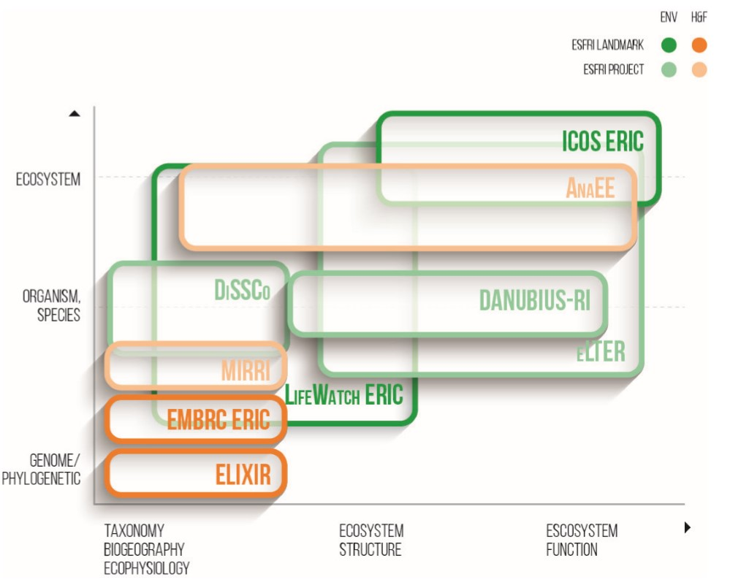
Opportunities for collaboration
ENVRI as an excellent tool for self-organization of Environmental RIs
EUROPEAN RI ECO-SYSTEM
A federated approach should help to reduce overlaps, to maximise synergies and benefits, and to coordinate RIs
Efficient strategies of interconnectedness within and across scientific domains. Thus accelerating high-quality research and leading to greater sustainability
Three interdependent resources, that of technological capital, cultural capital and human capital are needed to develop and achieve that vision

Slide 7

Rationale for clustering of RIs
Self – organization RI
Horizontal across fields
Vertikal - structuring effect
Multiple perspectives for generating unique and creative solutions
Better services to users and scientific cummunities
Global competitivness of European research through international collaboration
Better diffusion of scientific and technological knowlege
Sharing of best practices in management and/or technological solutions
Cost effectiveness in purchase - Cost savings
Access to broader range of trustable data
Better respond to societal challenges SDGs
Visibility and societal acceptance
Public procurement issues

Slide 8
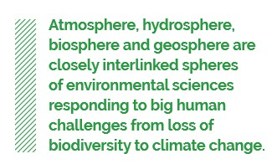

Clustering of environmental RIs
Collaborative research and services to users and Society
Tackling environmental challenges is crucial for mankind and for life on Earth
Combining research in individual domains enhances the knowledge about our planet, and these synergies often save time and resources
Role of European RIs in the global landscape
Global and require global cooperation. Building up on large experience in Europe in collaborative reseach, structured RI organization and on datasharing. Role model and good practice example
Enhancing societal impact
ENV RIs have significant impact in preservation of wealth. Outreach and enlarged visibitilty of Research and RIs in general.
Benefiting from enhanced synergies in managerial and Economic terms
Sharing of knowledge, best practice examples (managerial, technological, legal ...),
Technology co-development, Public procurmentpractices, joint tenders

Slide 9

Future Challenges
Is ENVRI EOSC ready?
Excellent research is more and more based on diverse data sources oriented to study the same phenomena (multimessenger approach already adopted in ENV and H&F RIs)
RI clusters as enablers of ex-ante interdisciplinary or multidisciplinary research
Knowledge-based society addressed by open data concept
High quality data which are FAIR and Reproducible (accessible to users form different disciplinary domains)

Slide 10
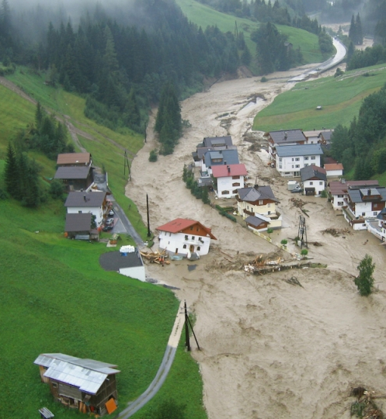
Future needs in atmosphere and hydrosphere
The Landscape Analysis published in 2018 identified several gaps, challenges and future needs in the area of Environment:
Cross-domain
  Effect of air pollution on children´s health should be better explored
  Societal
  Science-based assessmend criteria to evaluate the impact of human activities on environmental status shall be better known

Slide 11
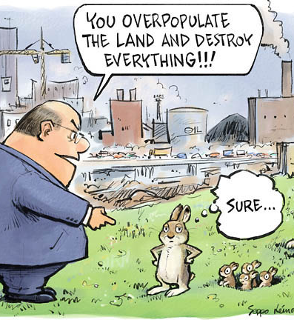
Future needs in biodiversity and geospehre
  The taxonomic gap needs to be overcome, in order to discover and describe the ¾ of the biodiversity still to be known.
  Genetic sequencing and ICT (including big data analysis and digitalisation)
  New RIs and data are urgent in the fields of geo-resources and mining, in order to achieve meaningful targets of energy and mineral security in Europe
MANY others .....

Slide 12
Thank you
Final ENVRIplus event, 4. 6. 2019
Jan Hrušák

Slide 13


The Roadmap – Strategic report
Upon mandates of EU Competitiveness Council ESFRI has completed the ESFRI Roadmaps 2006, 2008, 2010, 2016, and the ESFRI Roadmap 2018. The Roadmap
identifies new pan-European Research Infrastructures and the evolving role of RIs, corresponding to the needs of European research communities in the next 10 to 20 years, in all fields of research
identifies the ESFRI Landmarks that are implemented projects leading in their domain and structuring the European and global landscape.
indicate strategies for the necessary major financial investment (~20 b€) and long term commitment for operation (~2 b€/year).
deals with LTS and innovation oriented approaches,
Landscape Analysis
Survey and analysis of the context, in each domain, of the operational national or international research infrastructures open to European scientists and technology developers through peer-review of competitive science proposals.
Identifies the existing resources, the gaps and the potential evolution of each field in the foreseeable future.
Monitoring of implemented RIs (landmarks)
Coordinatinon in HPC and data infrastructures (under discussion - WG Digit)

