Slide 1

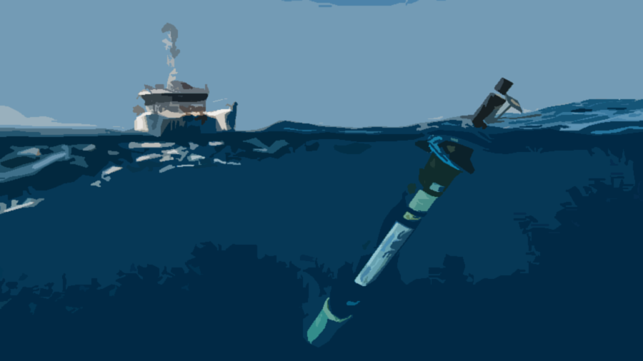
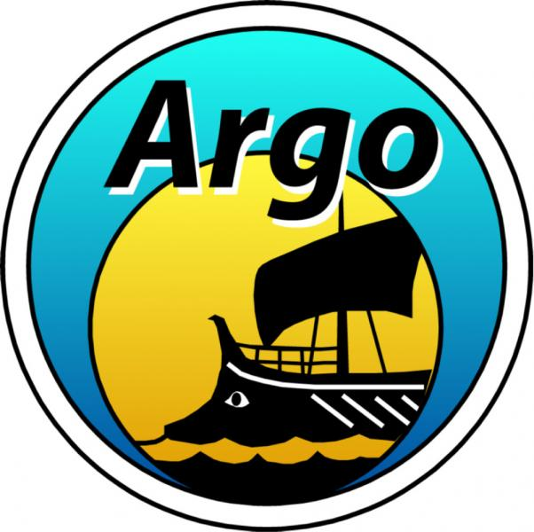
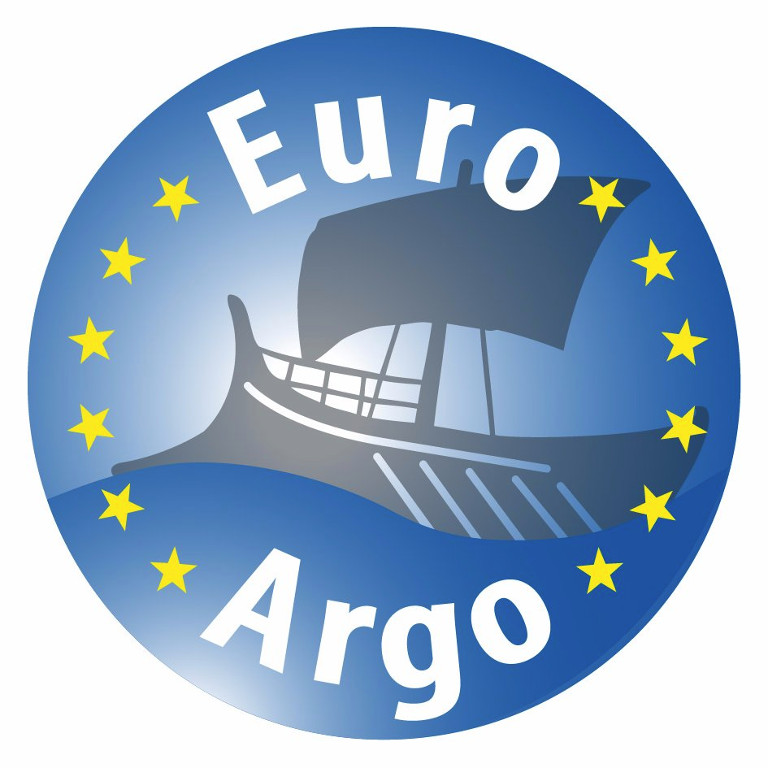
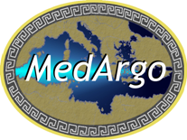


Argo in the Mediterranean and Black Seas
P.-M. Poulain
Istituto Nazionale di Oceanografia e Geofisica Sperimentale – OGS
Trieste, Italy
Outline
The Argo monitoring Program
Argo in the Mediterranean and Black Seas (MedArgo)
Examples of scientific results
Operational uses
ENVRIplus Booth @ EGU17 – 26 April 2017

Slide 2
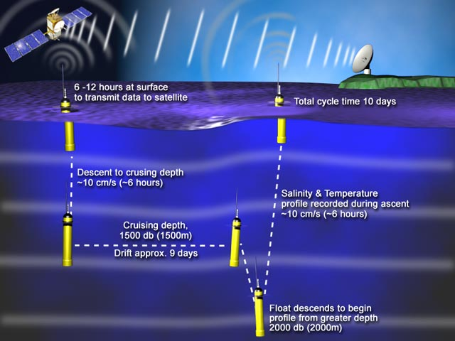
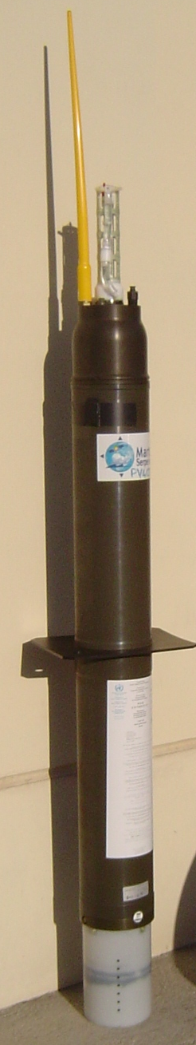
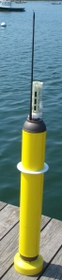
Argo: global ocean monitoring using profiling autonomous floats
Sampling in the World Ocean
ENVRIplus Booth @ EGU17 – 26 April 2017

Slide 3

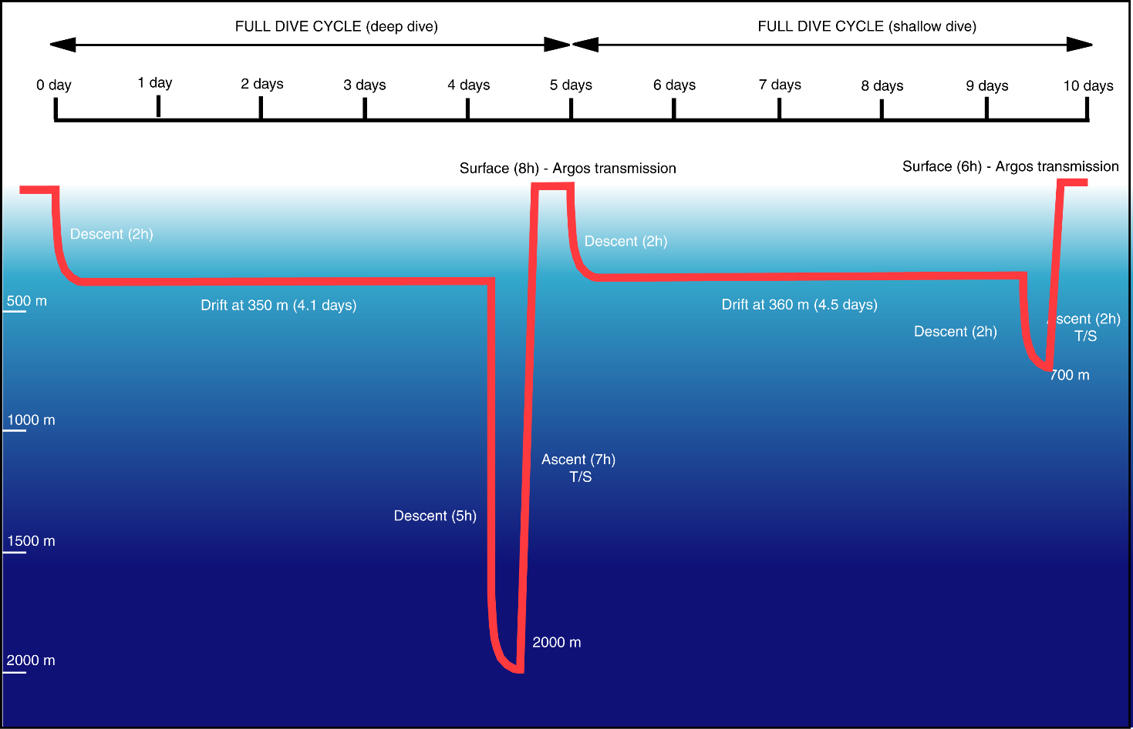
Argo: global ocean monitoring using profiling autonomous floats
Typical sampling in the Mediterranean Sea
ENVRIplus Booth @ EGU17 – 26 April 2017

Slide 4
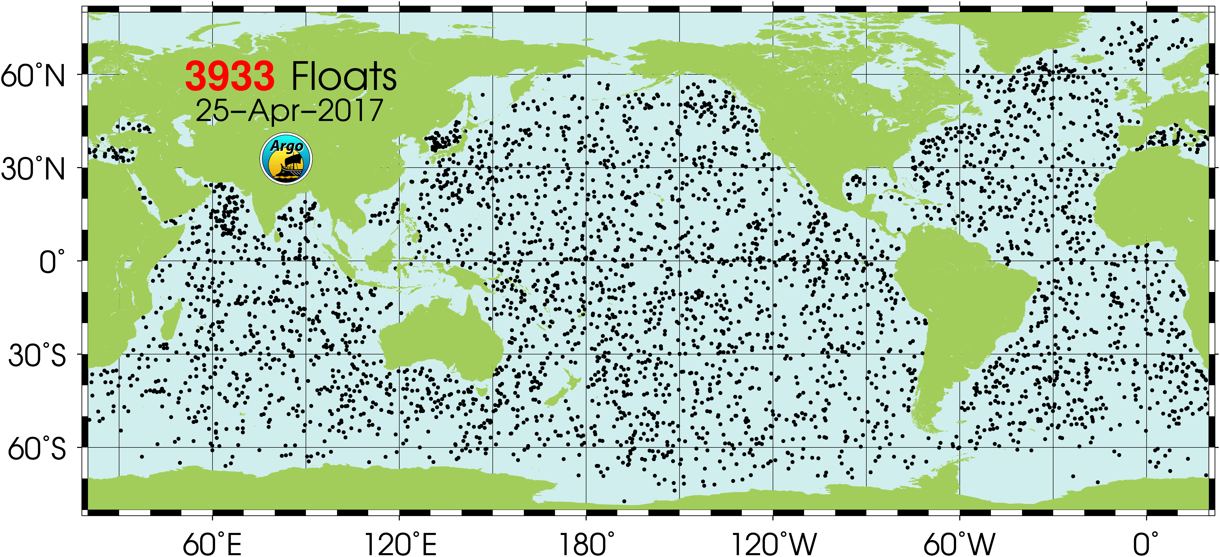
Argo: global ocean monitoring using profiling autonomous floats
ENVRIplus Booth @ EGU17 – 26 April 2017

Slide 5
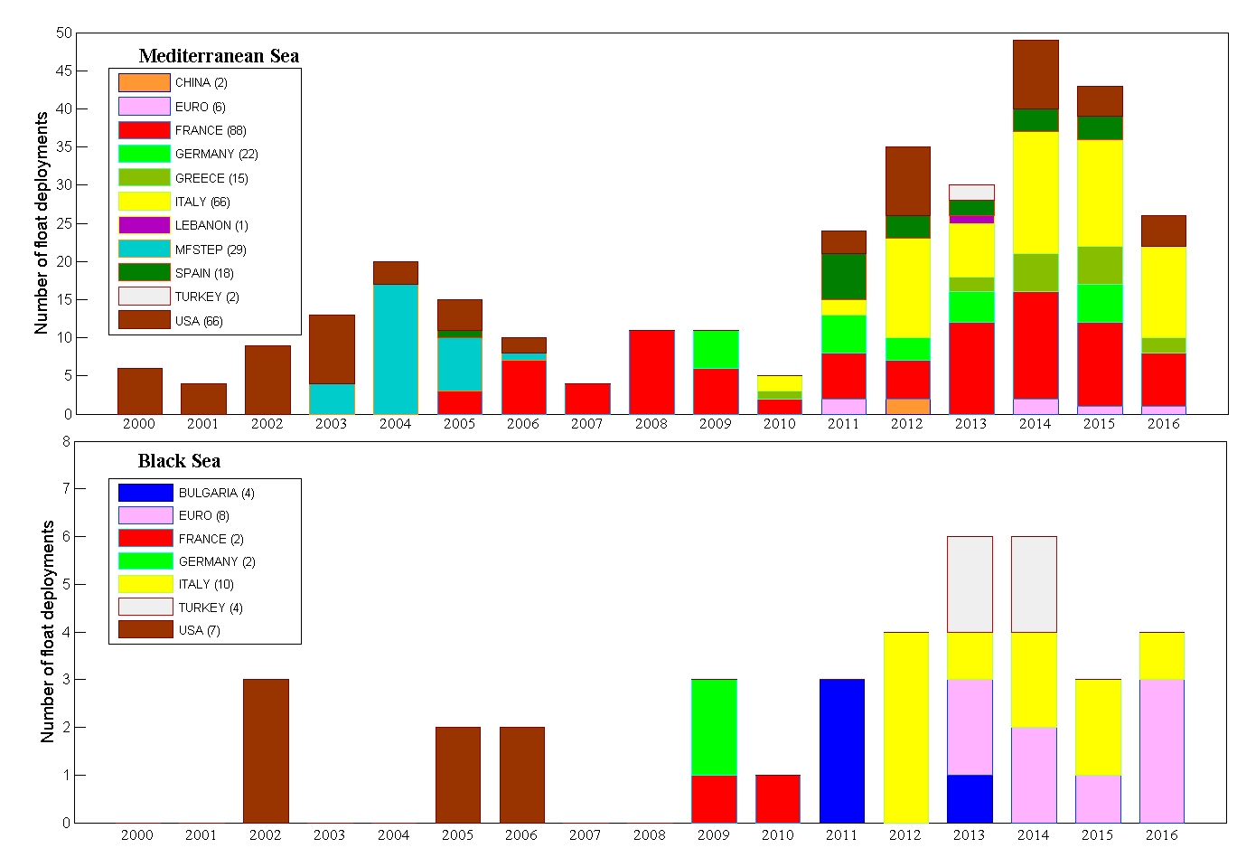
Argo float fleet in the Med & Black Seas (2001-2017)
ENVRIplus Booth @ EGU17 – 26 April 2017

Slide 6
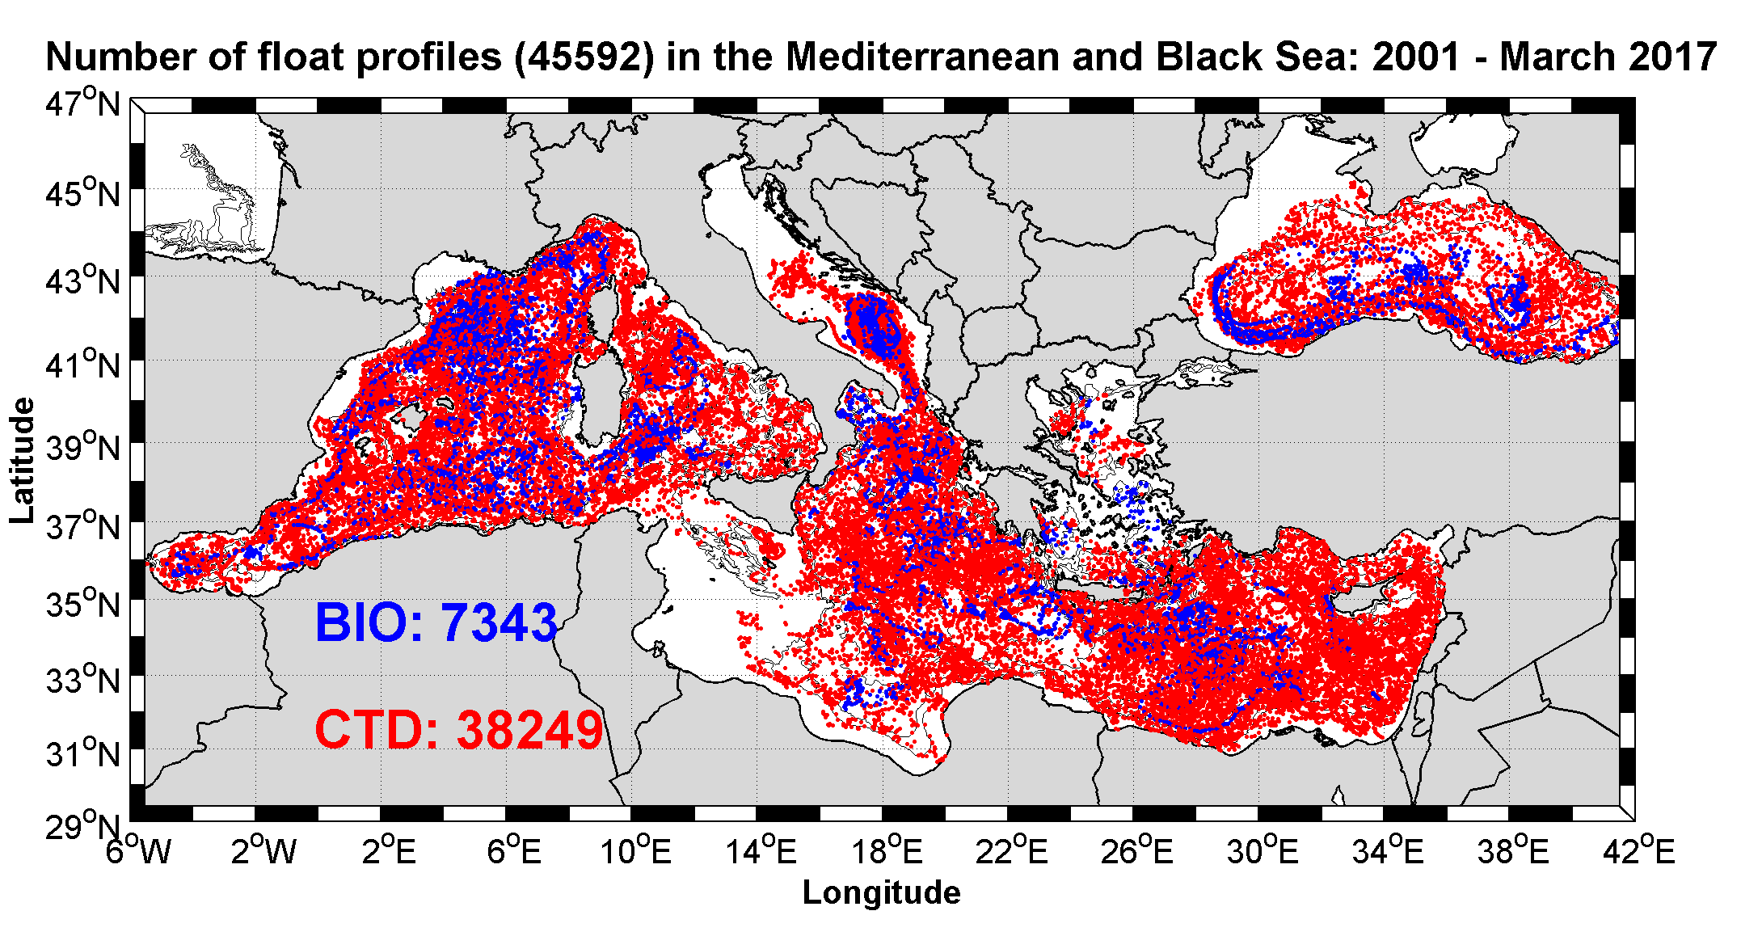
Argo float fleet in the Med & Black Seas (2001-2017)
Specifications of the Argo profilers (Med):
Cycle length → 5 days
Parking depth → 350 m
Deep dive (2000 m) every 1 or 2 cycles
Shallow dive → 700 m
Contributors
410 Floats
MFSTEP
SPAIN
FRANCE
GERMANY
GREECE
ITALY
BULGARIA
USA
EUROARGO
TURKEY
LEBANON
CHINA
45500 profiles
Updated to March 2017
ENVRIplus Booth @ EGU17 – 26 April 2017

Slide 7
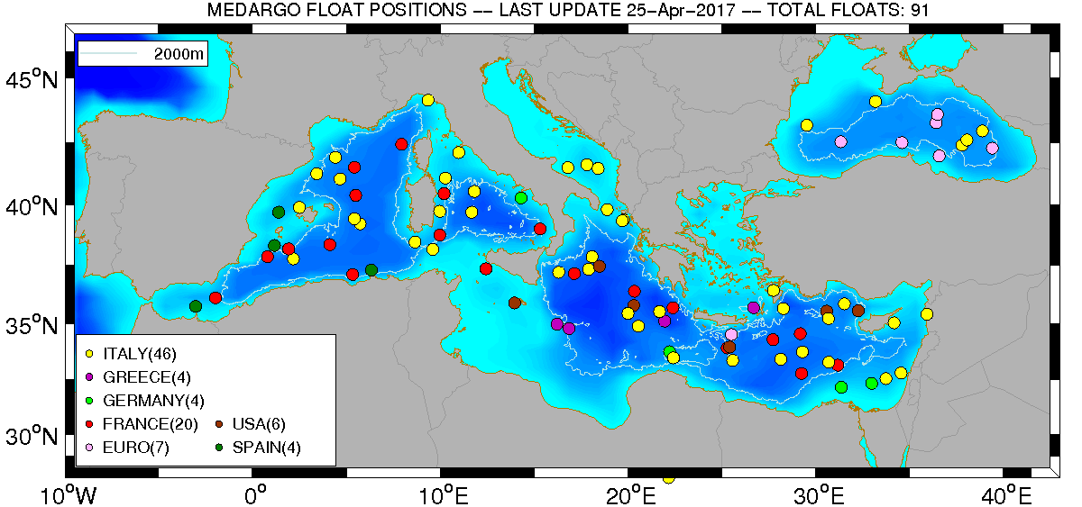
Argo float fleet in the Med & Black Seas (2001-2017)
ENVRIplus Booth @ EGU17 – 26 April 2017

Slide 8
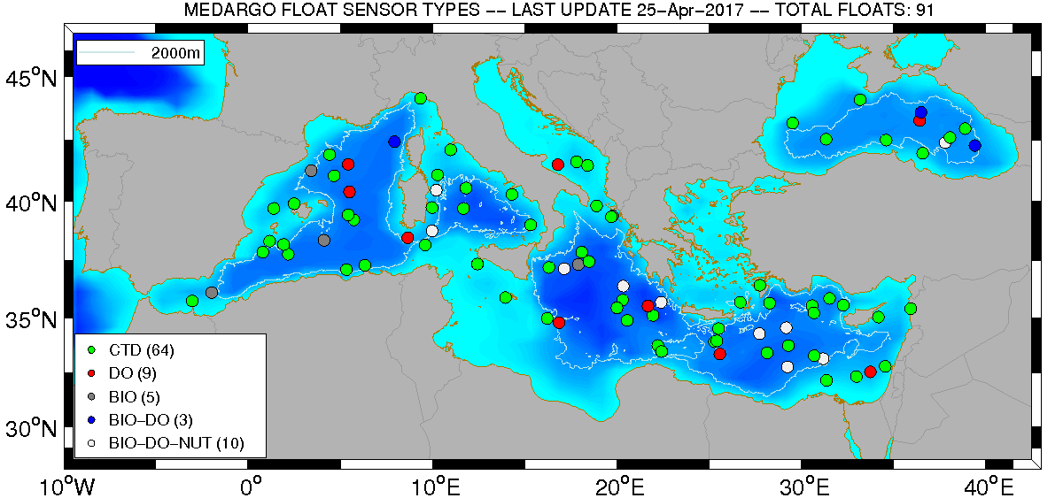
Argo float fleet in the Med & Black Seas (2001-2017)
Deep (1)
27 floats (30%) with biogeochemical sensors
1 deep float (3000 m)
ENVRIplus Booth @ EGU17 – 26 April 2017

Slide 9
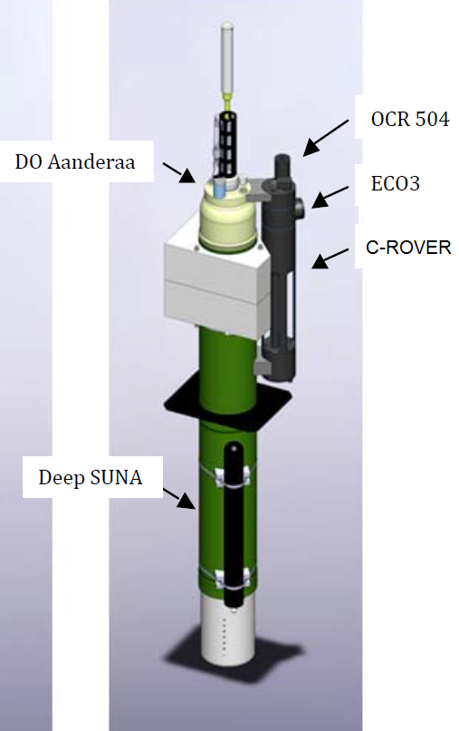
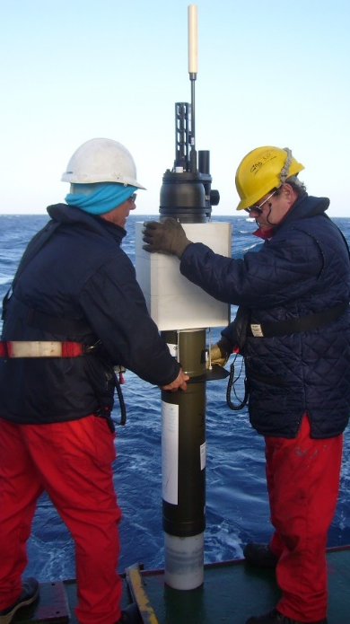
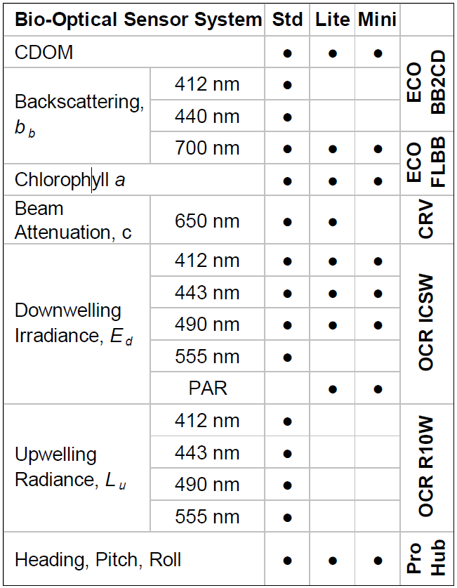
BGC floats in the Mediterranean and Black Seas
ProvBio II
Biogeochemical (BCG) float operated in the Mediterranean and Black Sea
Nitrate
ENVRIplus Booth @ EGU17 – 26 April 2017

Slide 10
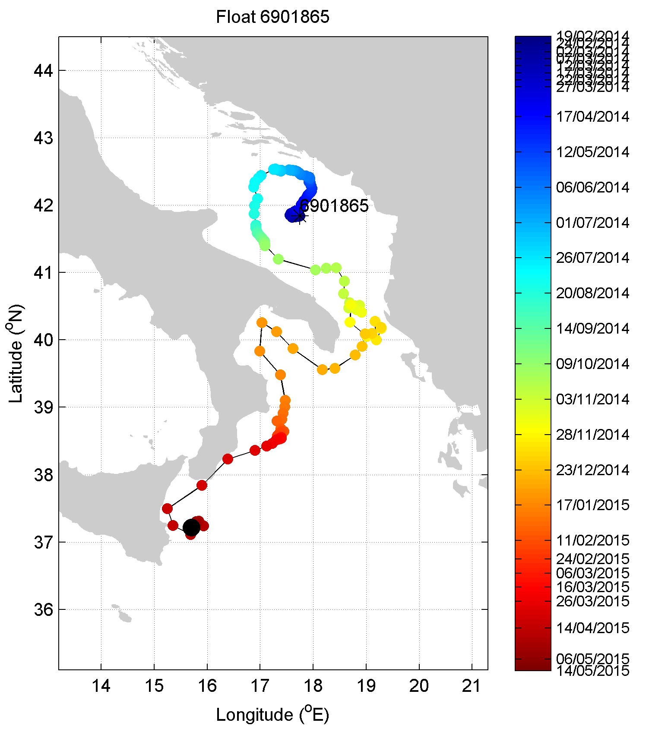
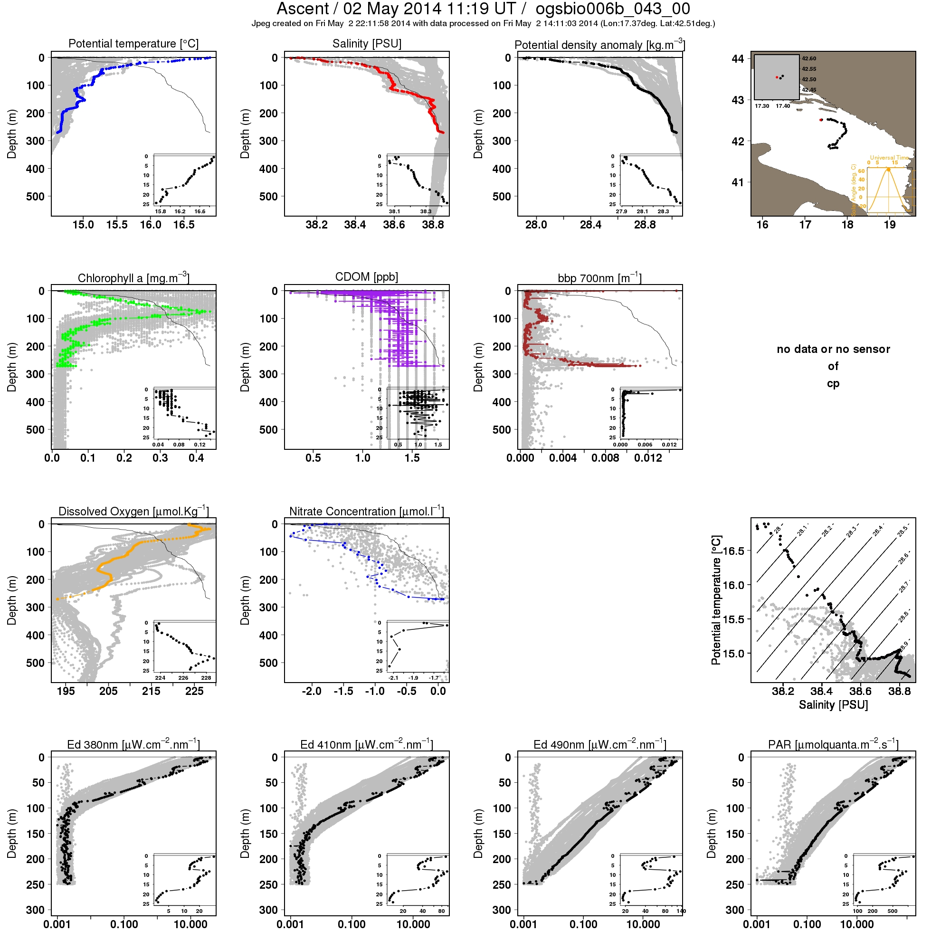
BGC floats in the Mediterranean and Black Seas
BioArgo Italy WMO 6901865 deployed in Feb 2014 (full sensor configuration) by the OGS R/V Explora
Parking depth: 350/1000 m
Cycle length: 1/5 days
ENVRIplus Booth @ EGU17 – 26 April 2017

Slide 11
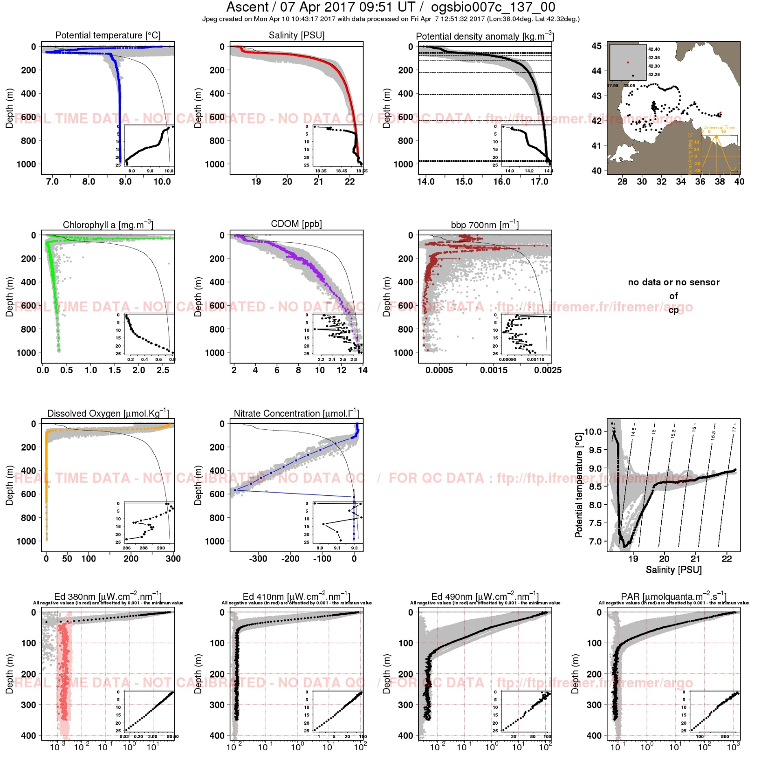
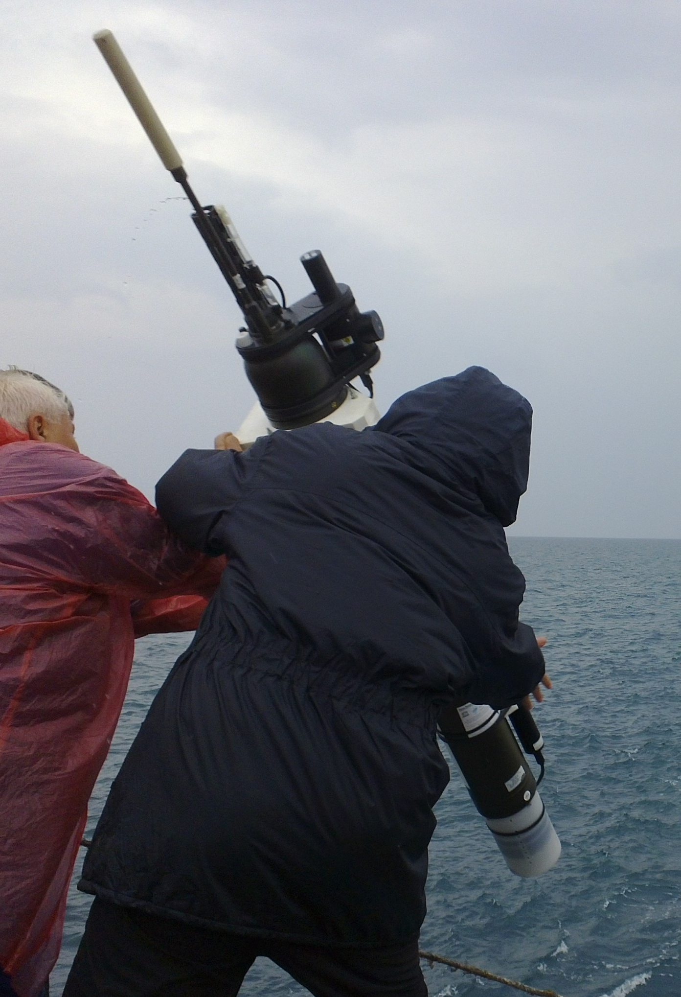
BGC floats in the Mediterranean and Black Seas
BioArgo Italy WMO 6901866 deployed in May 2015 (full sensor configuration) in Western Black Sea
Parking/profiling depth: 200/1000 m
Stanev et al. (submitted)
ENVRIplus Booth @ EGU17 – 26 April 2017

Slide 12
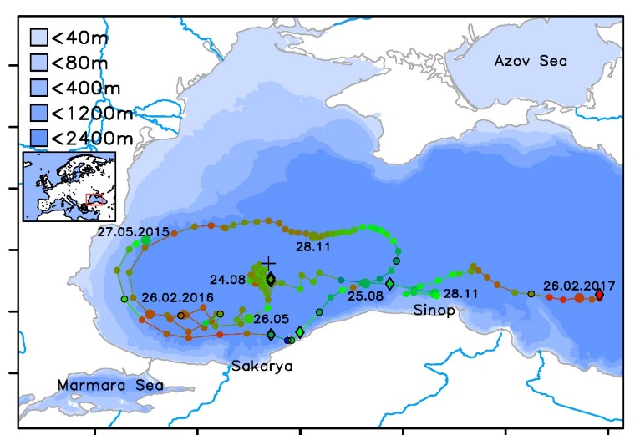
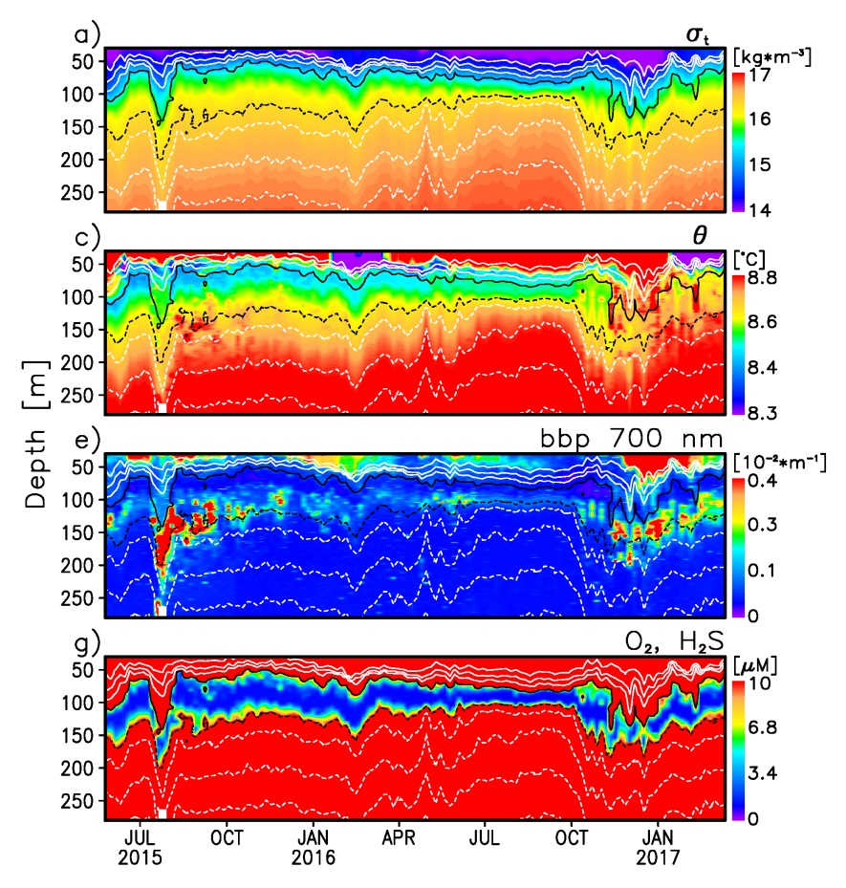
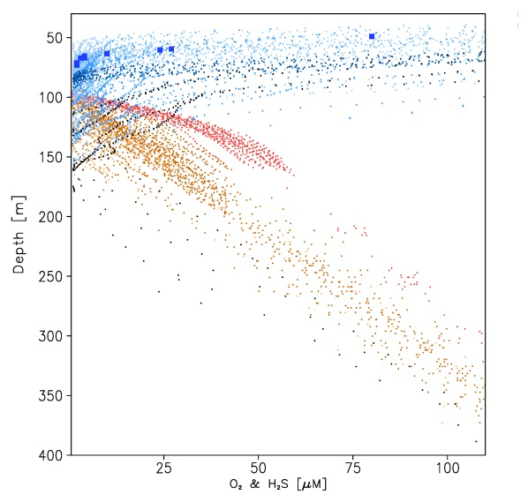
BGC floats in the Mediterranean and Black Seas
BioArgo Italy WMO 6901866 deployed in May 2015 (full sensor configuration) in Western Black Sea
Parking/profiling depth: 200/1000 m
Stanev et al. (submitted)
ENVRIplus Booth @ EGU17 – 26 April 2017

Slide 13
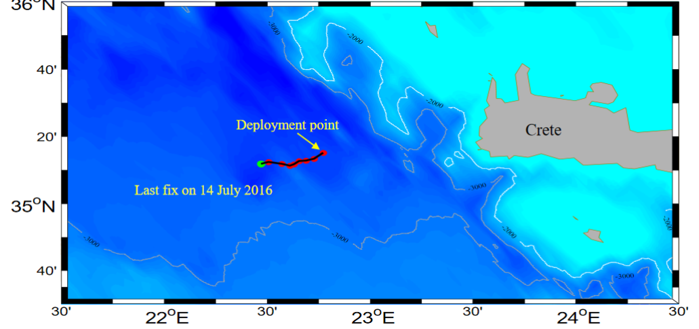
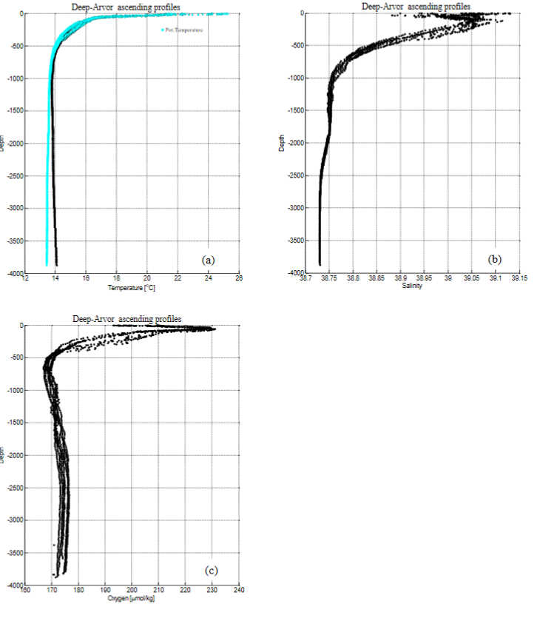
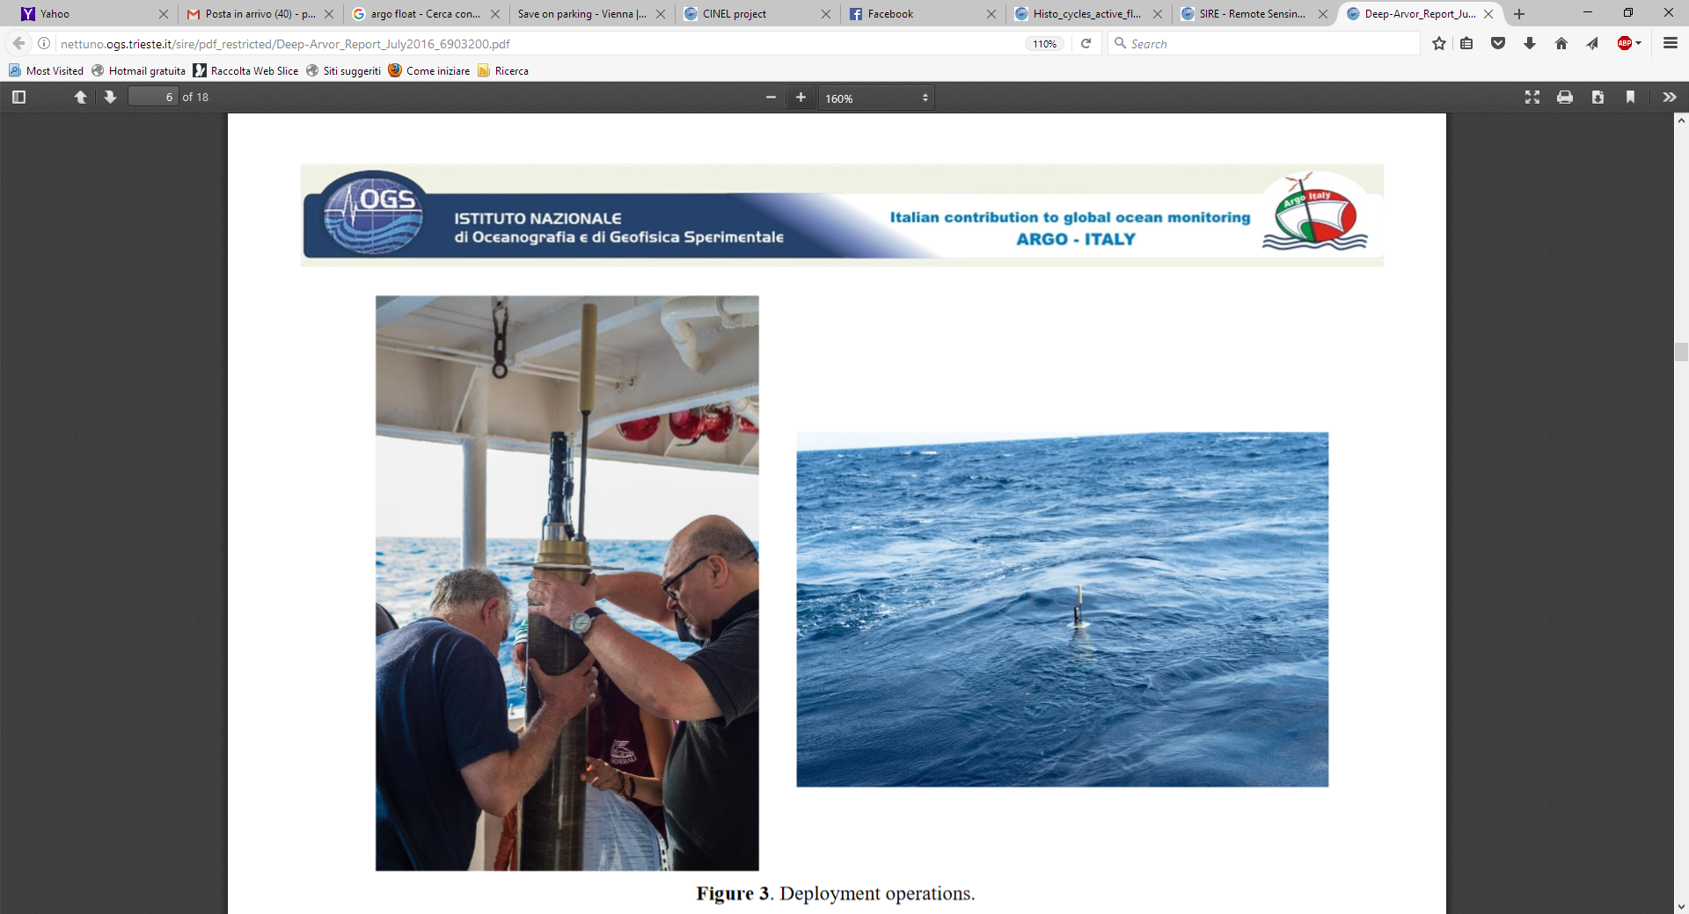
DEEP floats in the Mediterranean Sea
Deep Argo WMO 6903200 deployed on 8 June 2016 in deep NE Ionian
Parking/profiling depth: 4000/4000 m
Only 8 cycles (until 14 July)
ENVRIplus Booth @ EGU17 – 26 April 2017

Slide 14
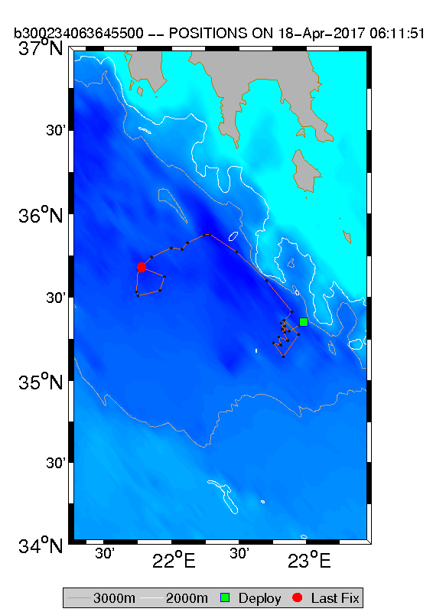
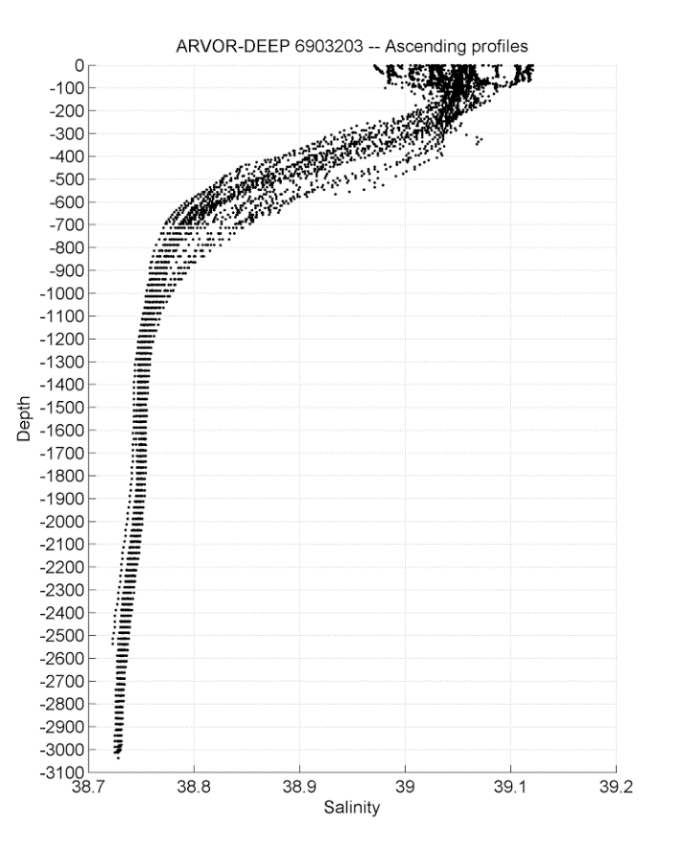
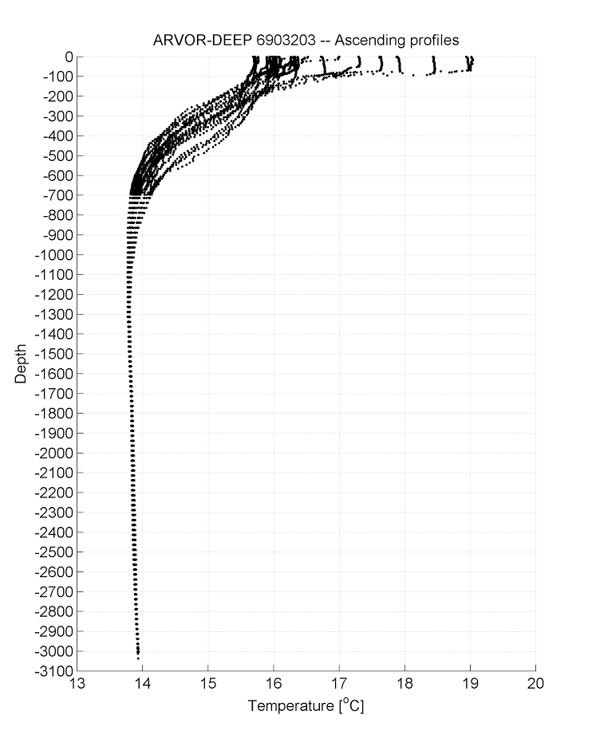
DEEP floats in the Mediterranean Sea
Deep Argo WMO 6903203 deployed on 7 Dec 2016 in deep NE Ionian
Parking/profiling depth: 3000/3000 m
Still alive (after 28 cycles)
ENVRIplus Booth @ EGU17 – 26 April 2017

Slide 15
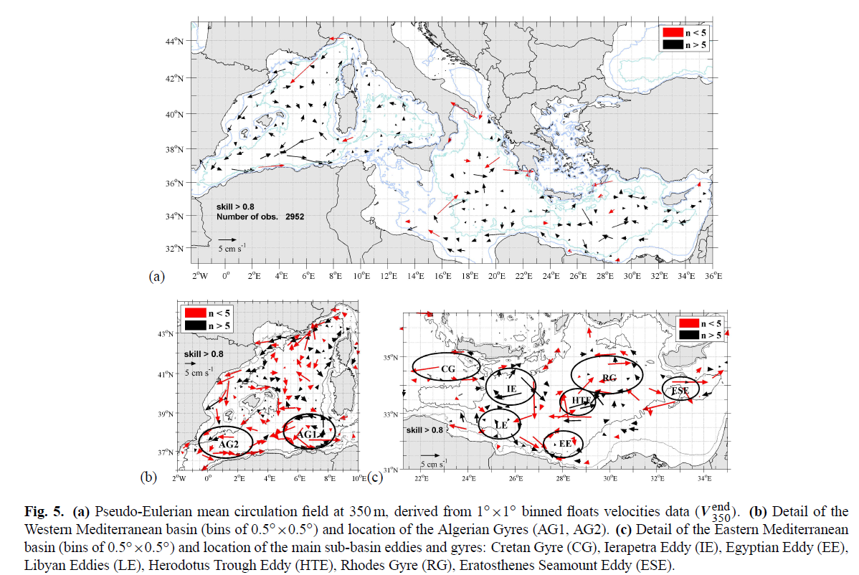
Examples of scientific results
Sub-surface circulation (Menna and Poulain, 2010)
ENVRIplus Booth @ EGU17 – 26 April 2017

Slide 16
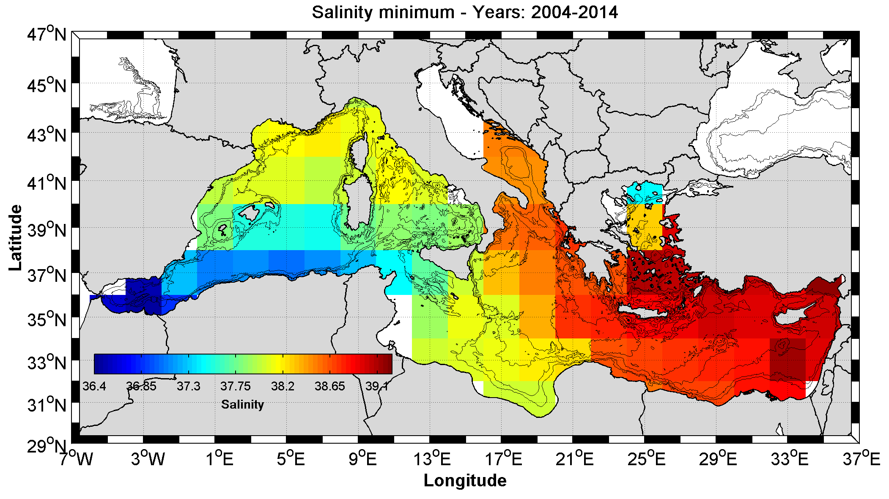
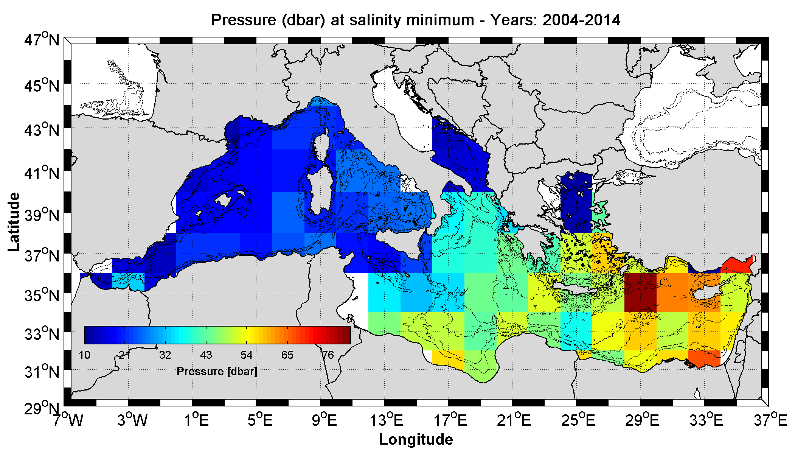
Examples of scientific results
Mean salinity minima and corresponding mean depths in 2x2 degree boxes (geographical structure of the Atlantic Water – AW)
The AW gradually sinks and increases in salinity along its path, from the source (Gibraltar) to the Levantine Sea
ENVRIplus Booth @ EGU17 – 26 April 2017

Slide 17
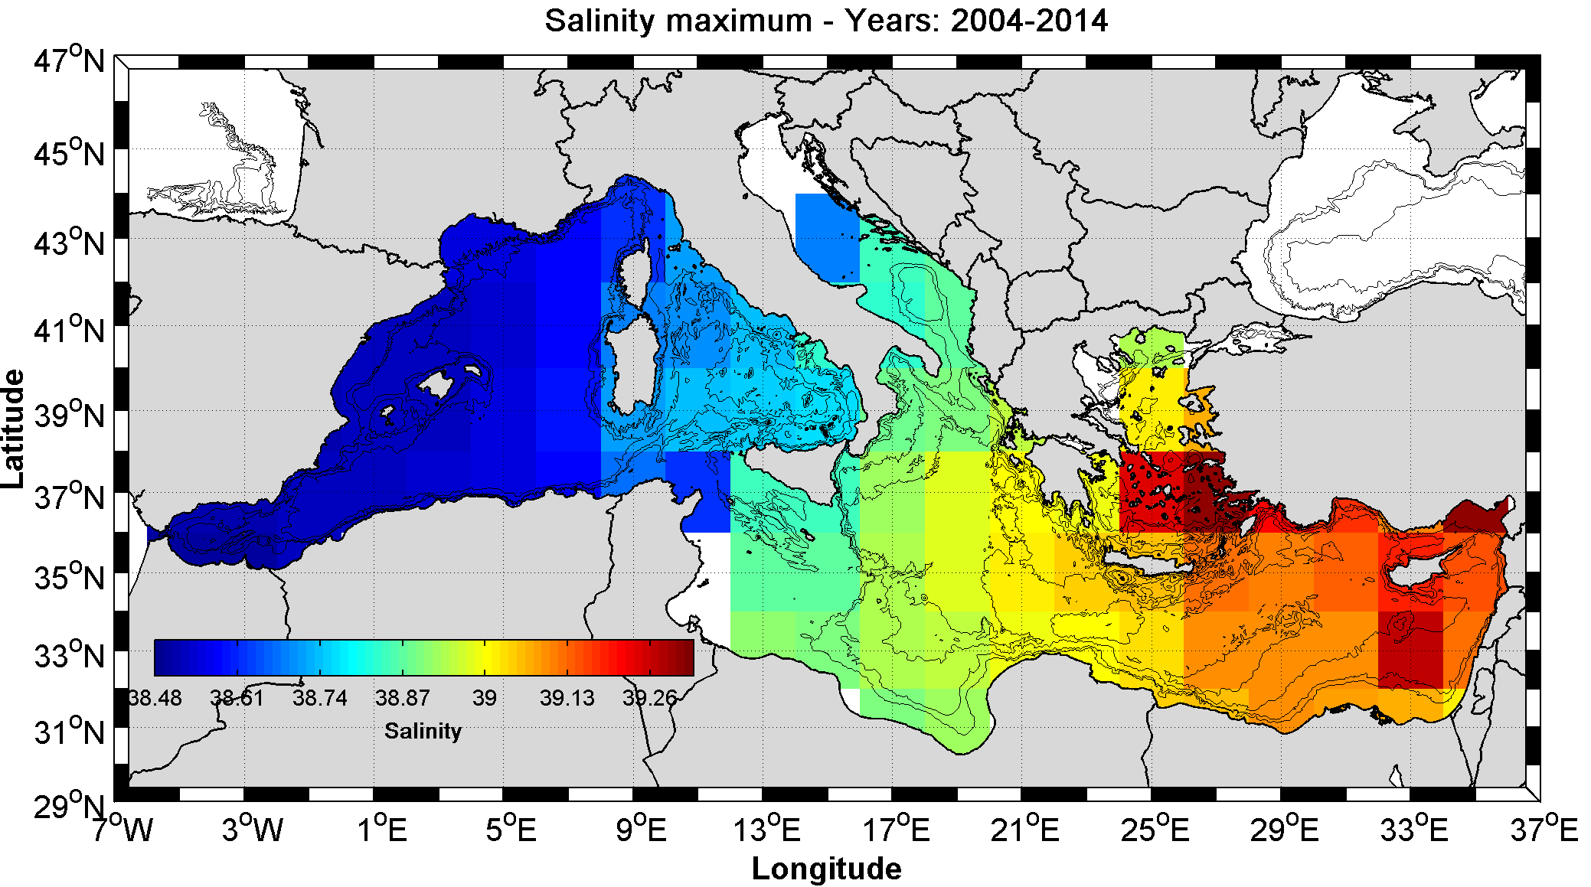
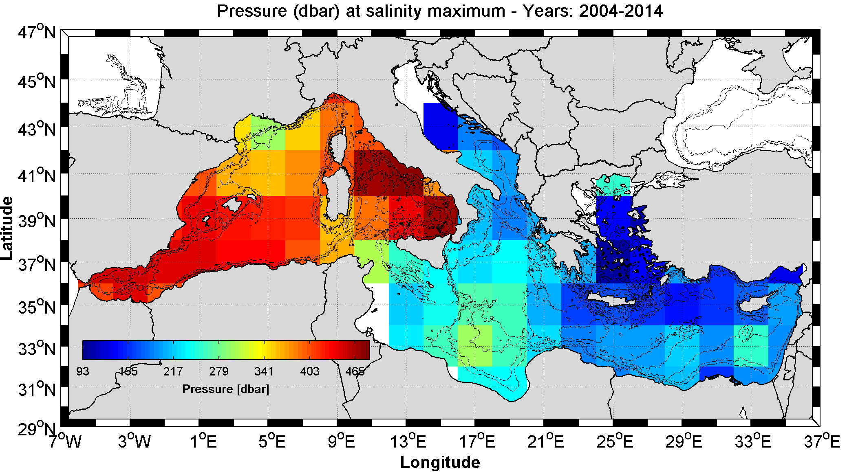
Examples of scientific results
Mean salinity maxima and corresponding mean depths in 2x2 degree boxes (geographical structure of the Levantine Intermediate Water – LIW)
The LIW gradually sinks and decreases in salinity along its path, from the formation site (Levantine) to the Alboran Sea
ENVRIplus Booth @ EGU17 – 26 April 2017

Slide 18
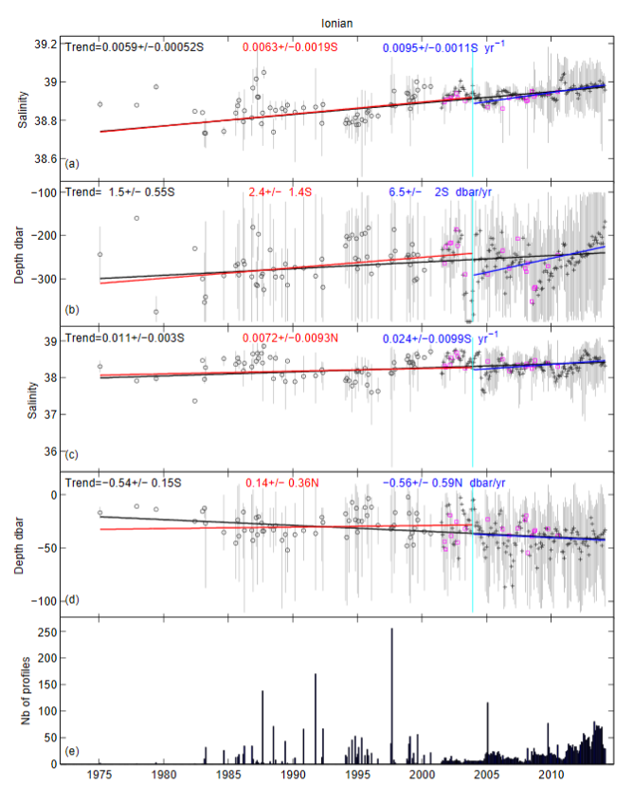
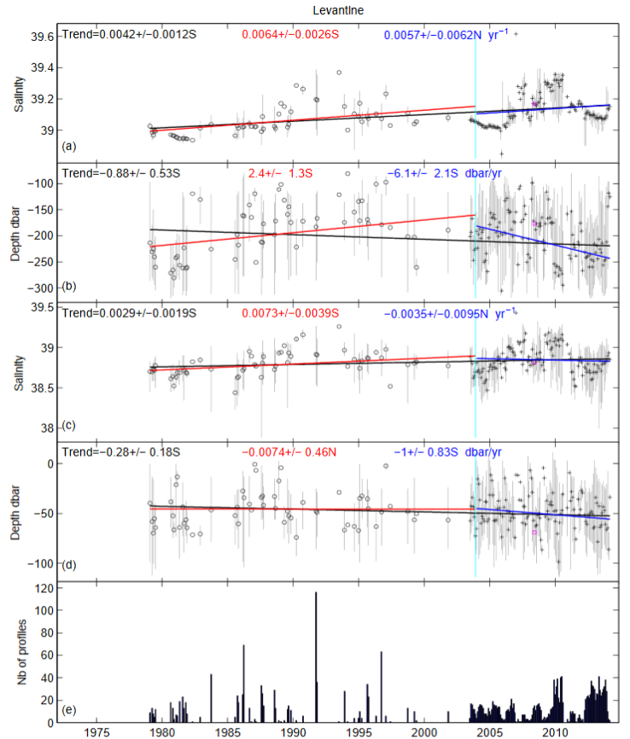
Examples of scientific results
Trends of LIW and AW properties (Zu et al., 2014)
LIW
AW
ENVRIplus Booth @ EGU17 – 26 April 2017

Slide 19
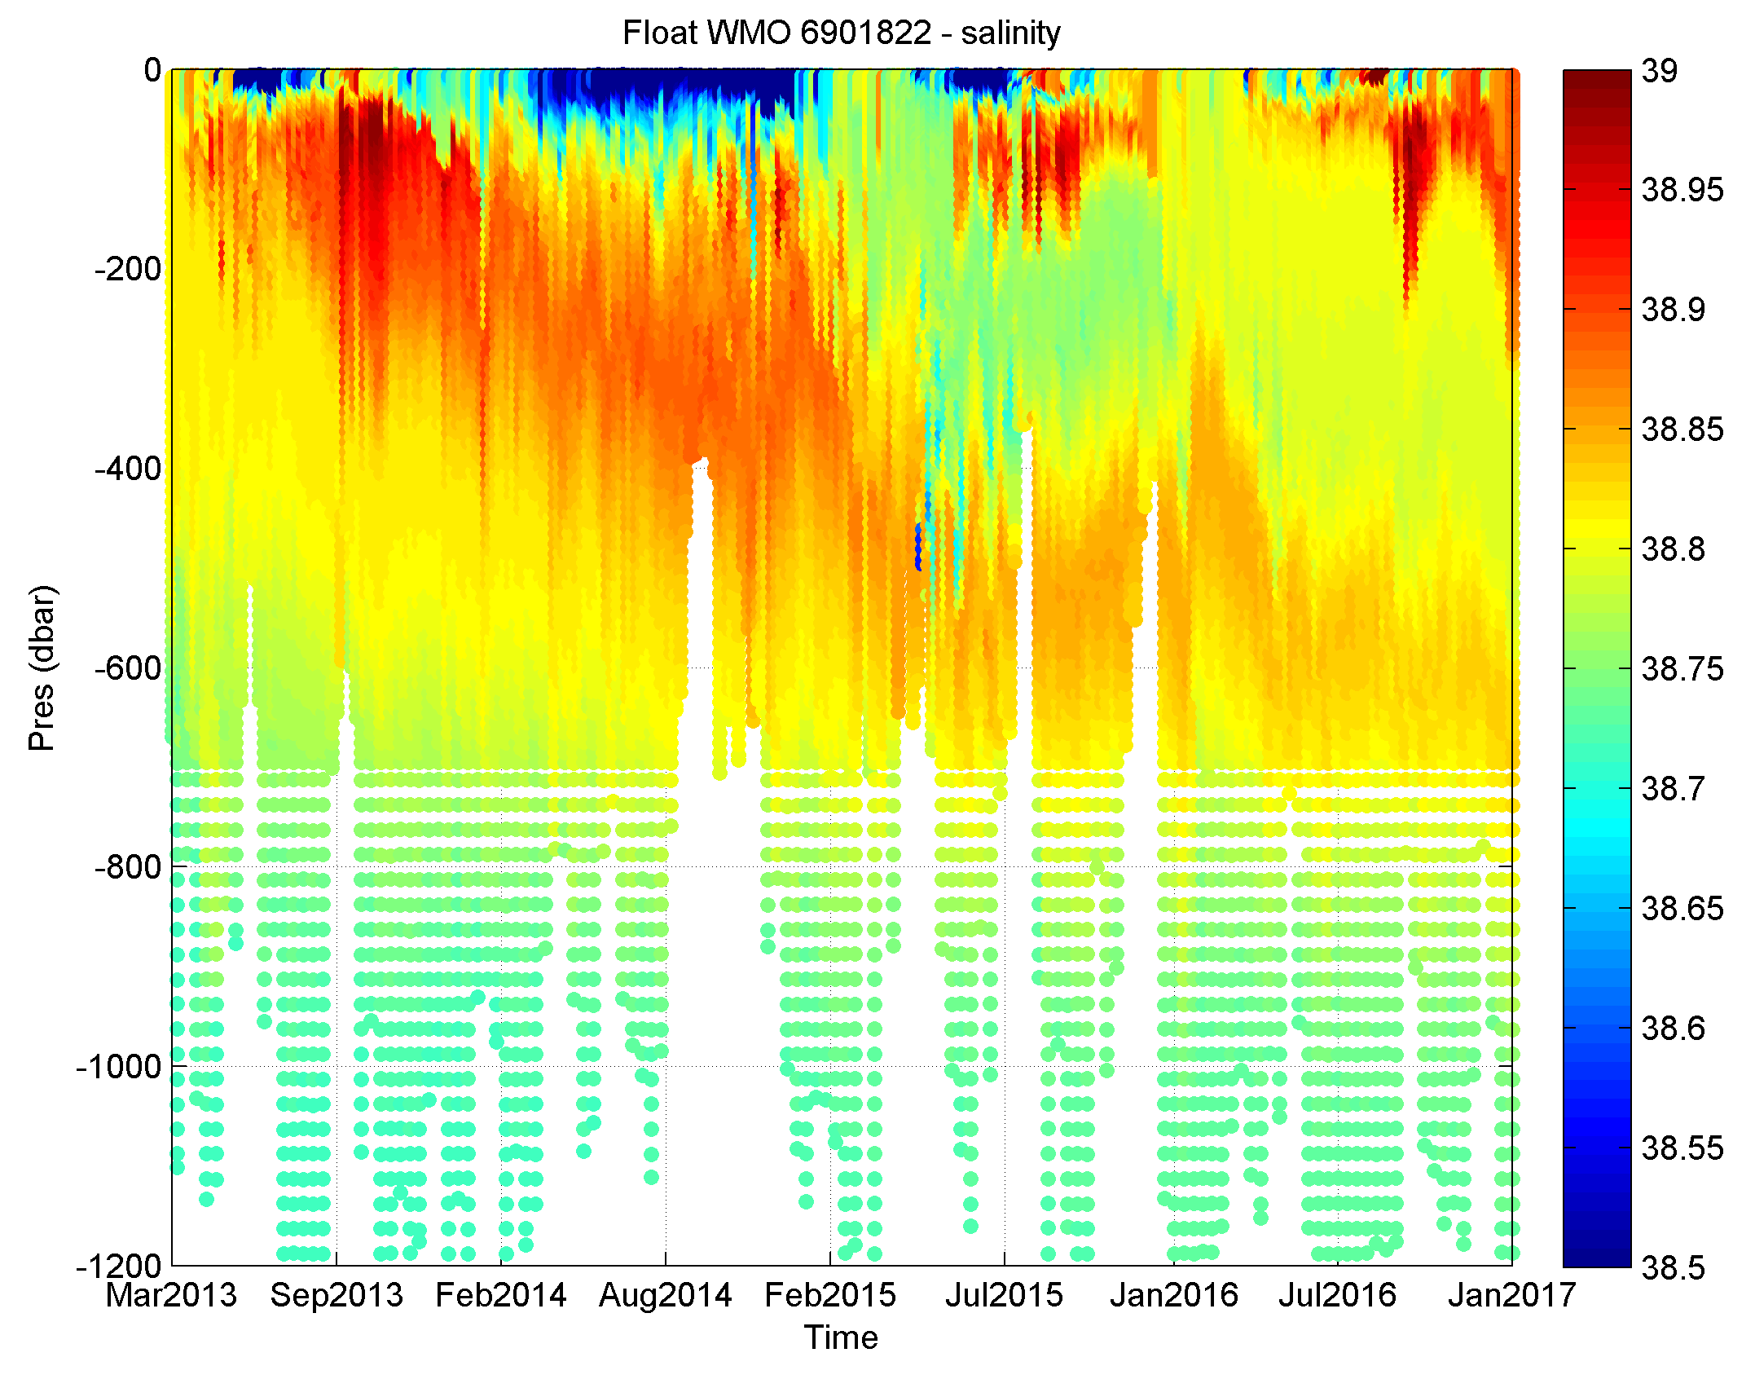
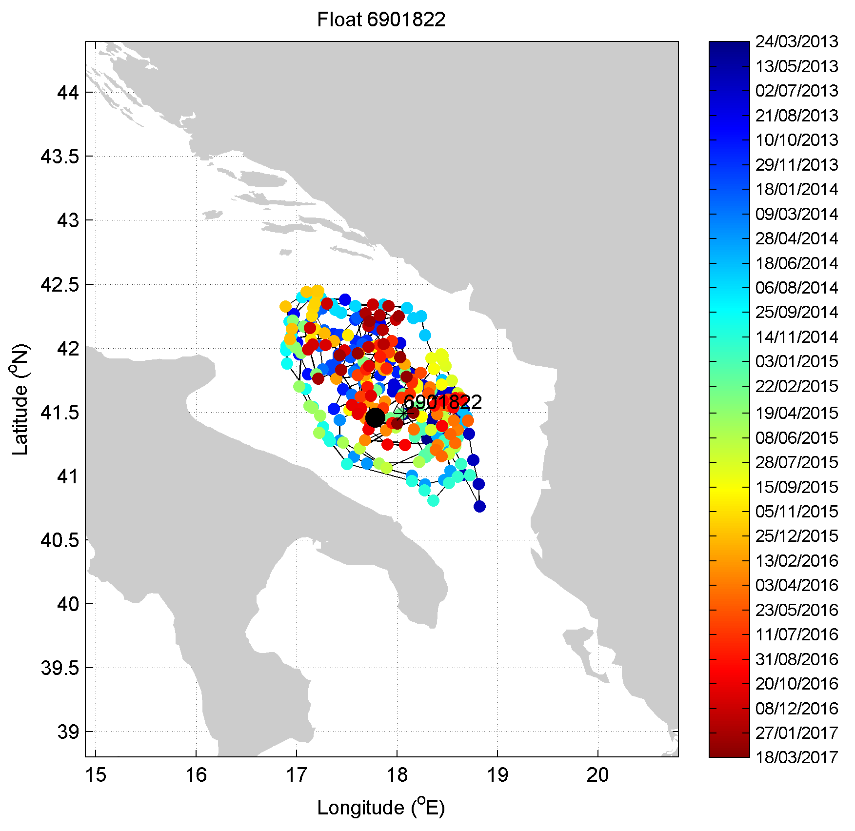
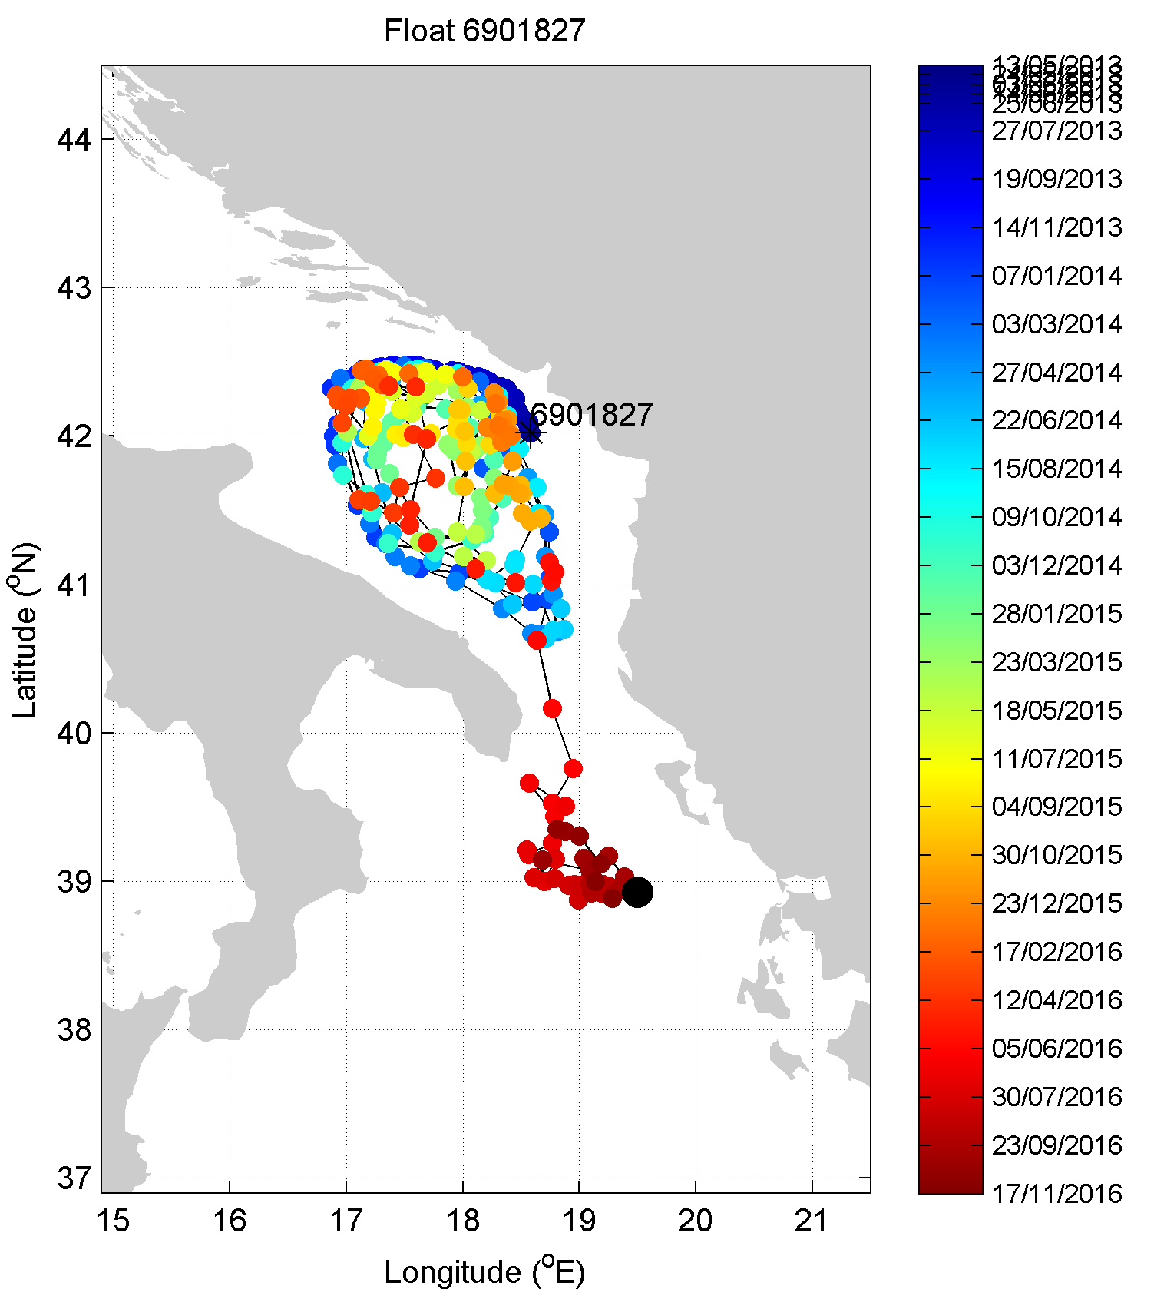
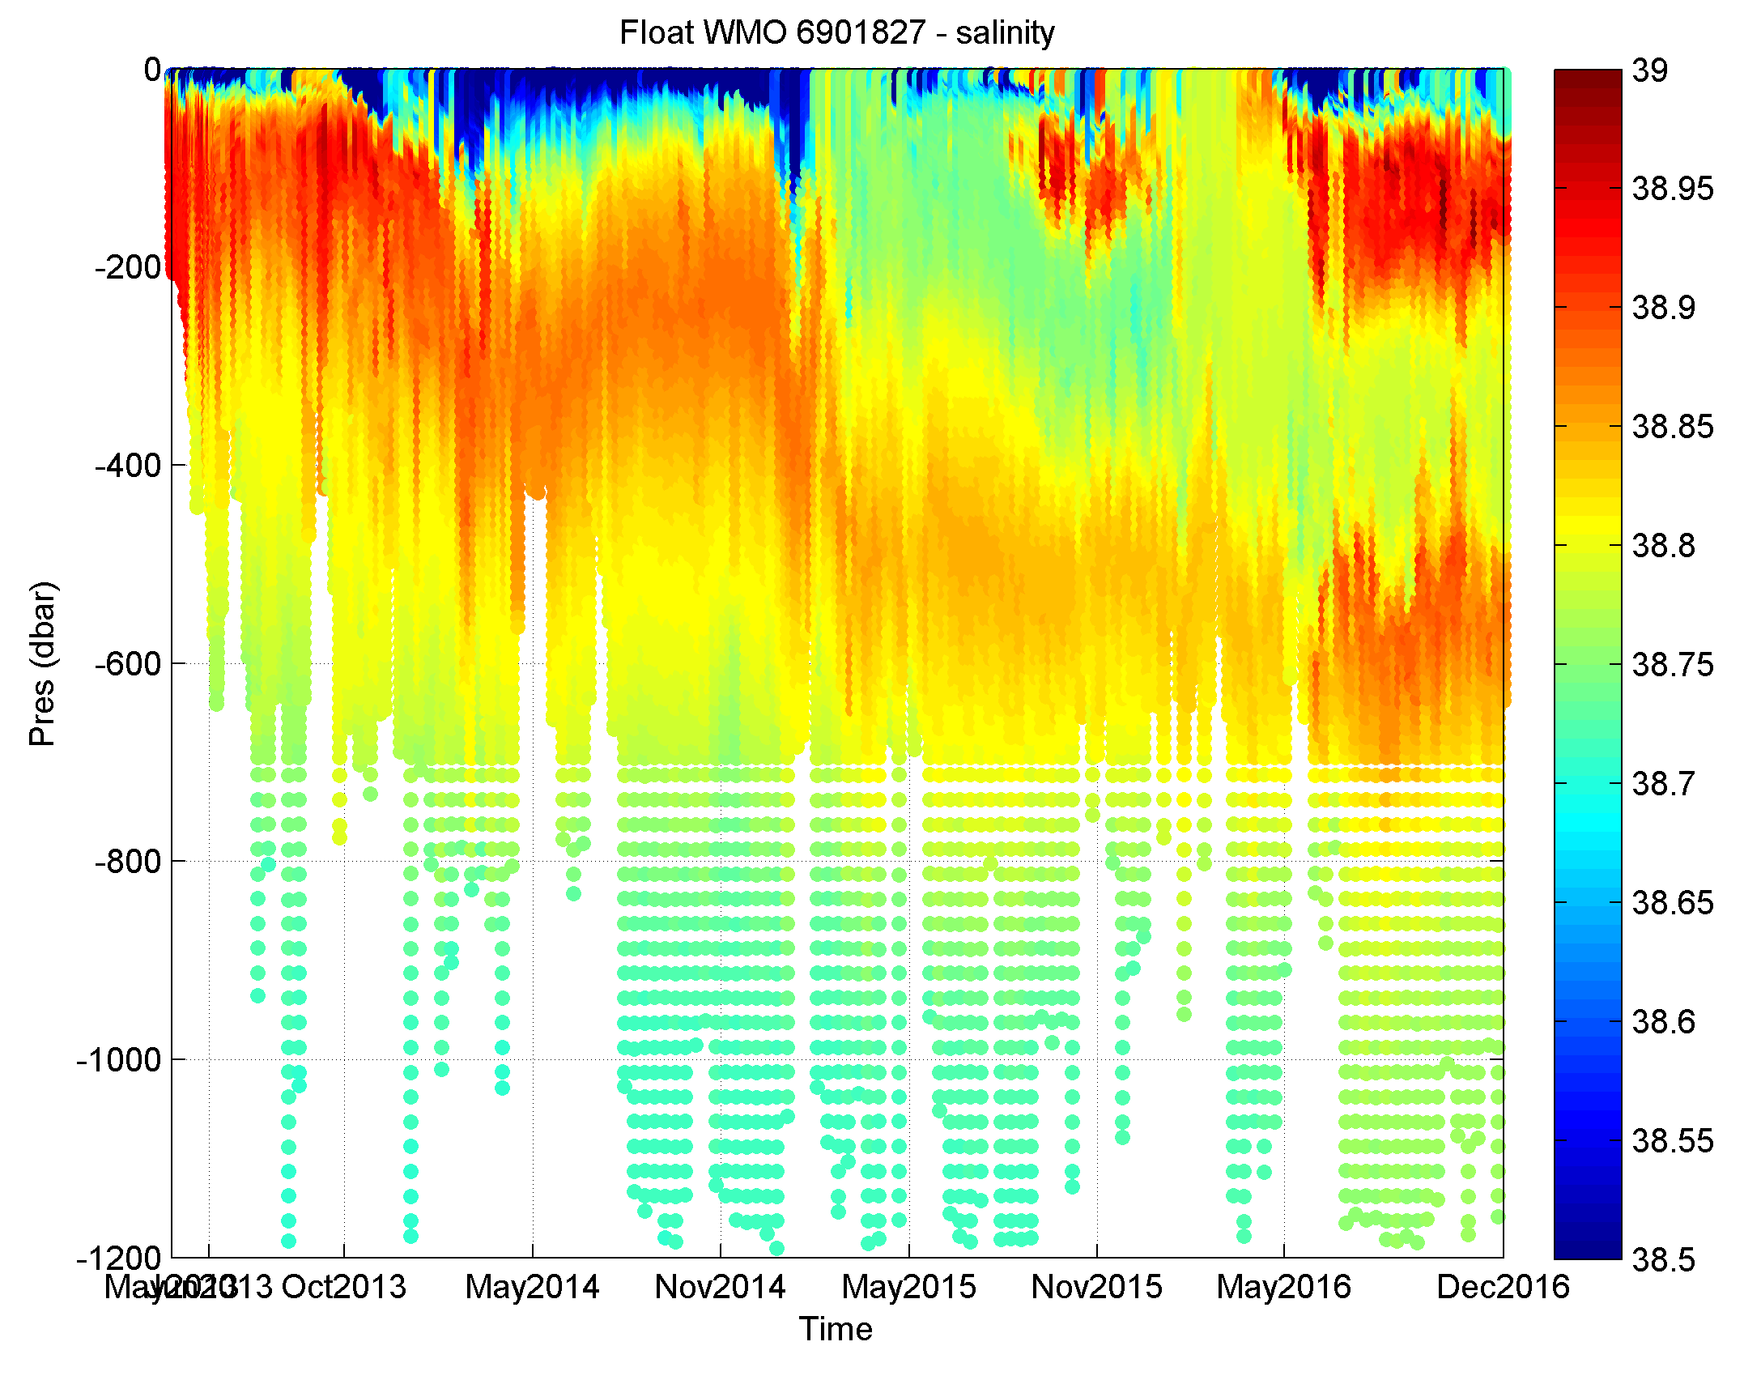
Examples of scientific results
Double salinity maximum in South Adriatic Sea (Kokkini et al., 2017)
ENVRIplus Booth @ EGU17 – 26 April 2017

Slide 20
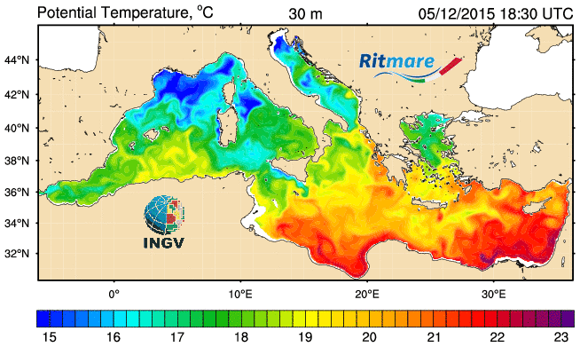
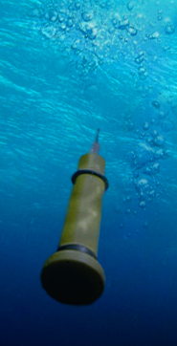


Operational uses
MedArgo float data are assimilated in numerical forecasting models by INGV (MFS-Copernicus-Ritmare)
MedArgo contributes to programs of operational oceanography, such as MONGOOS (Mediterranean Oceanography Network for the Global Ocean Observing System) and is essential for the production of marine core and downstream services products of Copernicus (the European system for monitoring the Earth).
ENVRIplus Booth @ EGU17 – 26 April 2017

Slide 21
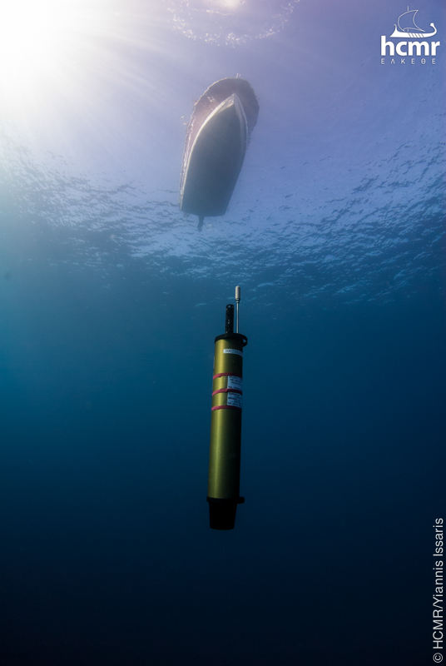
Thanks for your attention!
Any questions?
ENVRIplus Booth @ EGU17 – 26 April 2017

