Slide 1

Greenhouse gases in our atmosphere;
2015 status
Alex Vermeulen^{1,2}, WMO GAW Science Advisory Group on Greenhouse Gases
1: ICOS ERIC, Carbon Portal, Lund, Sweden,
2: Lund University, Physical geography and Ecosystem science, Lund, Sweden

Slide 2
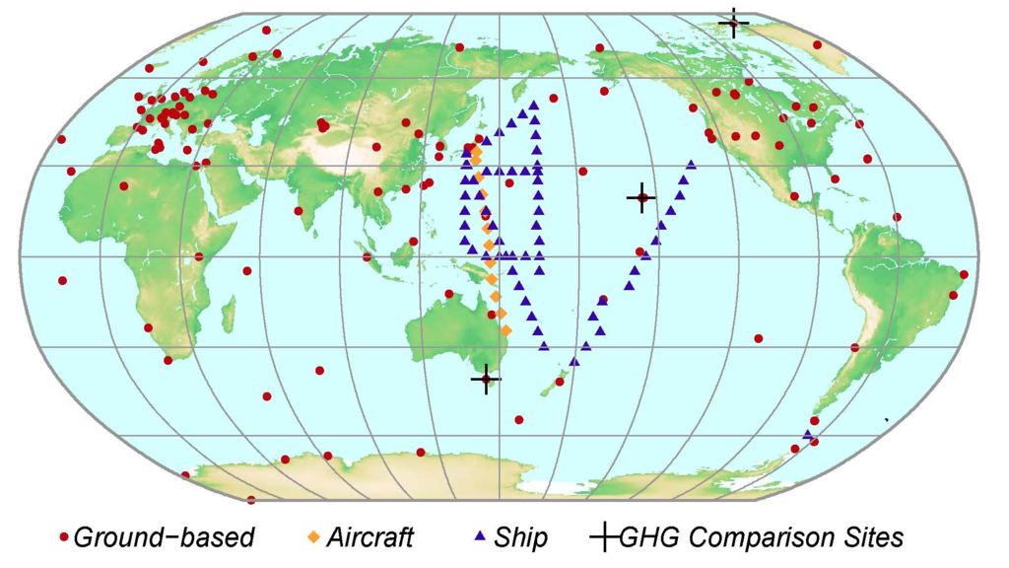
The WMO GAW global network for GHGs

Slide 3
Long time series, high accuracy
Fluctuations on background abundances small
High precision and accuracy required
background compatibility goal percentage
CO₂ 400 ppm (10⁻⁶) 0.05-0.1 ppm 0.01%
CH₄ 1900 ppb (10⁻⁹) 2 ppb 0.1 %
N₂O 330 ppb (10⁻⁹) 0.1 ppb 0.03 %
SF₆ 7 ppt (10⁻¹²) 0.1 ppt 1%
Increases per year in order of percent
Vital input for Global Carbon Budget and many other model studies

Slide 4
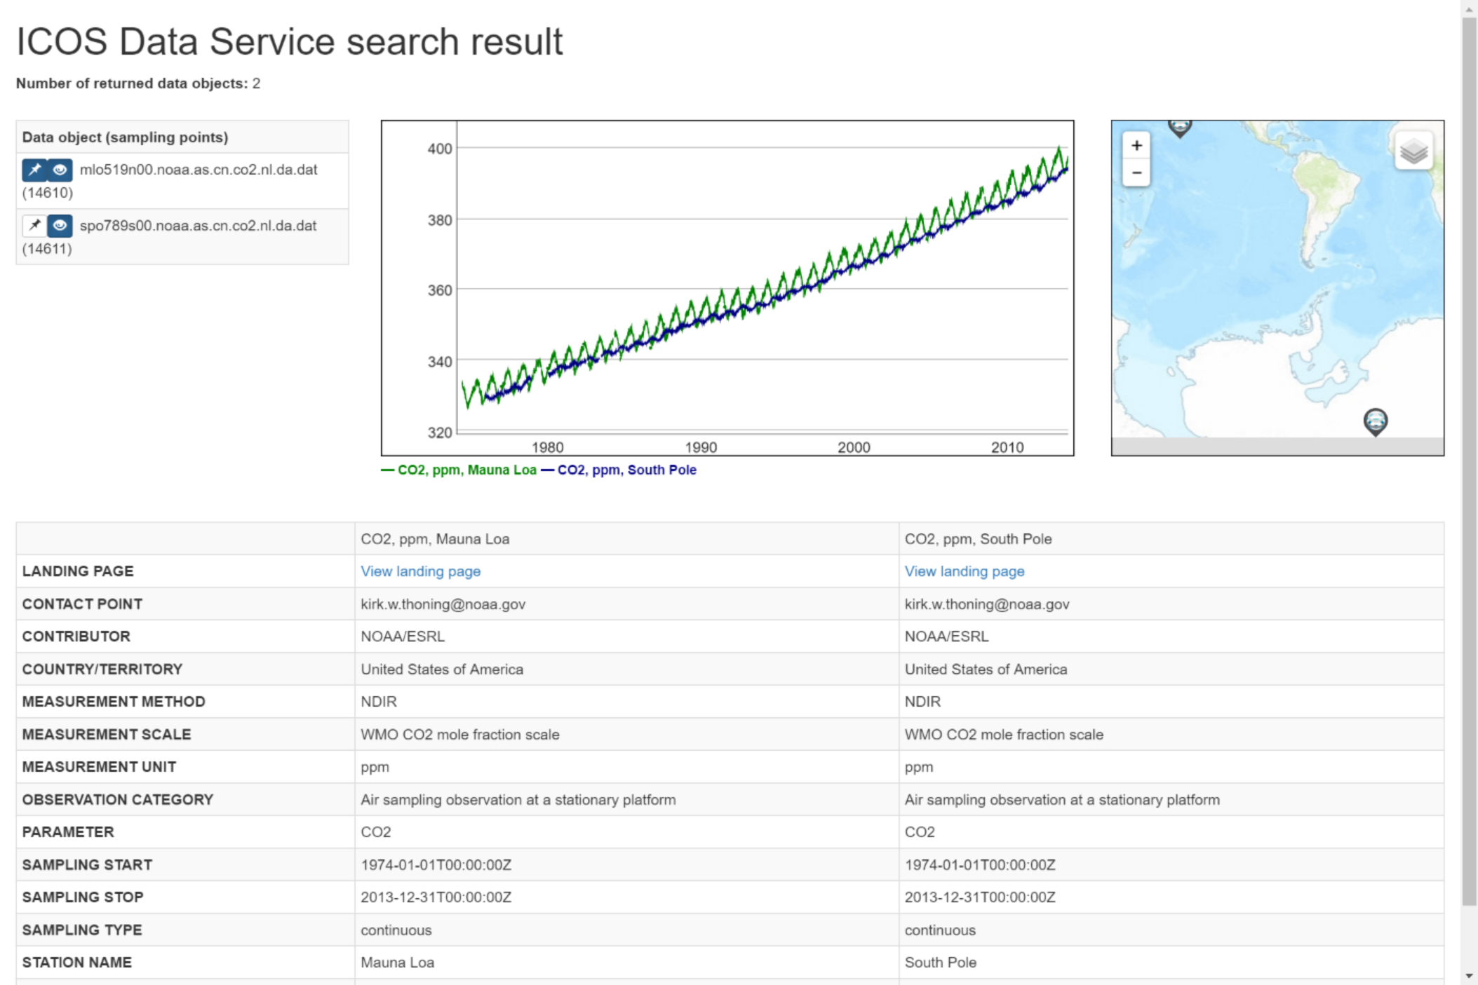
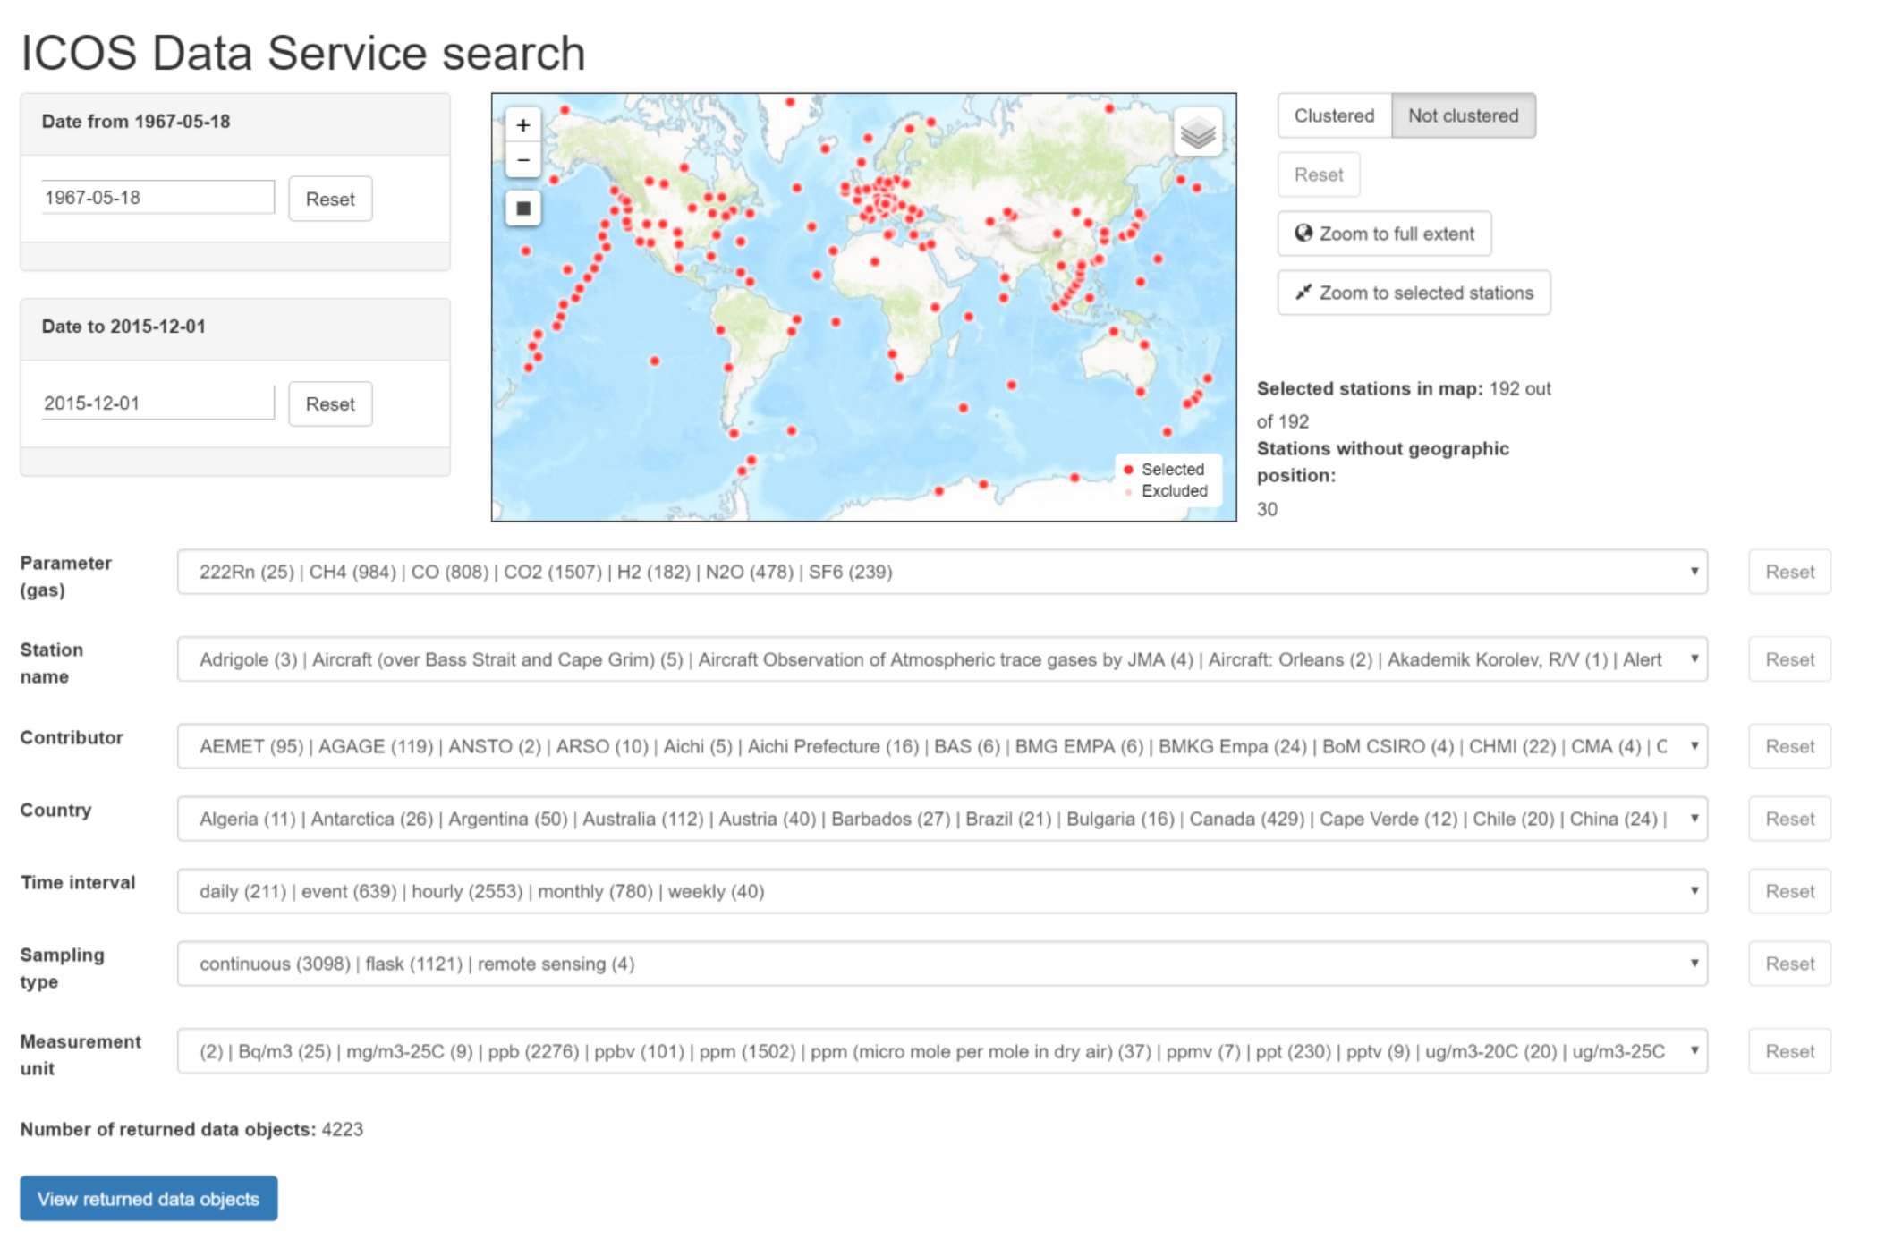
ICOS Data Service https://data.icos-cp.eu/wdcgg

Slide 5
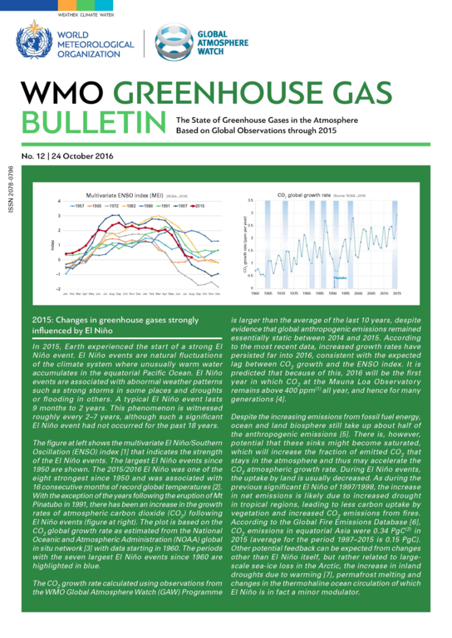
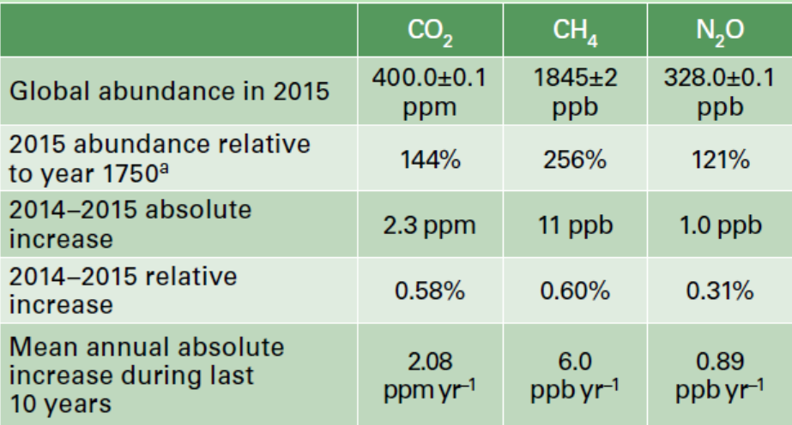
GHG Bulletin no 12
http://www.wmo.int/pages/prog/arep/gaw/ghg/GHGbulletin.html
Conclusions:
All GHG levels reached new highs
Increasing growth rate of CO₂
Big influence of El Nino

Slide 6
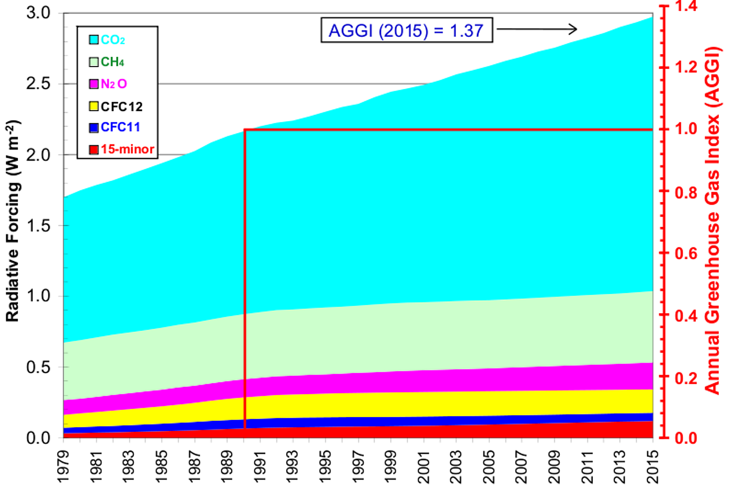
Increase of Greenhouse Gas radiative effect

Slide 7
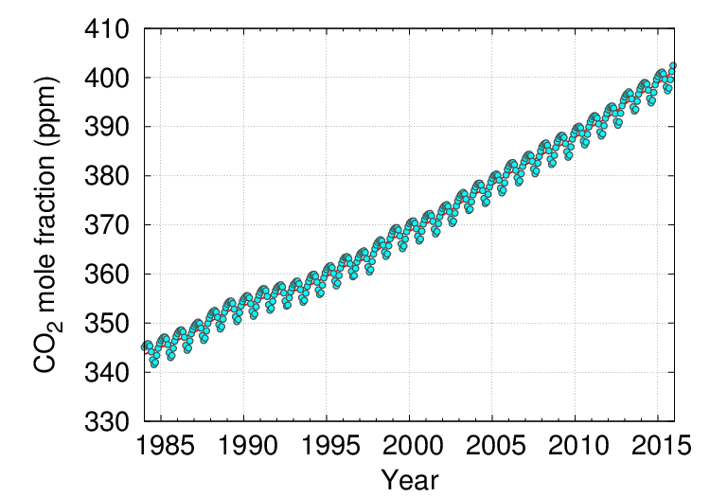
Global average CO₂ abundance

Slide 8
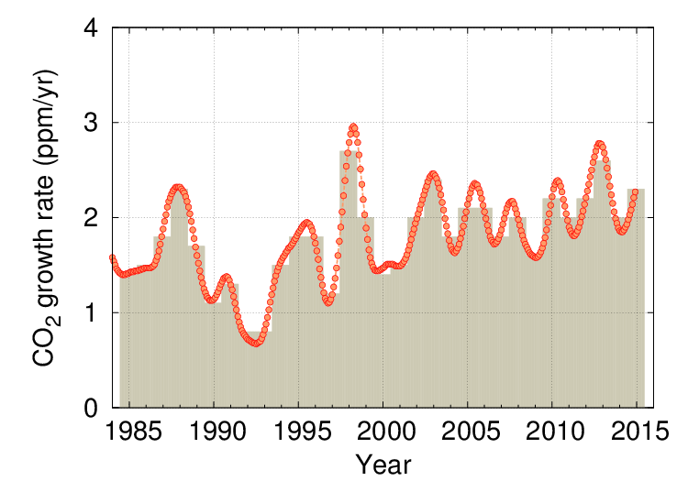
Global CO₂ growth rate GAW

Slide 9
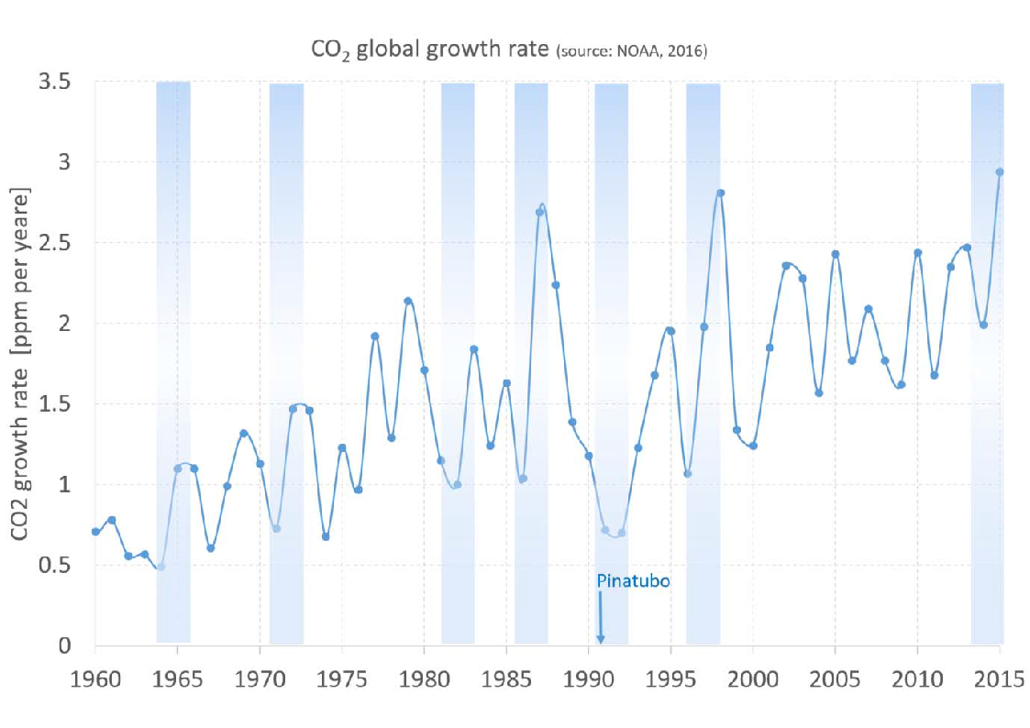
Strong El Nino events and CO₂ growth rate

Slide 10
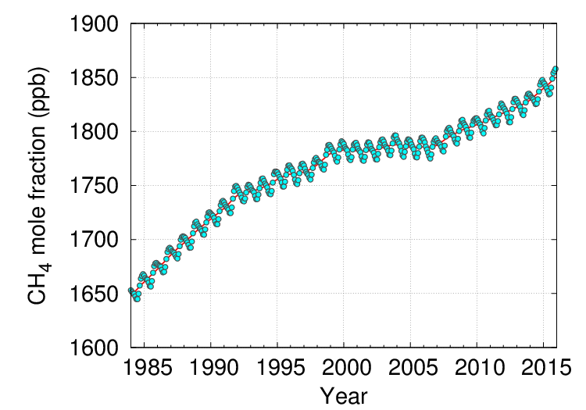
Global average CH₄ abundance

Slide 11
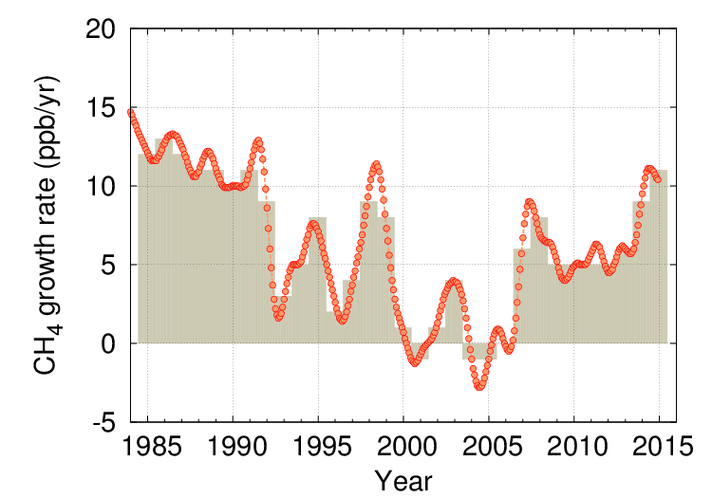
Global CH₄ growth rate GAW

Slide 12
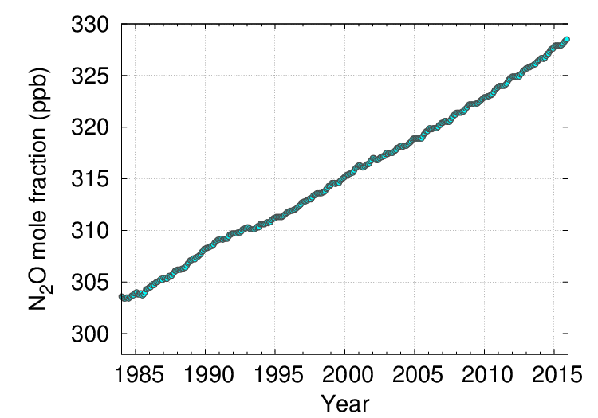
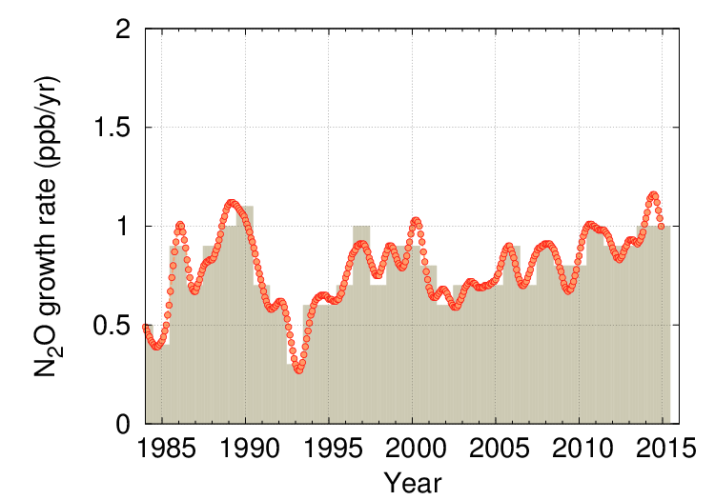
Global N₂O abundance and growth rate GAW

Slide 13
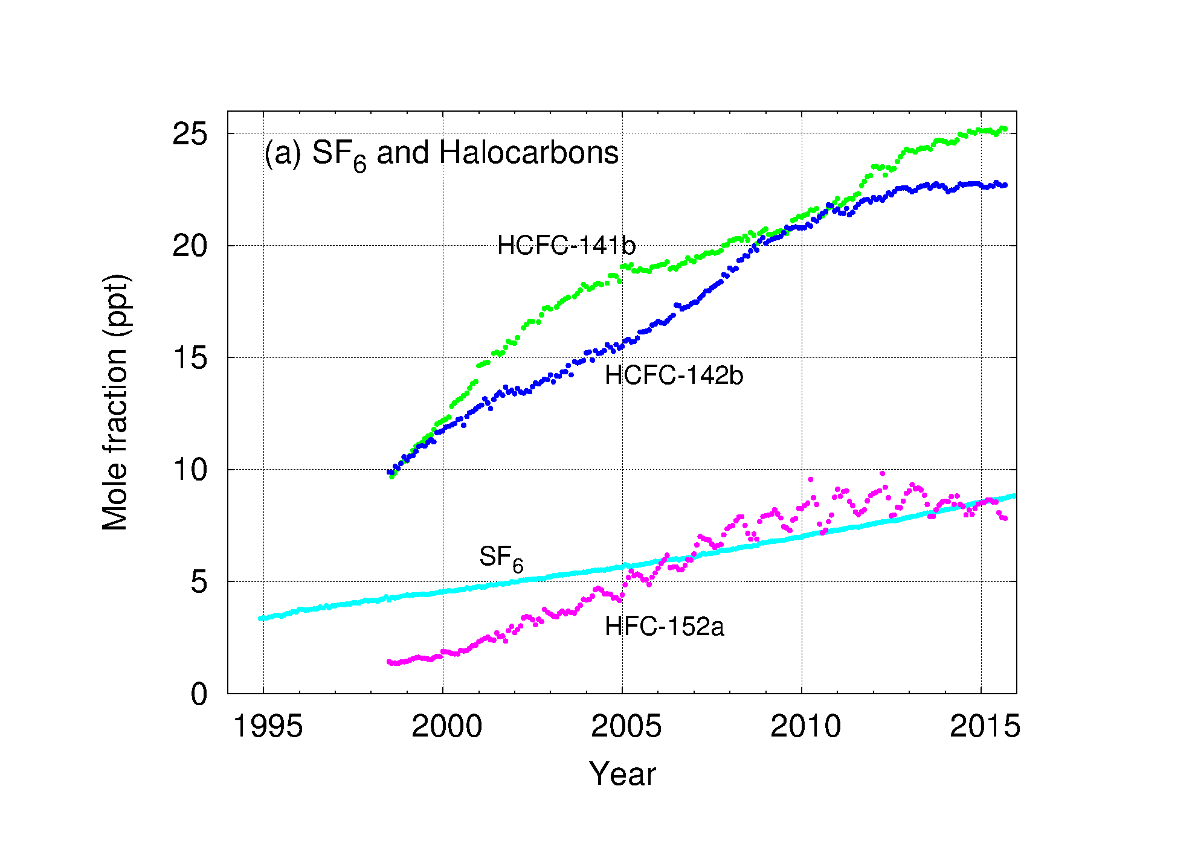
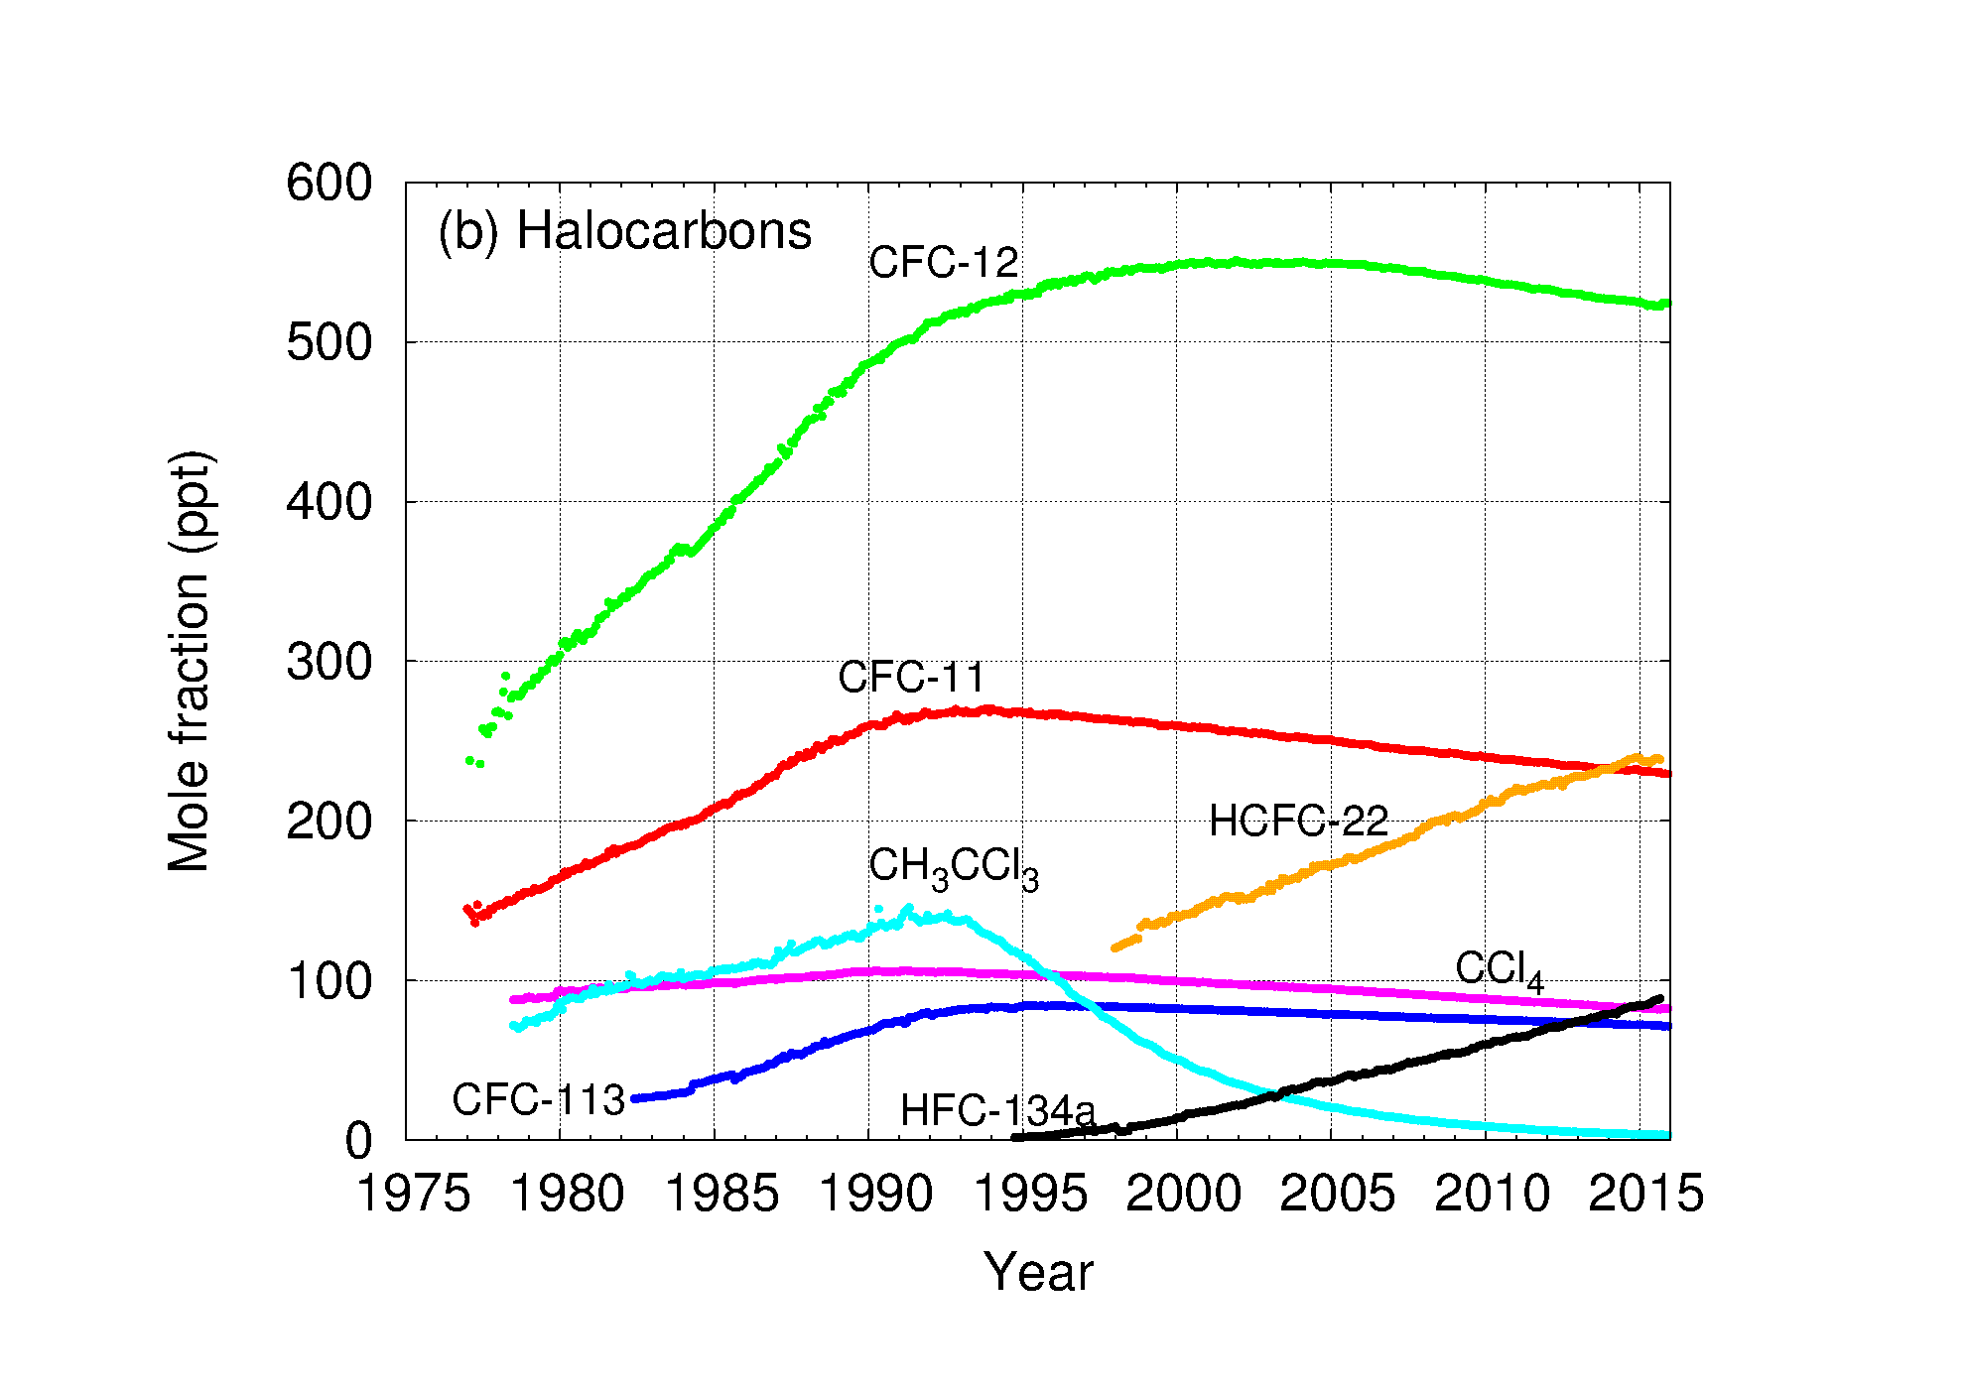
SF₆ and halocarbons

Slide 14
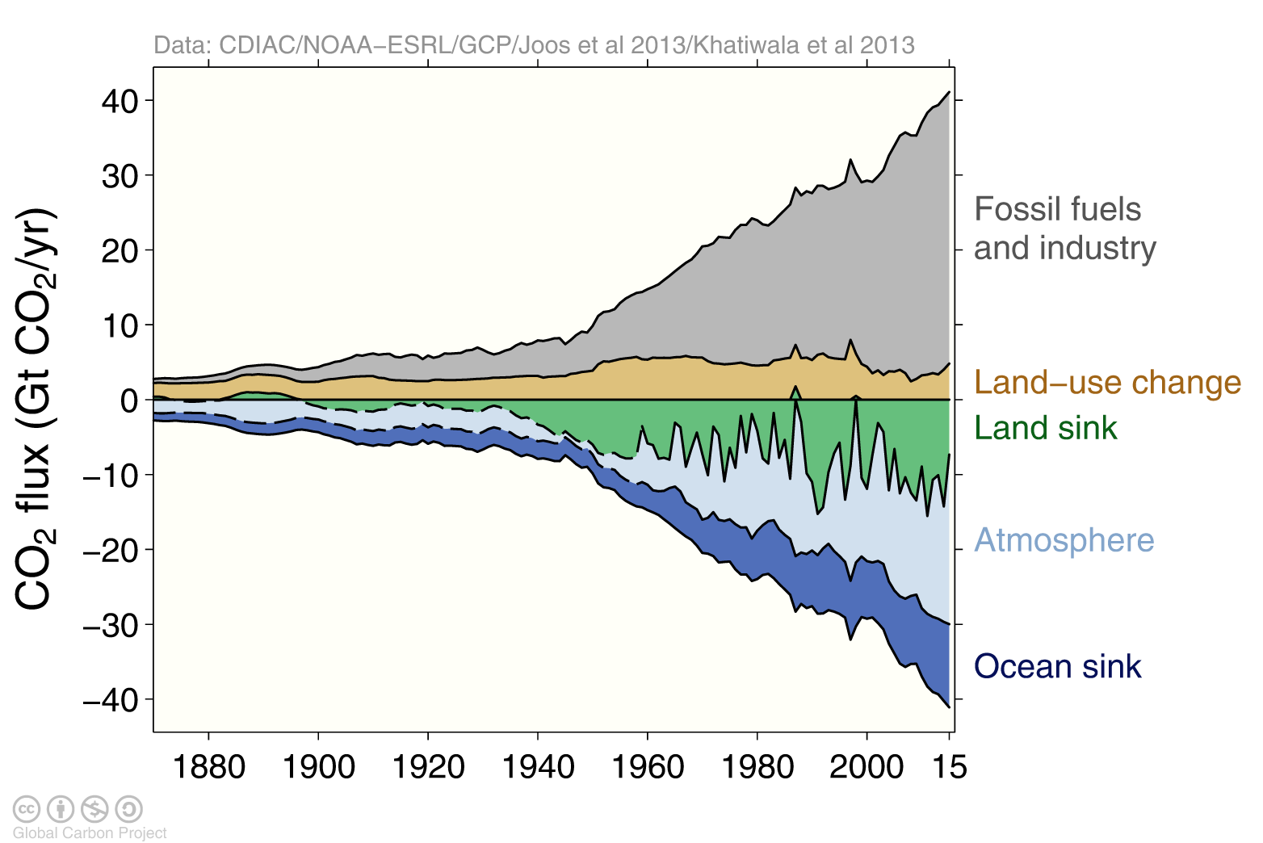
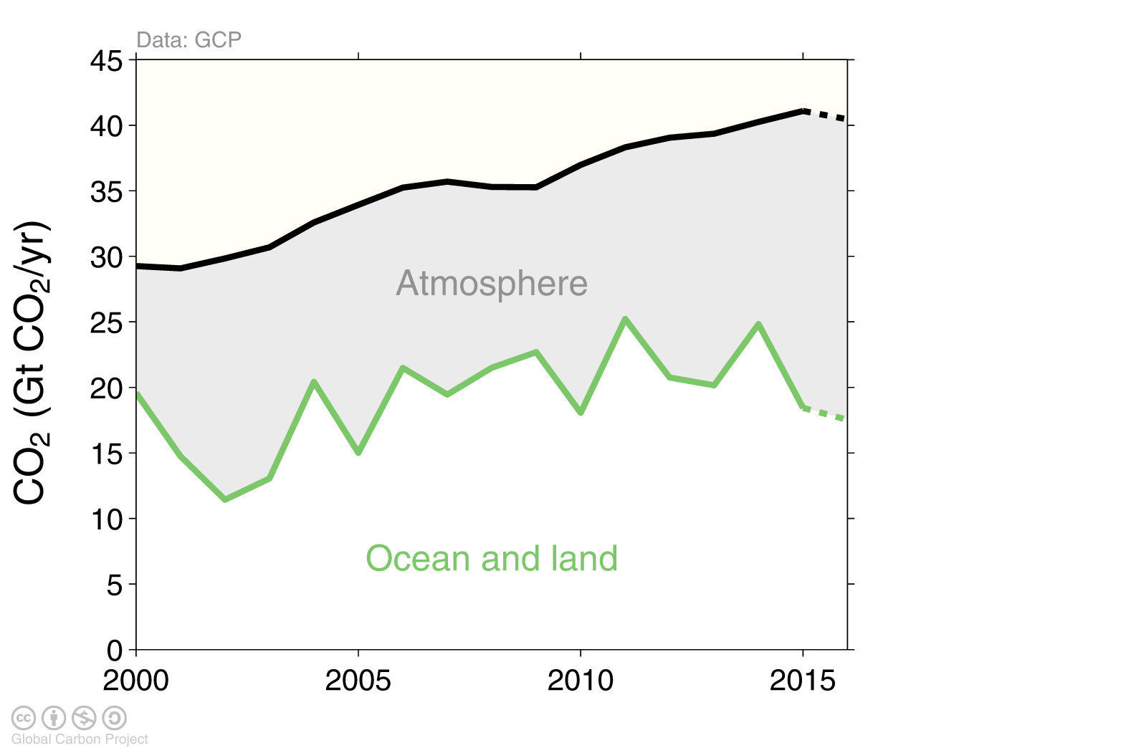
Example of use: Global Carbon Project
Le Quéré et al, 2016

Slide 15
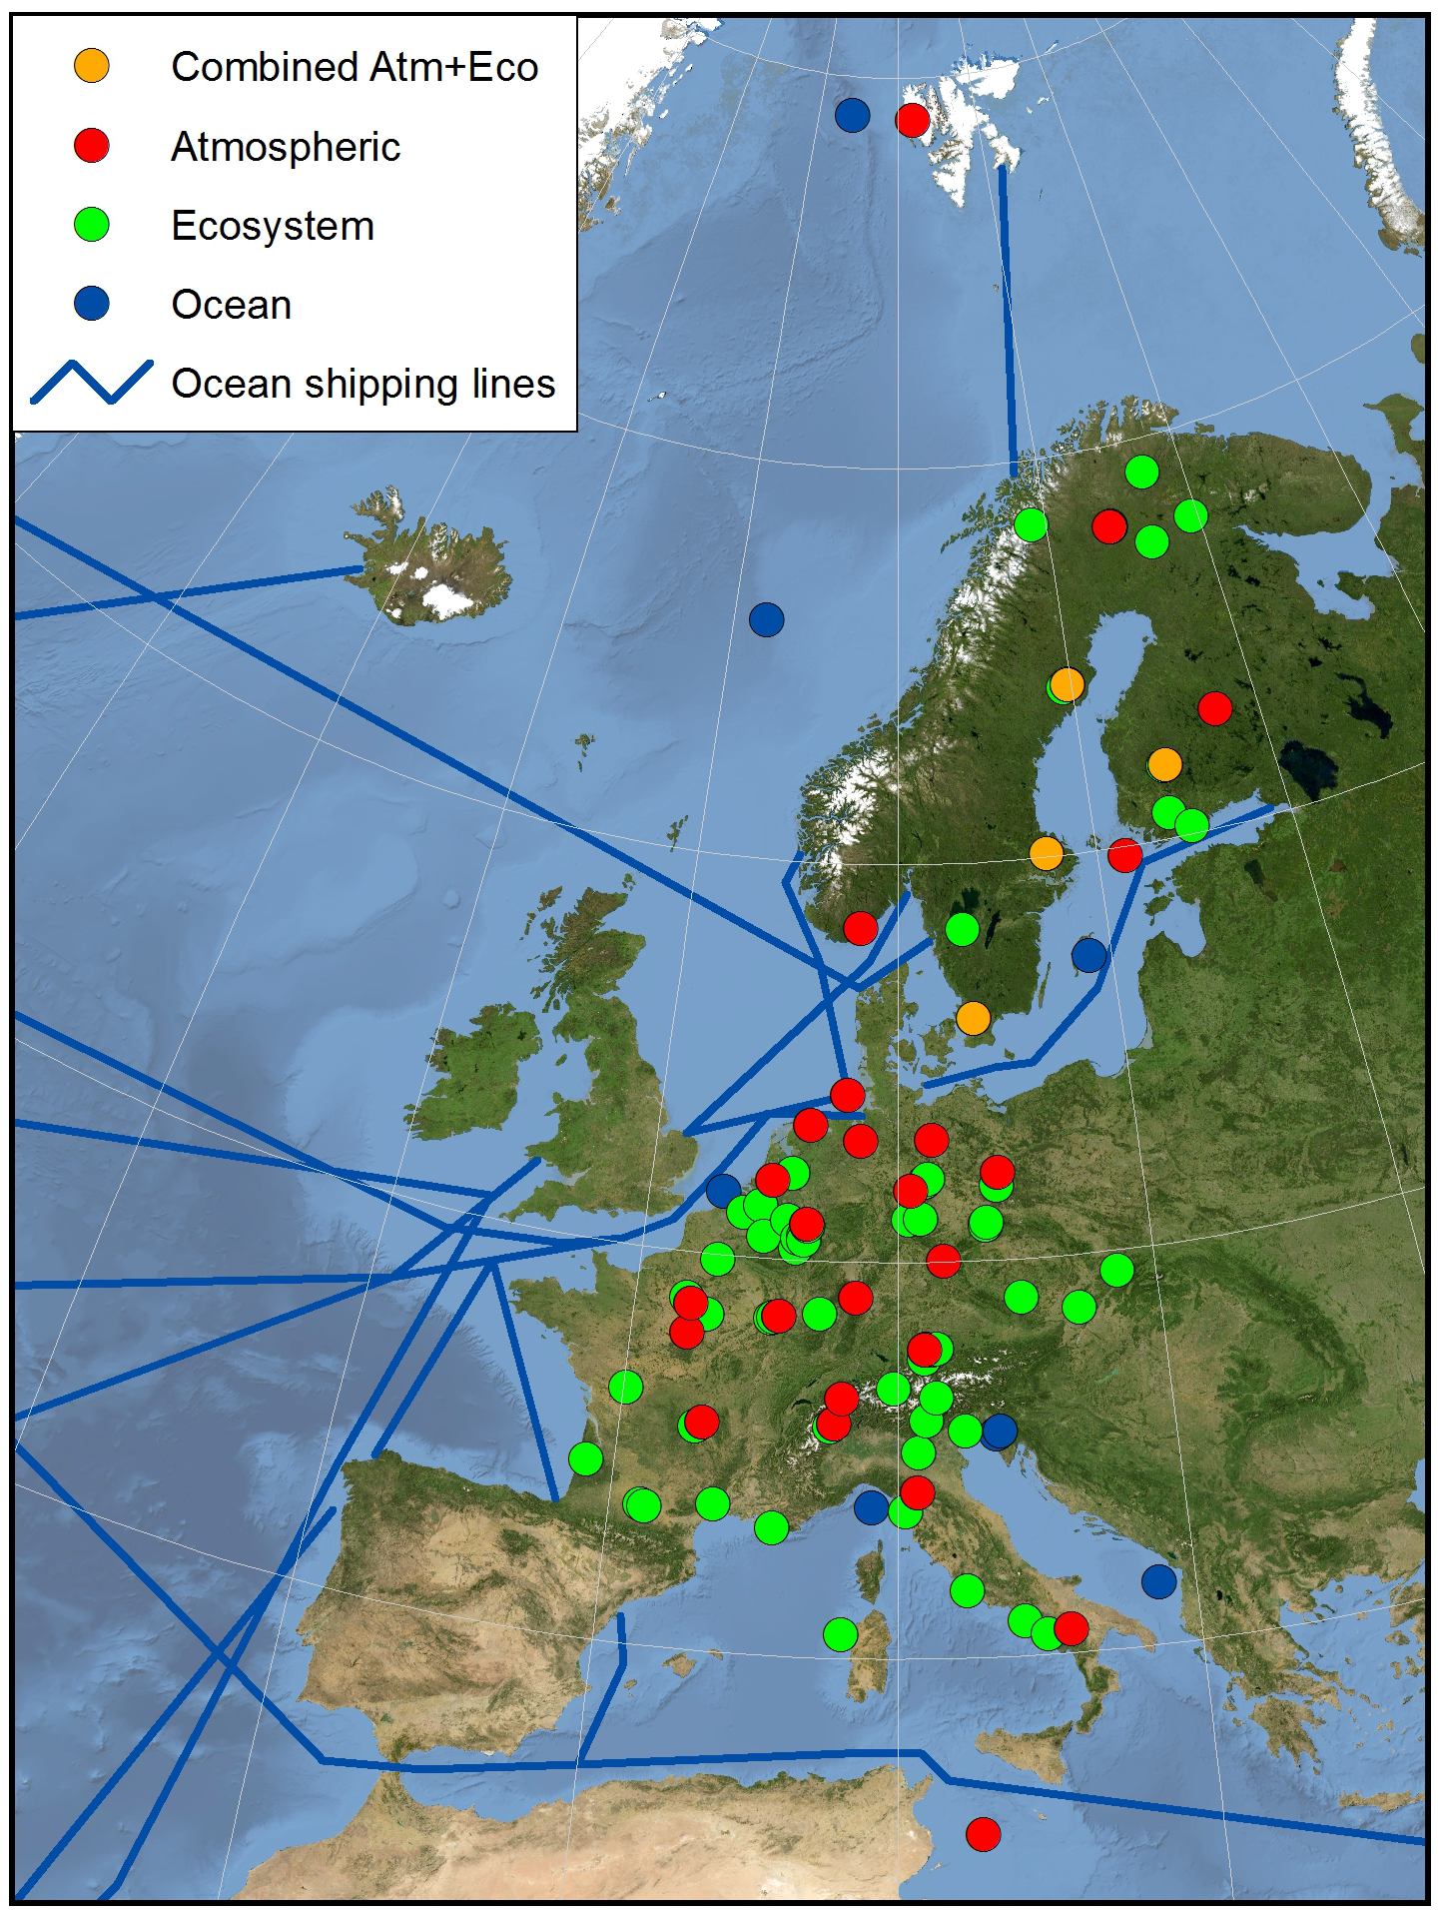
ICOS Stations
126 measurement stations
71 Ecosystem stations
34 Atmosphere stations
21 Ocean stations
including two stations in Greenland,
one in French Guyana, La Reunion, Cape Verde (not visible here)
+ 5 UK stations entering the Step 1 process

Slide 16

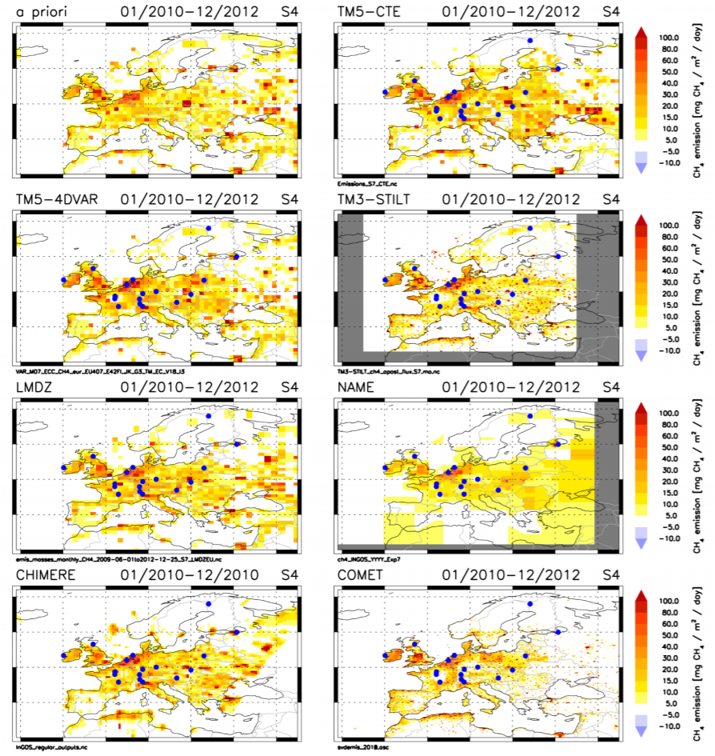
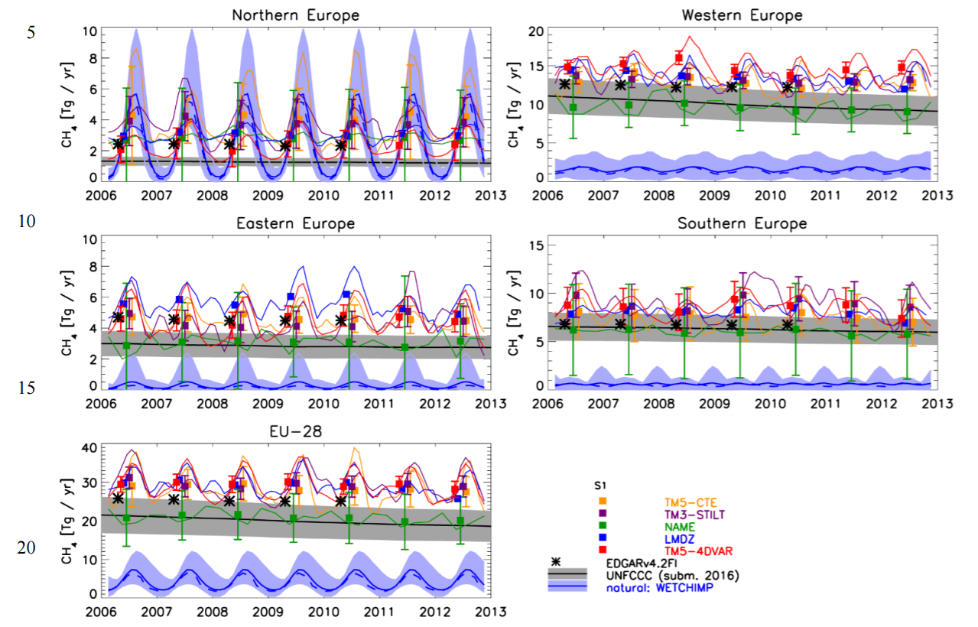
Example of use: European CH₄ emissions
Bergamaschi et al, 2017; doi:10.5194/acp-2017-273

Slide 17
Conclusions
In situ GHG observations are a vital source of information
Increased spatial coverage and time resolution allow for regional budgets and even source attribution
Atmospheric Transport Models are largest source of uncertainty
Models also show that accuracy demands on observations necessary for future evaluation
Satellite data can fill uncovered areas but will most likely never fulfil accuracy and longevity demands

Slide 18
Thank you!

