Slide 1
New developments in the global ocean observing system Argo and its European component Euro-Argo
Birgit Klein on behalf of the Euro-Argo Research Infrastructure Consortium
EGU, 24-28 April 2015, Vienna

Slide 2
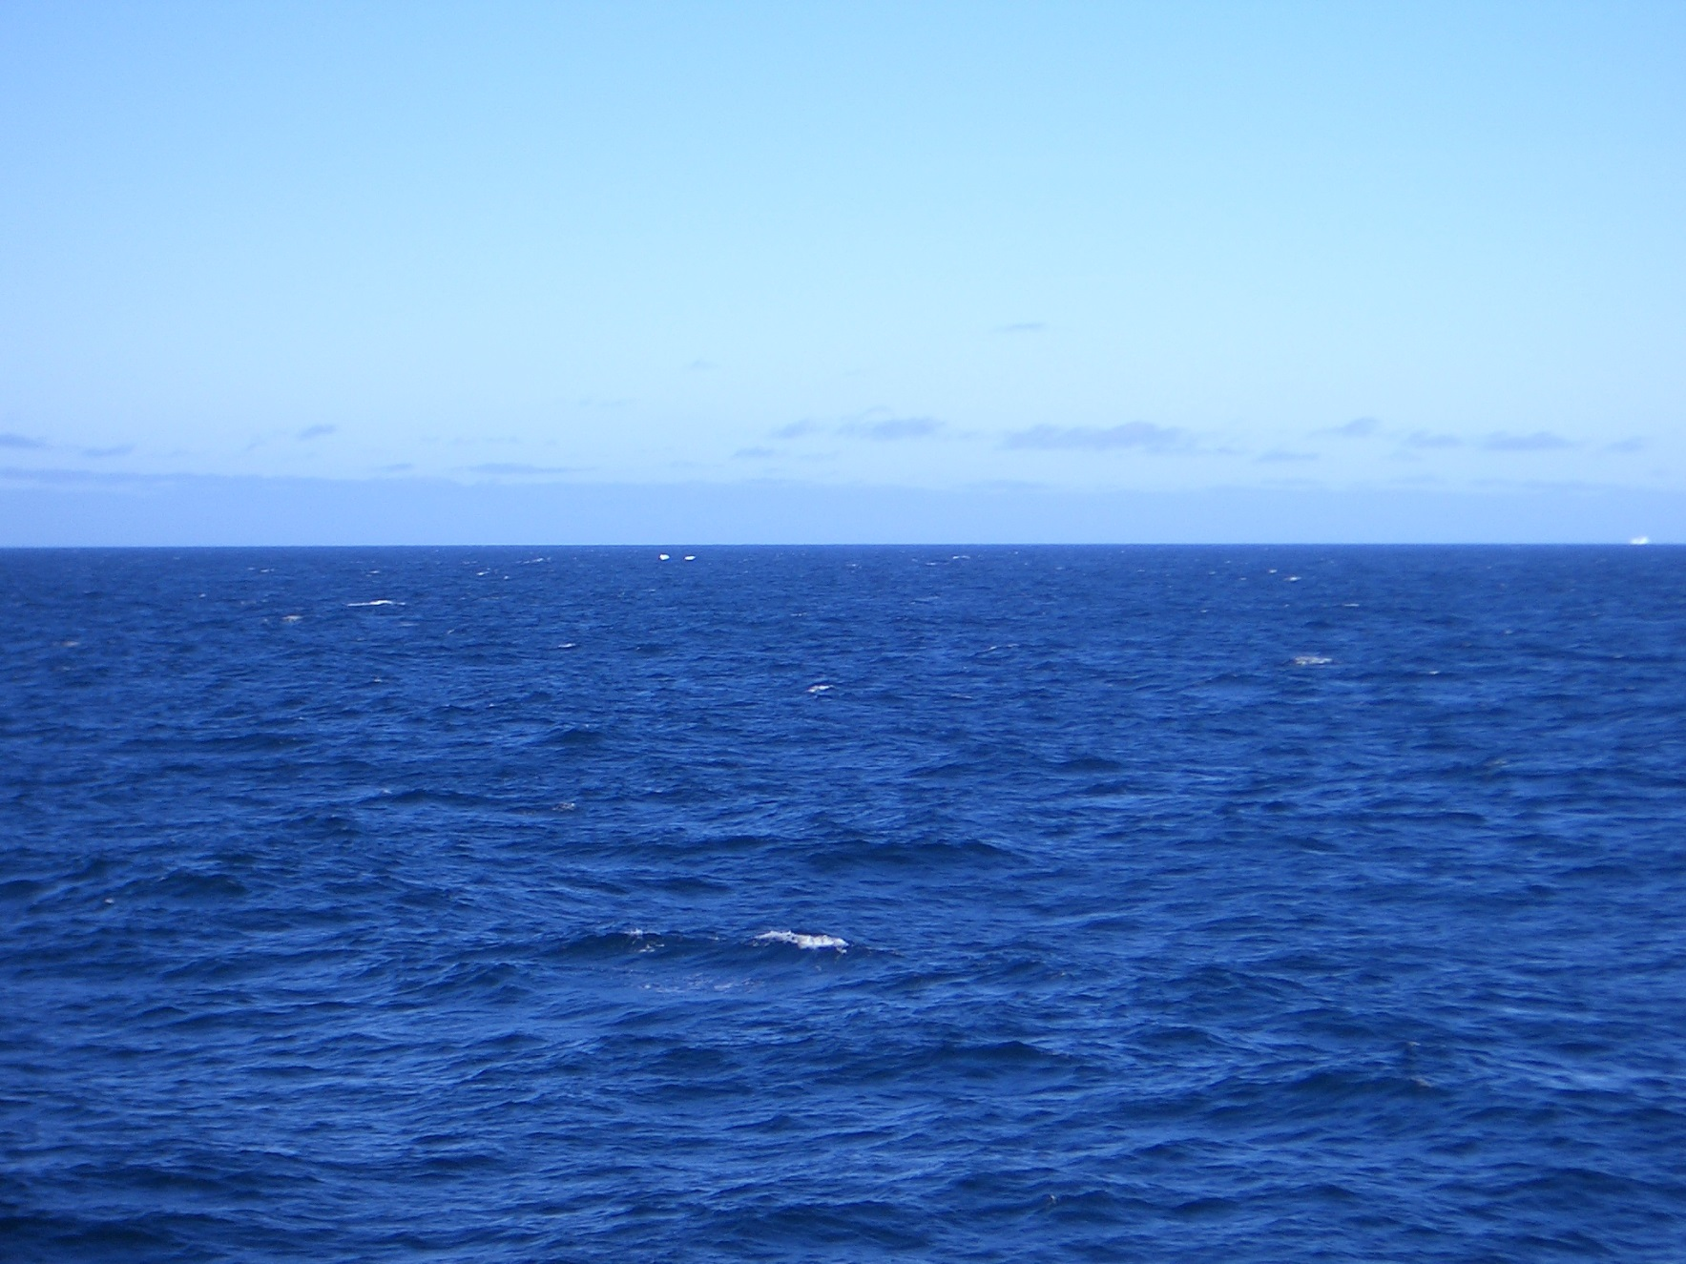
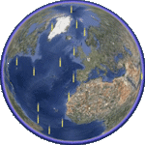







What is Argo?
Explore the Argo system by clicking on the icons
Overview
Data System
Euro-Argo
Pilot Extensions
Argo Products
Argo Science

Slide 3
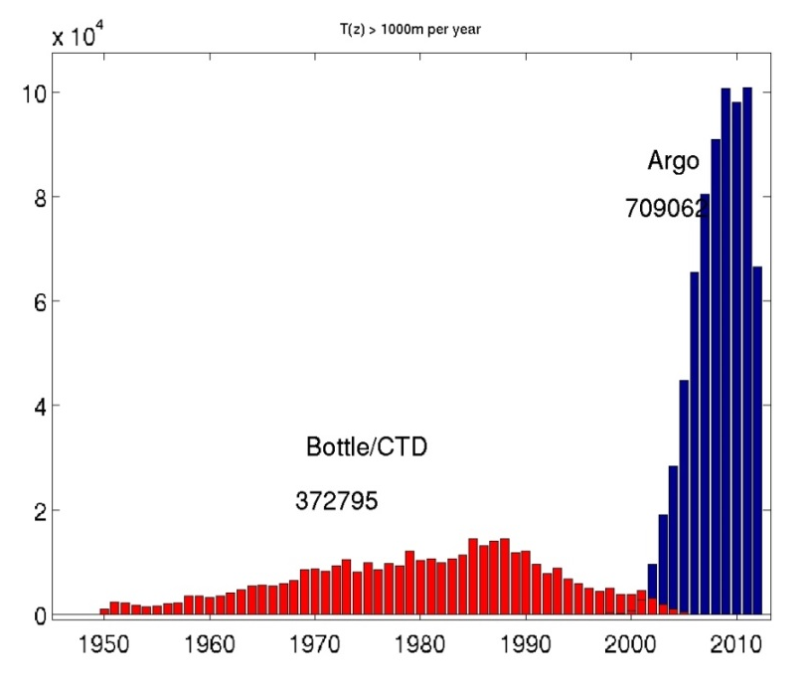
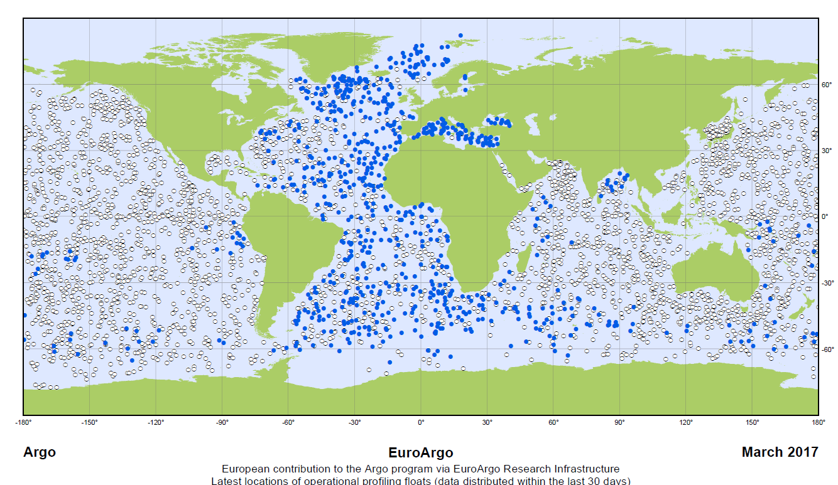

What is Argo?
Argo is a fleet of autonomous instruments (floats) probing the interior of the ocean
Array design: 1 float per 3° x 3° box
Floats are carried horizontally by currents
Floats are actively moving up and down in the water column (every 10 days, down to 2000 m depth)
Standard measurement parameters: T, S, P
new sensors being developed and added
Data are provided operationally within 24h
Argo Information Centre (AIC) monitors array and provides statistics and graphs
Contribution of Argo to World CTD data base
Overview
Data System
Number of profiles x 10⁴
Euro-Argo
Pilot Extensions
Argo Products
Distribution of floats: European floats and others ○
Argo Science
Link to AIC

Slide 4
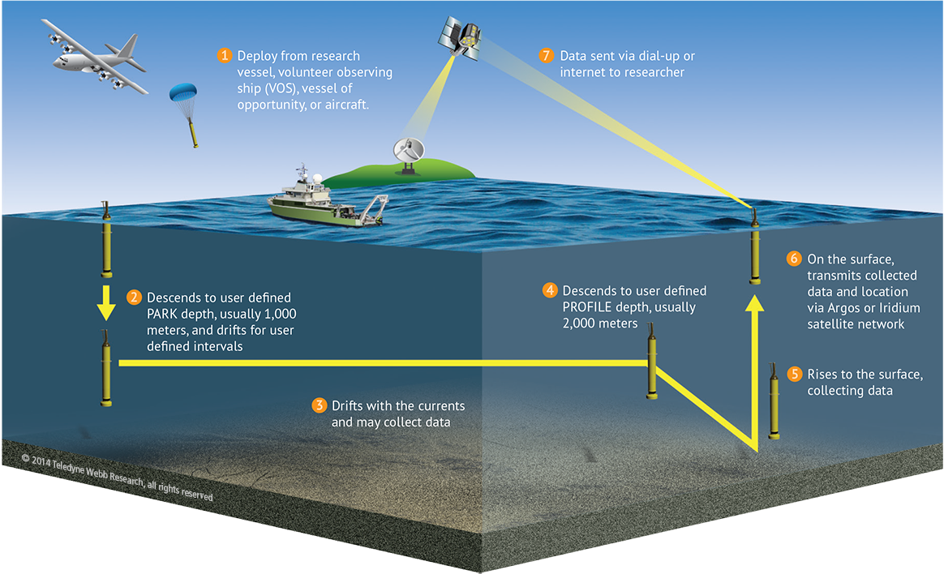
How do the floats operate?
Overview
Data System
Euro-Argo
Pilot Extensions
Argo Products
Argo Science
The measurement cycle of the floats consists of multiple phases as shown on the schematic and is repeated continuously during the lifetime of the floats. For more information about the operating principle visit Argo home page.
Argo home

Slide 5
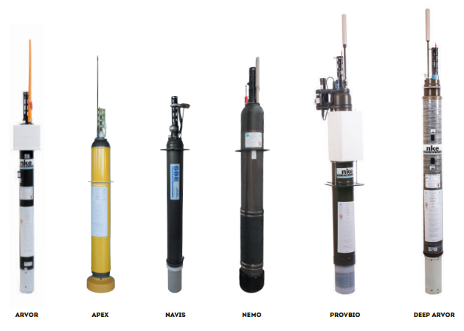
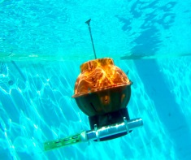
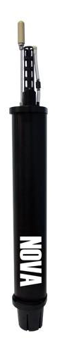
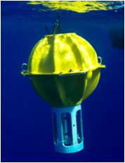
Which float types are used within Argo?
Overview
Data System
Deep SOLO
Euro-Argo
Pilot Extensions
Argo Products
Deep APEX
Argo Science
NOVA
Floats are manufactured by a few companies around the world. Until recently floats followed a common design and were cylindrical in shape and between 1.5-2 m long. Measurement sensors are found on top of the float and batteries and hydraulic pump are housed inside the metal cylinder. New floats measuring down to 6000 m depth have a different design with the measurement sensors at the bottom of a floatation sphere. For more information visit Argo home page.
Argo home

Slide 6
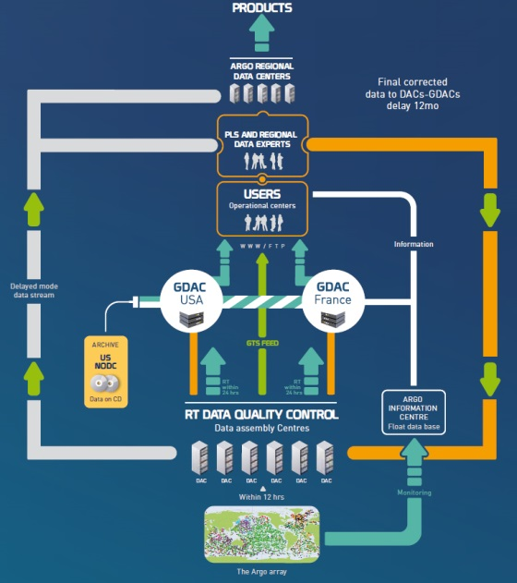
Data flow
Overview
Data are processed at national level by 10 national level Data Assembly Centres (DAC)
They are forwarded to operational users via the Global Telecommunication System (GTS) by DACs
Data are aggregated at two Global Data Assembly Centres. These form primary access points with data exposed via FTP servers and archived versions available that include DOI
The data system is monitored by Argo Information Centre (AIC)
Argo Data Management serves as template for other Global Ocean Observing System components.
Data System
Euro-Argo
Pilot Extensions
Argo Products
Argo Science

Slide 7
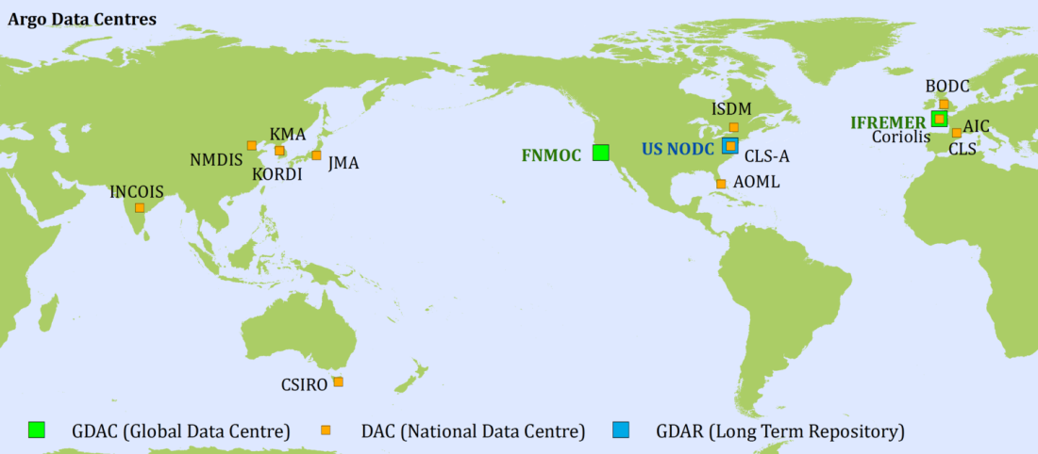
Argo Data centers
Overview
Data System
Euro-Argo
Pilot Extensions
Argo Products
Argo Science
The Argo data system is spread over the world, but the user can collect all data from either of the two global data centers. The data can be selected according to ocean area or float by float.
Link to GDAC

Slide 8
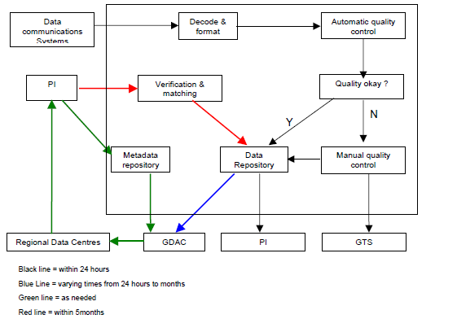
Data management and quality control
Documents about data formats and handling found at the data management page. Please have a look at the following references.
A beginners guide to accessing Argo data
The Argo data management handbook
Argo User’s manual
The Argo data management handbook
The organisation of the Argo Global Data Centers
Overview
Data System
Euro-Argo
Pilot Extensions
Argo Products
Argo Science
To data page

Slide 9
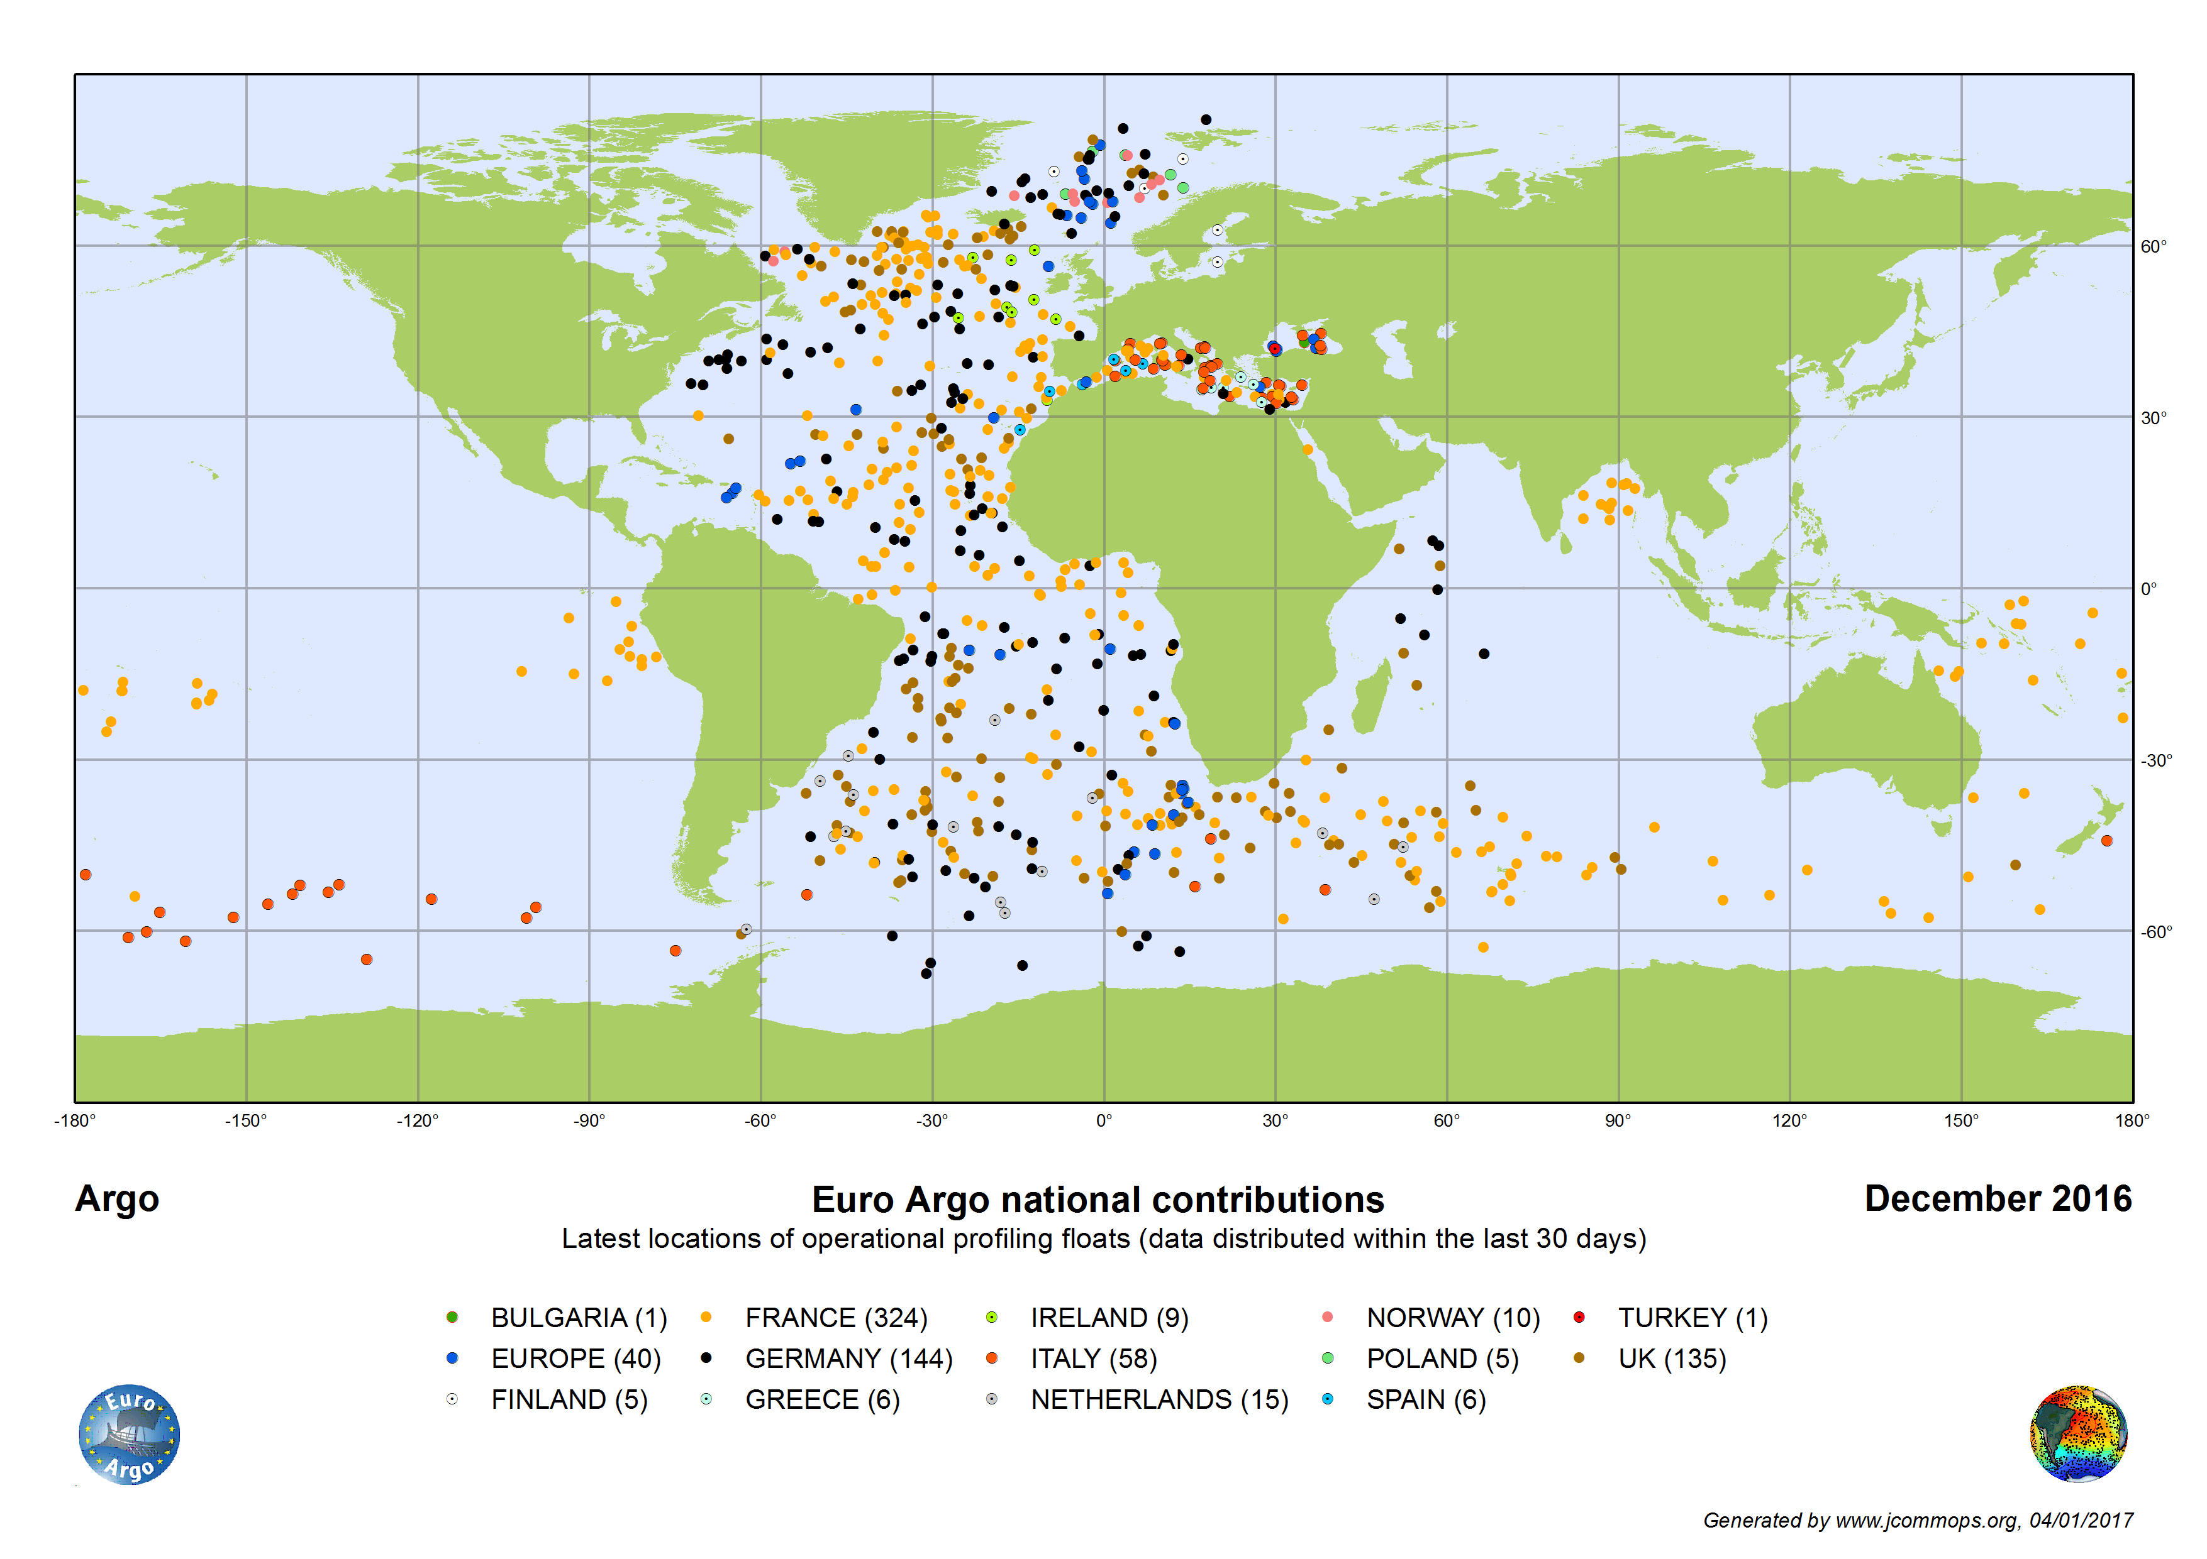
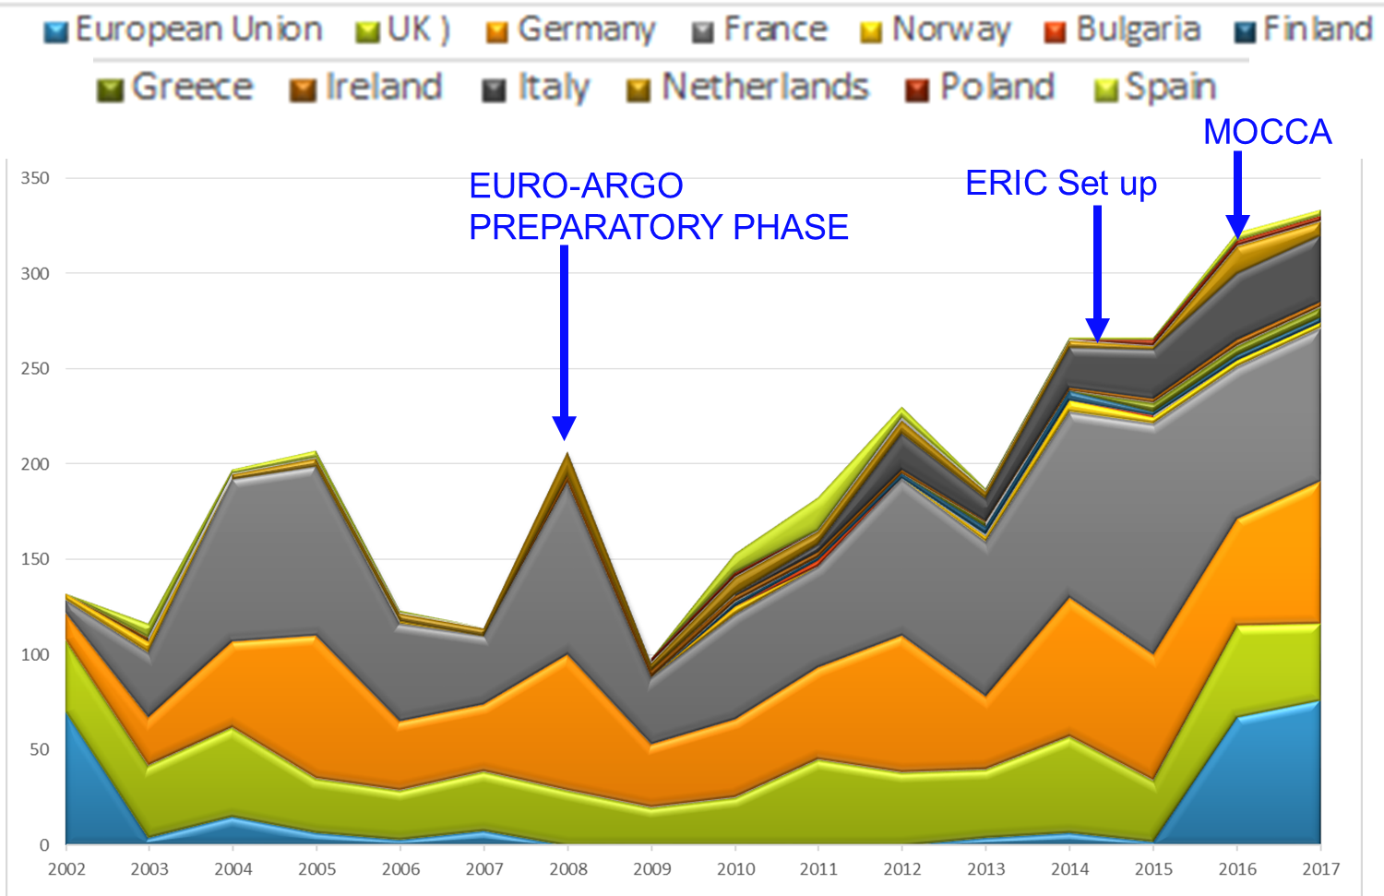
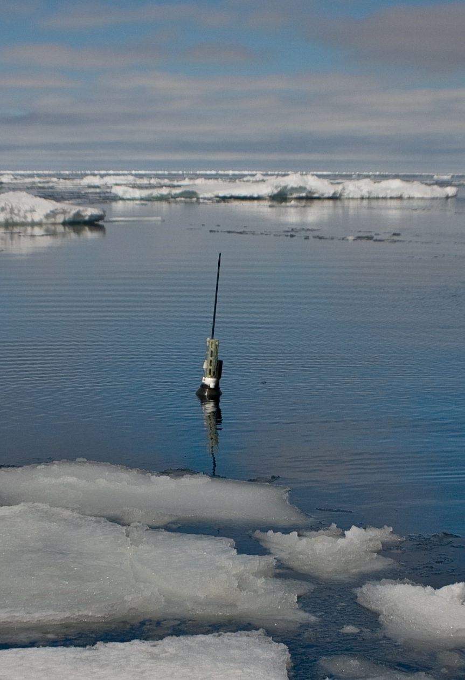
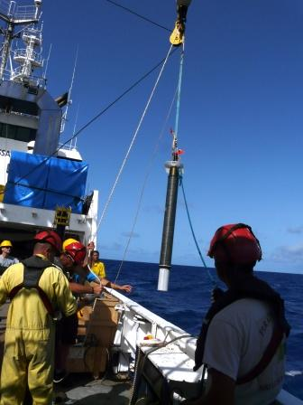
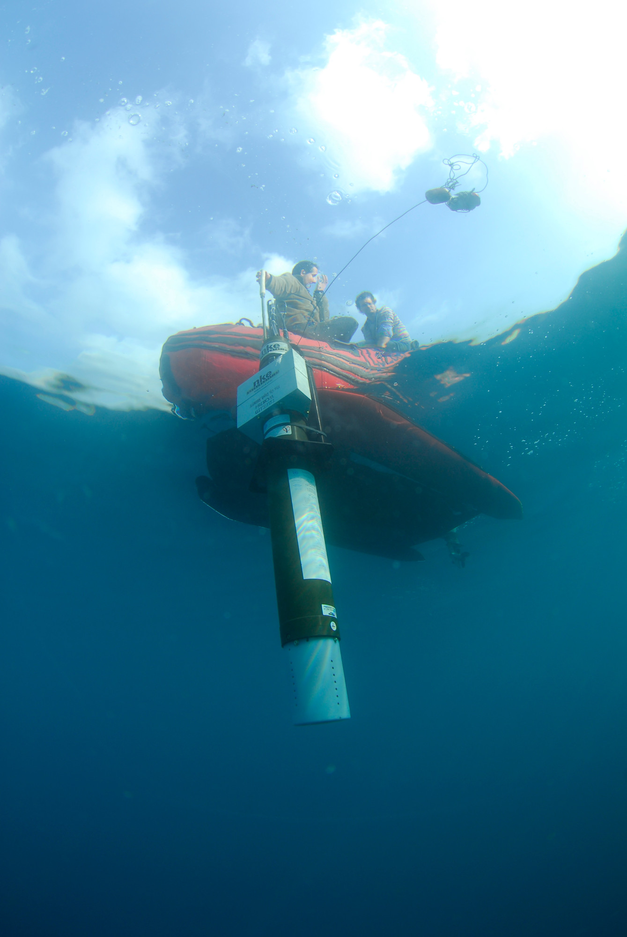
Euro-Argo
Overview
Data System
Euro-Argo
Pilot Extensions
The ERIC ( European Research Infrastructure Consortium) was created with 9 countries in May 2014, 2 more joined in 2016-2017.
The main challenges for the coming years are
To maintain the RI over the next decades
To extend its capacity to the abyssal ocean (4000 to 6000 m), to partially ice covered areas and biogeochemistry
Goal is to involve new countries and new funding (first EC funding received by DG-MARE for MOCCA project ) to increase of the European contribution to the international network to ~25%.
Argo Products
Argo Science

Slide 10
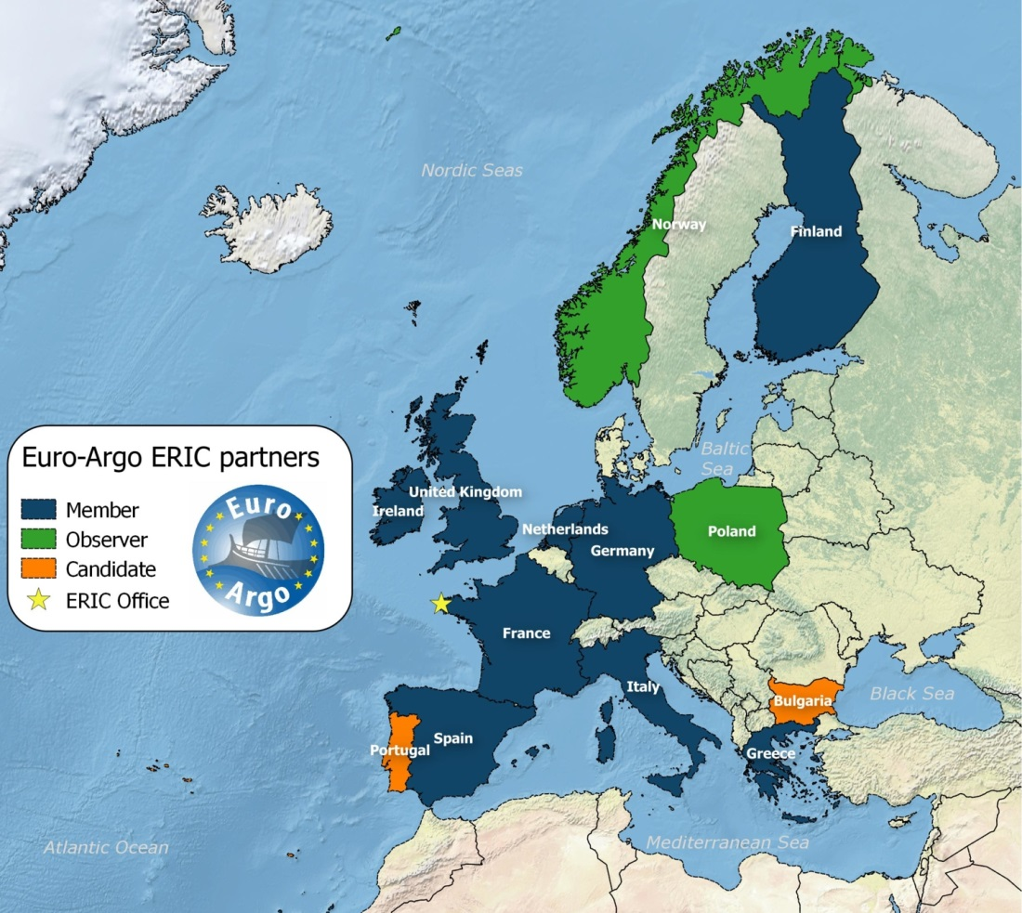
Euro-Argo members
The goal of this new European legal structure (Euro-Argo ERIC) is to allow European countries to consolidate and improve their contribution to Argo international. The aim is to establish an infrastructure for ¼ of the global array and ensure a long term European contribution to Argo .
Overview
Data System
Euro-Argo
Pilot Extensions
Argo Products
Argo Science
To Euro-Argo

Slide 11
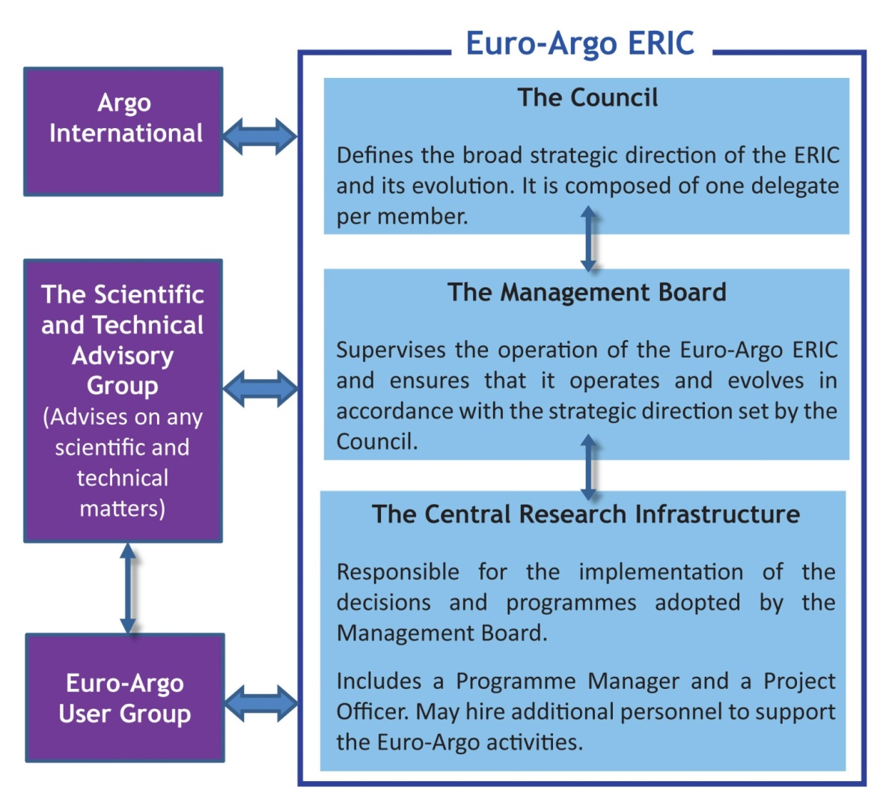
Governance of the Euro-Argo ERIC
Local Host for Euro-Argo ERIC
France (Ifremer, Brest)
Members:
Finland, France,
Germany, Greece,
Ireland, Italy, Netherlands, Spain, United Kingdom
Observers:
Norway, Poland
Candidate Members: Bulgaria, Portugal
Overview
Data System
Euro-Argo
Pilot Extensions
Argo Products
Argo Science
The ERIC is composed of the national infrastructure and a central research infrastructure which is for now hosted by France.

Slide 12
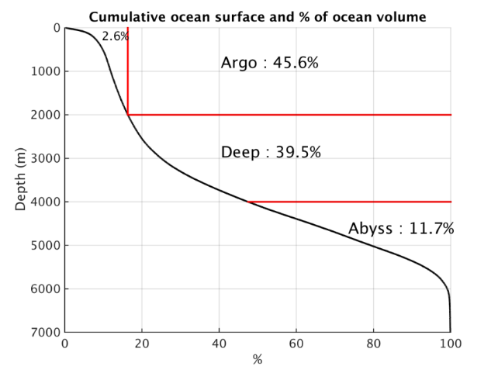
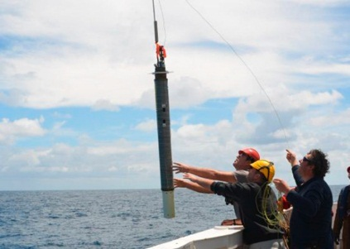
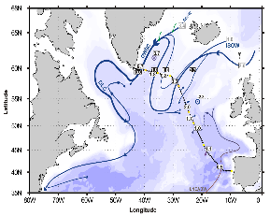
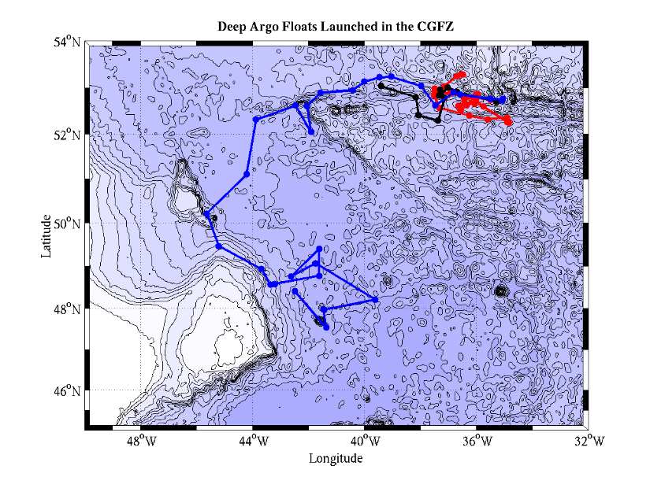
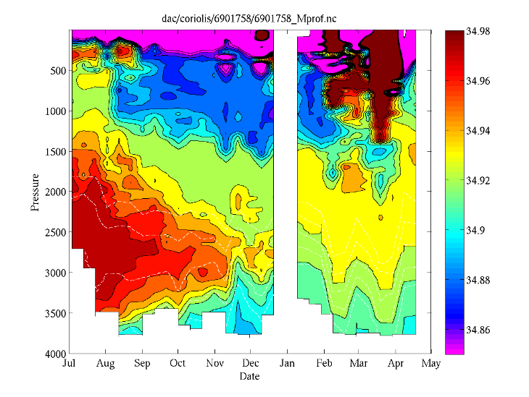
Pilot extensions: Deep Argo
Argo floats (0-2000m depth) give access to ~50% of the global ocean volume
Deep Argo floats (0-4000m depth) give access to ~90% of the global ocean volume and are necessary to close global heat and sea level budgets.
Overview
Data System
Deep Argo float deployment
Euro-Argo
Pilot Extensions
Argo Products
Argo Science
The left figure highlights a deep mixing event in the upper 2000m late March measured by deep Argo float 6901758. The salinity data will also be used to study the deep and salty Island Scotland Overflow Water (ISOW) between 2000 and 4000m depth. The drift trajectory of this float is shown above in blue between deployment (July 2015) and May 2016.

Slide 13
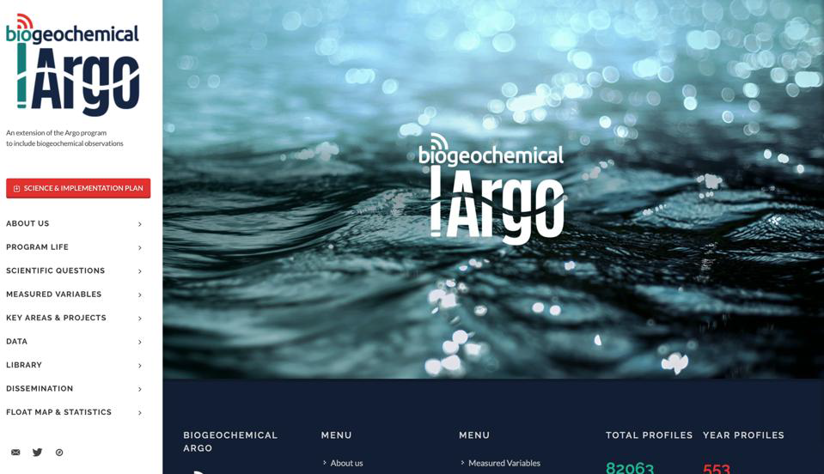
Pilot extensions: Biogeochemical Argo
  New sensors (O2, pH, Chl, carbon, nitrate, …) are needed to observe the ecosystem and geochemical impacts of climate change.
Overview
Data System
Euro-Argo
Pilot Extensions
Argo Products
Argo Science
Biogeochemical Argo core variables:
•O2
•NO3
•pH
•Chla
•Suspended particles
•Downwelling irradiance
To Bio-Argo

Slide 14
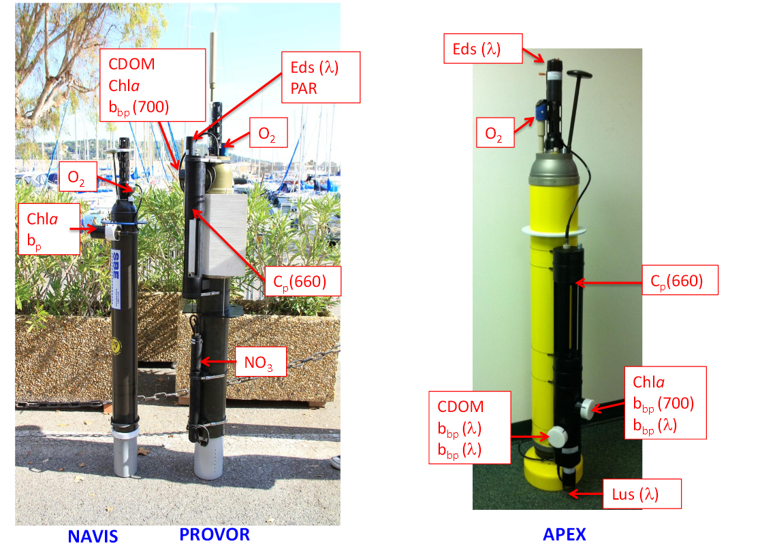
Pilot extensions: Biogeochemical Argo
Overview
Data System
Euro-Argo
Pilot Extensions
Argo Products
Argo Science
Biogeochemical sensors are mounted as additional payload on regular floats. Up to now miniaturized sensors for main biogeochemical parameters are available.

Slide 15
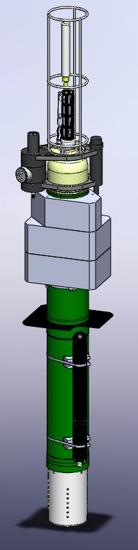

Pilot extensions: Polar Areas
The NAOS Equipex Project (2011-2019) tests Bio-Argo floats in the Arctic Ocean in Baffin Bay (PIs: M. Babin, C. Marec)
Overview
The float developed and tested in the project is the ProvorCTS5 (NKE) with additional payload:
SUNA (nitrates)
OCR 504 (Ed 3 wavelengths: 380, 410, 490nm) +PAR (400-700nm)
FLBBCD (fluo chla, fluo CDOM, backscattering)
Sea Ice detection and avoidance (ISA) (+ optics, acoustic)
Storage of data in case no surfacing is possible for transmission
Modification of the mission without communication (date criteria)
Protective frame for sensors
Data System
Euro-Argo
Pilot Extensions
Argo Products
Argo Science
To NAOS

Slide 16
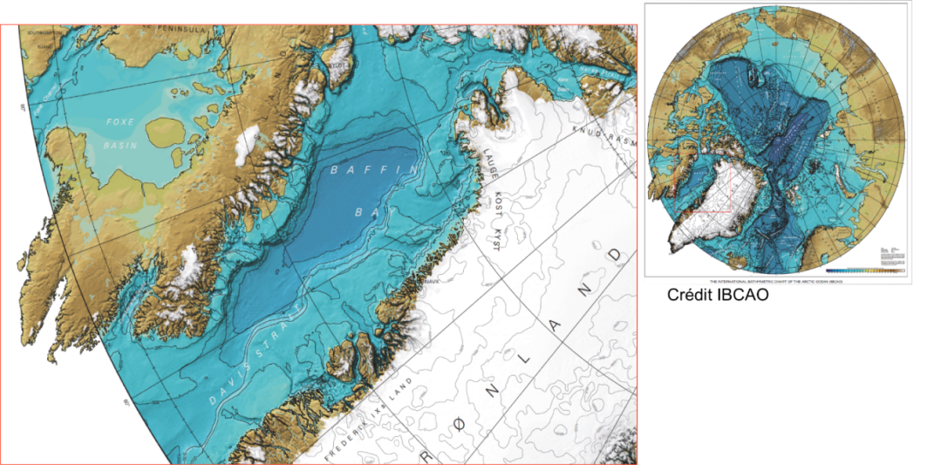
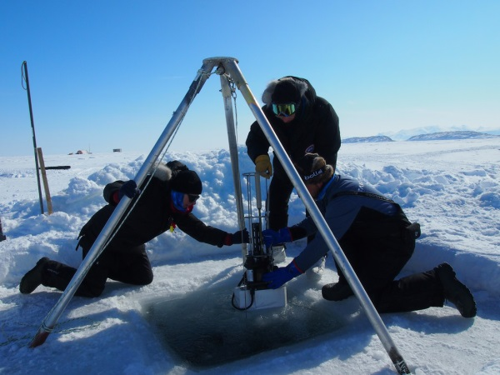
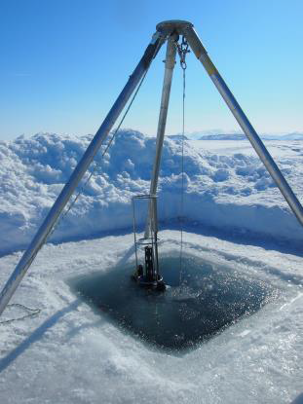
Pilot extensions: Polar Areas
NAOS Bio-Argo floats in the Artic ocean (Baffin Bay)
Overview
Science Goal:
To understand the ice-edge blooms. Ice edge blooms are systematically observed in Baffin Bay. Remote sensing observations indicate that spring blooms occur now 50 days earlier than in1997.
Data System
Euro-Argo
Pilot Extensions
Argo Products
Argo Science
Bio-Argo float tests
during GreenEdge 2015 Qikiqtarjuaq, Nunavut

Slide 17
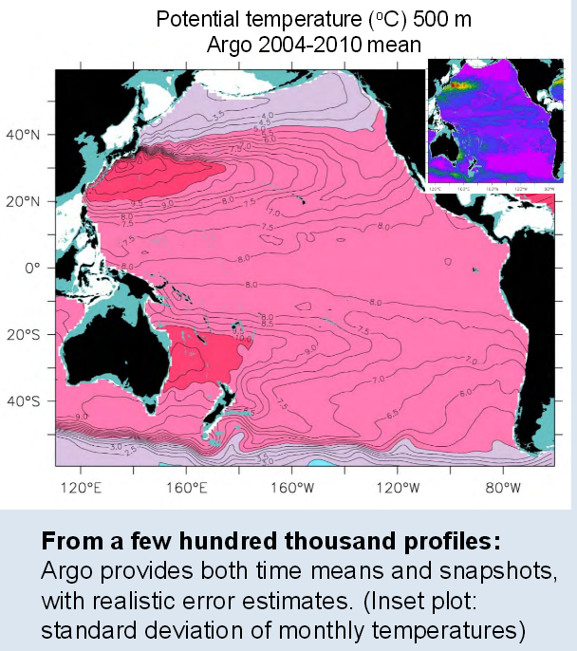
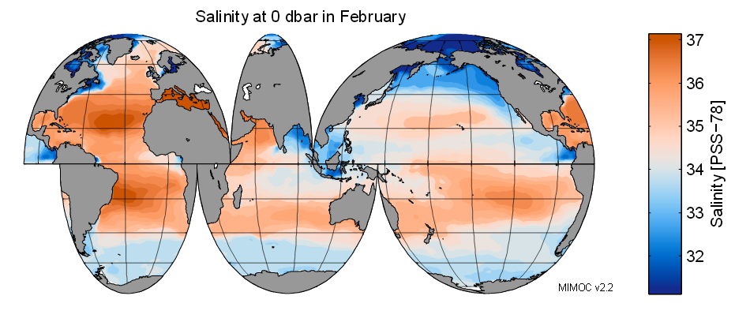
Gridded temperature and salinity fields
Argo floats provide 100,000 plus temperature and salinity profiles each year, but often it is necessary to combine the profiles into a grid to look at different water properties. There are now several gridded fields and other data products available on the world wide web based on Argo data, as well as other data sources from the Argo homepage. Two examples are shown below.
Overview
Data System
Euro-Argo
Pilot Extensions
Argo Products
Argo Science
Monthly Isopycnal & Mixed-layer Ocean Climatology (MIMOC) from Argo data and other sources from Sunke Schmidtko, Gregory C. Johnson, John M. Lyman
To products
Global gridded NetCDF Argo only dataset produced by optimal interpolation from John Gilson and Dean Roemmich

Slide 18
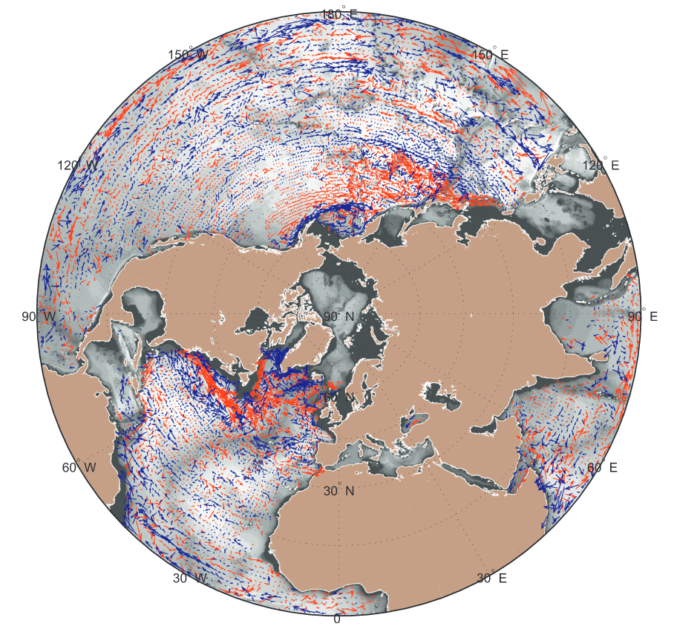
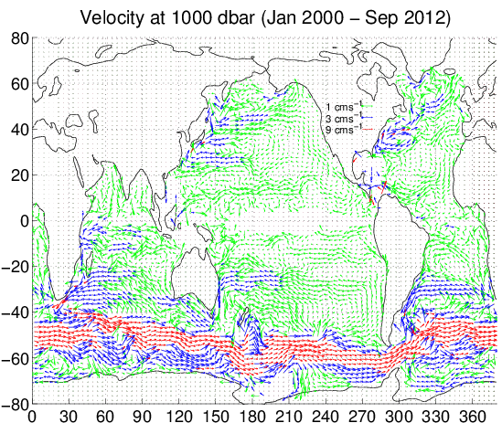
Climatological velocity fields
Additionally, trajectories from Argo floats drifting at depth can be used to calculate velocities which may or may not be gridded to examine the currents at 1000 dbars. Two examples are shown below, for access to the velocity climatologies please go to product webpage.
Overview
Data System
Euro-Argo
Pilot Extensions
Argo Products
Argo Science
YoMaHa'07: velocity data assessed from trajectories of Argo floats at parking level and at the sea surface
To products
Andro: An Argo-based deep displacement dataset from M. Ollitrault and J.-P. Rannou

Slide 19
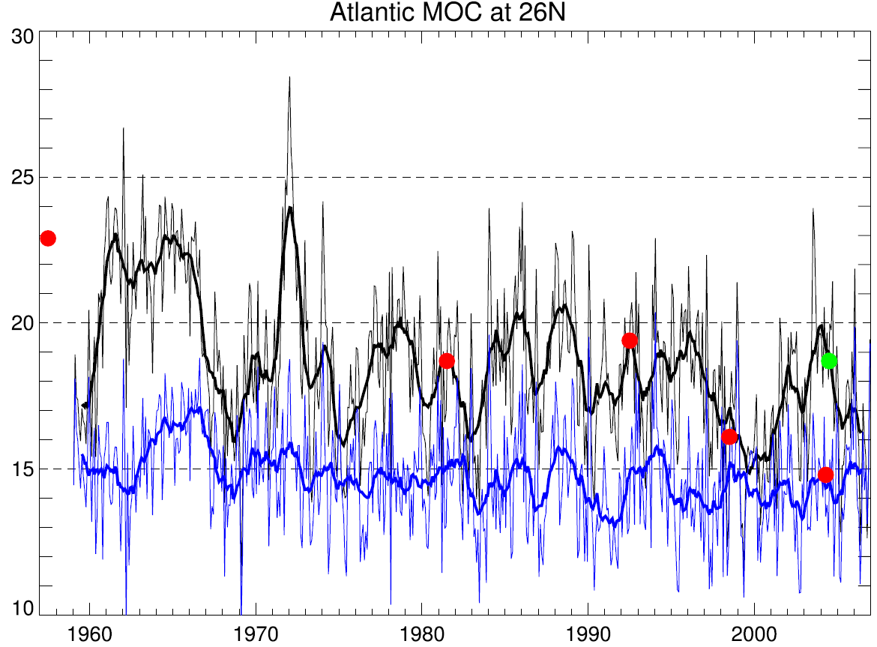
Increase in data density and spatial coverage
Lack of data and incomplete coverage in space of time have been a severe problem in the past. For example Bryden et al. (Nature, 2005) had inferred that “[...] the AMOC has slowed by about 30 per cent between 1957 and 2004” based on five occupations of the 26ºN transect.
Overview
Data System
Euro-Argo
Pilot Extensions
Balmaseda et al. (GRL, 2007) repeated analysis based on reanalysis data, including Argo data and found large variability, but no large trend.
=> continuous observations necessary to capture variability
Argo Products
Argo Science

Slide 20
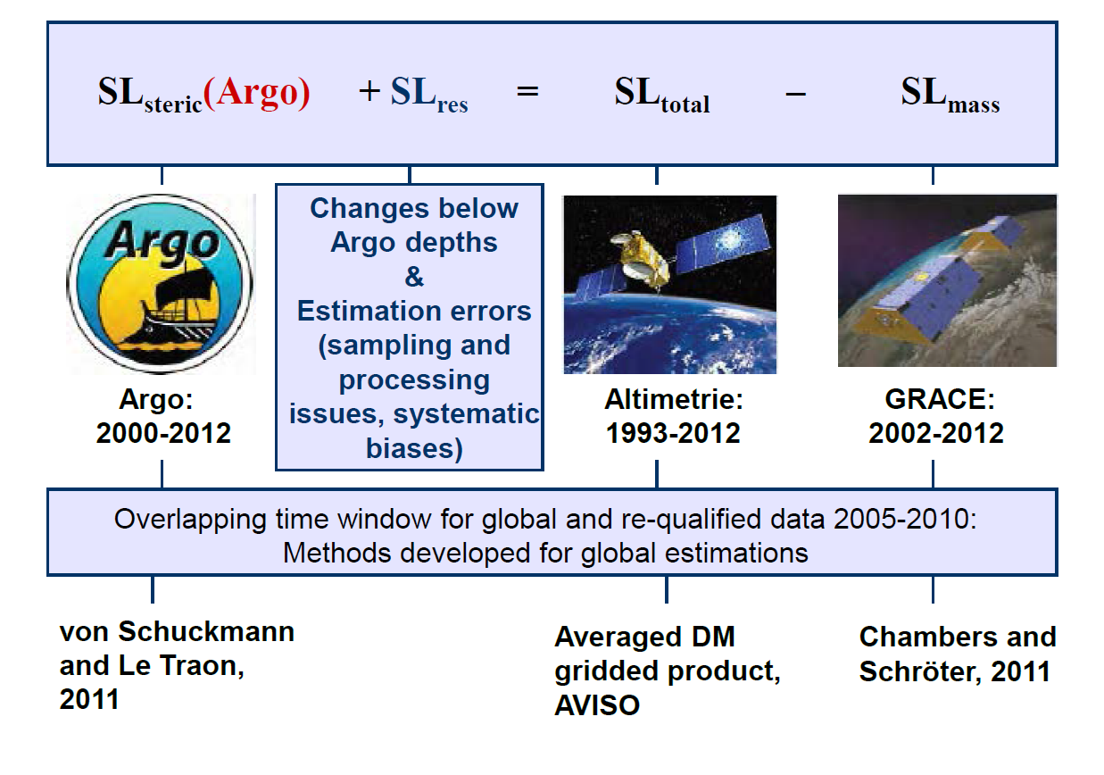
Closure of sea level budget
Overview
Data System
Euro-Argo
Pilot Extensions
Argo Products
Argo Science
Von Schuckmann et al. (2013)
In combination with satellite based observations of sea level (Altimetry) and mass (GRACE) the closure of the sea level budget could be improved.

Slide 21
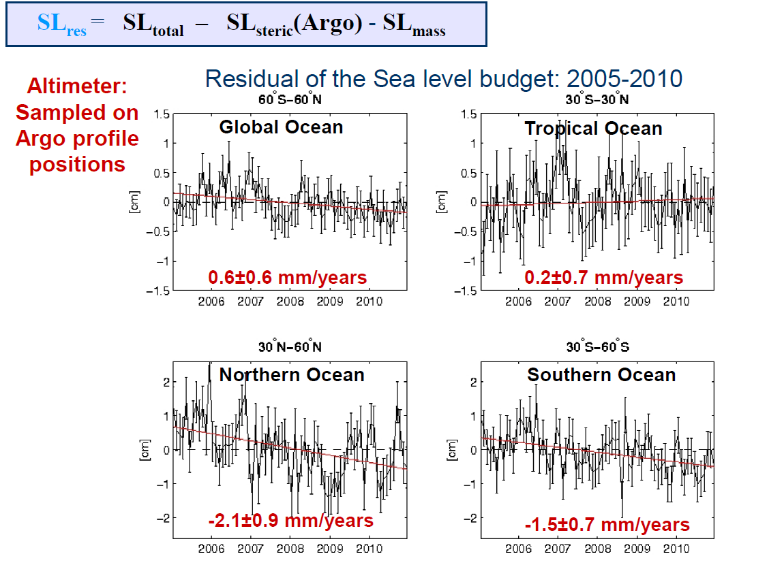
Closure of sea level budget
Overview
Data System
Euro-Argo
Pilot Extensions
Argo Products
Argo Science
Von Schuckmann et al. (2013)
The global and tropical budgets are nearly closed as shown above, but issues remain regionally in the extra-tropics.

Slide 22
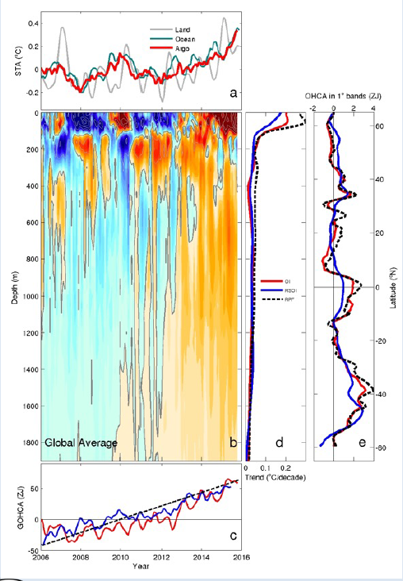
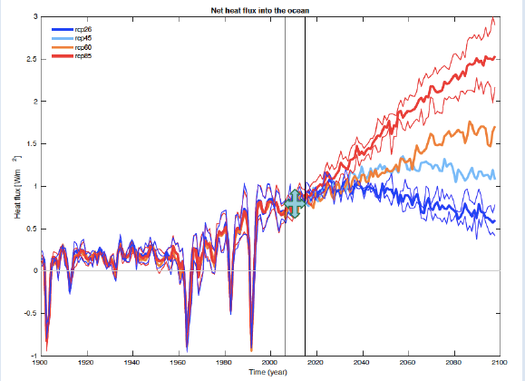
Impact of Argo on ocean heat content estimates
The Argo data enable near real time tracking of the warming of the Earth:
Shows robust results across different analysis of 0.64-0.7 W/m^{2.}
The Southern hemisphere dominates warming and warming occurs down to current Argo sampling depth of 2000 m.
Observed trends agree with CMIP5 projections.
Overview
Data System
Euro-Argo
Pilot Extensions
Argo Products
Argo Science
Wijfells et al., NCC, 2015

Slide 23
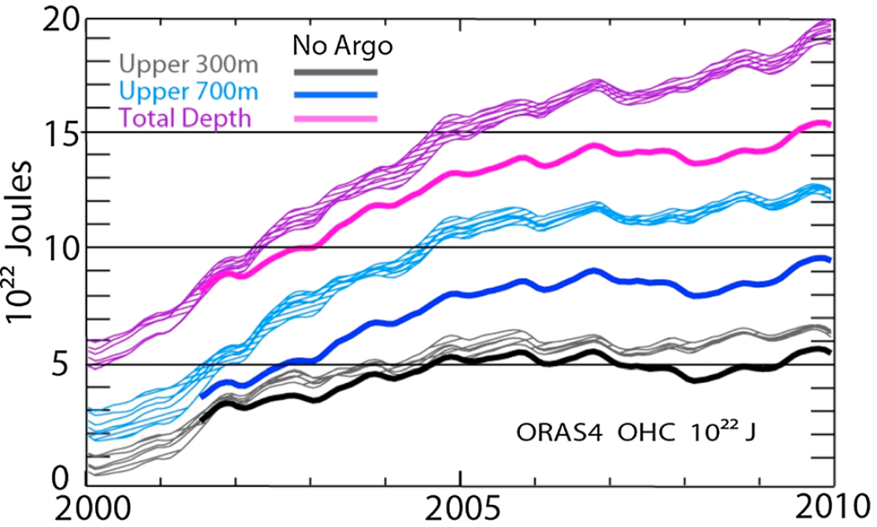
Impact of Argo on ocean heat content estimates
Overview
Data System
Euro-Argo
Pilot Extensions
Argo Products
Argo Science
Balmaseda et al. (2013)
In the last decade, about 30% of the warming in the ocean has occurred below 700 m, contributing significantly to an acceleration of the warming trend.
The impact of providing this information for assimilation in reanalyses is shown above. Withdrawing the Argo data from the assimilation (here in ORA-S4) is reducing the trends considerable below 700m, although the warming remains.

Slide 24
Conclusions and outlook
Argo is the single most important in-situ observing system for operational oceanography building on strong complementarity with satellite observations. Argo delivers global data sets in a few hours that are critical data for assimilation in ocean forecasting models.
Argo and Euro-Argo need to evolve to answer to new needs ( deep ocean, biogeochemistry, under ice observation ) and will require new investments for research and development activities.
Europe has a key role to play in complement of national efforts and EU support must be strenghthen and sustained.
Enhancing the system through technological advances has increased its value. Bi-directional communication with the floats has enabled shortened surface time, surface layer sampling and active management of the array. High data bandwidth has enabled high resolution profiles which for example can be used to estimate ocean mixing.
In the future it will be possible to get a clearer view of Argo’s impact on seasonal prediction, on the initialization and validation of Decadal Prediction Systems. New missions and parameters will service whole new areas of scientific endeavor.

