Slide 1
20 years of eddy flux research in EuroFlux and AmeriFlux
Dario Papale – ICOS Ecosystem Thematic Centre
Viterbo, Italy

Slide 2
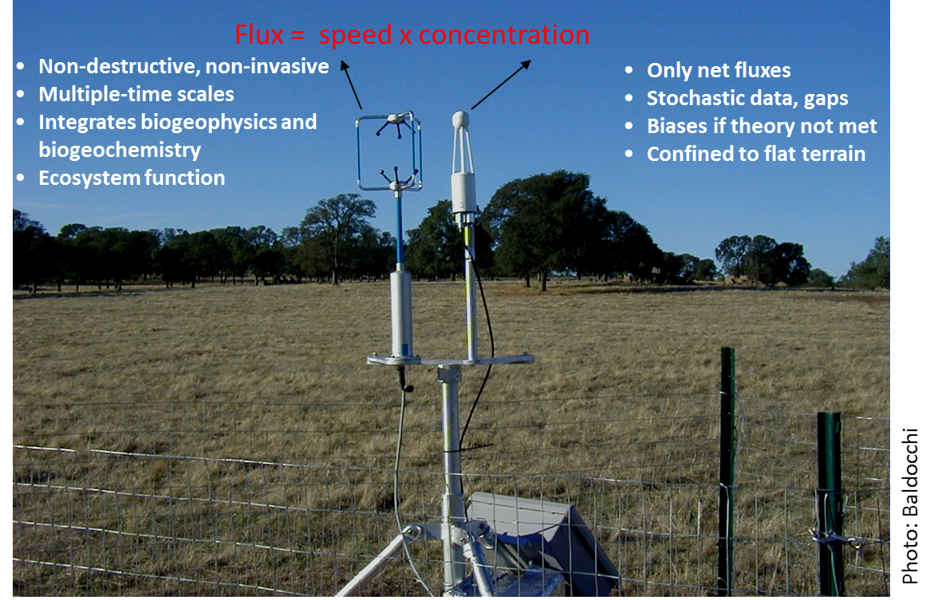
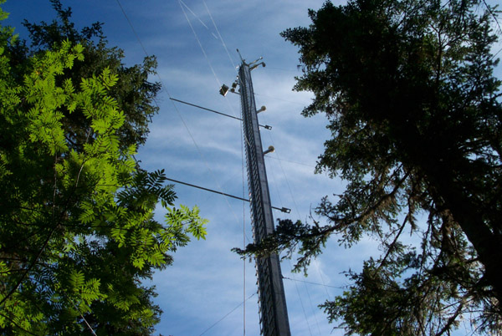
What are EuroFlux and AmeriFlux
In 1996, a small group of scientists from Europe and USA, following the initiative of Dennis Baldocchi and Riccardo Valentini, created two continental networks of eddy covariance stations.
Eddy covariance allows continuous measurements of net ecosystem exchange of CO2, H2O, energy and other GHGs at ecosystem level at time from half-hourly to interannual

Slide 3
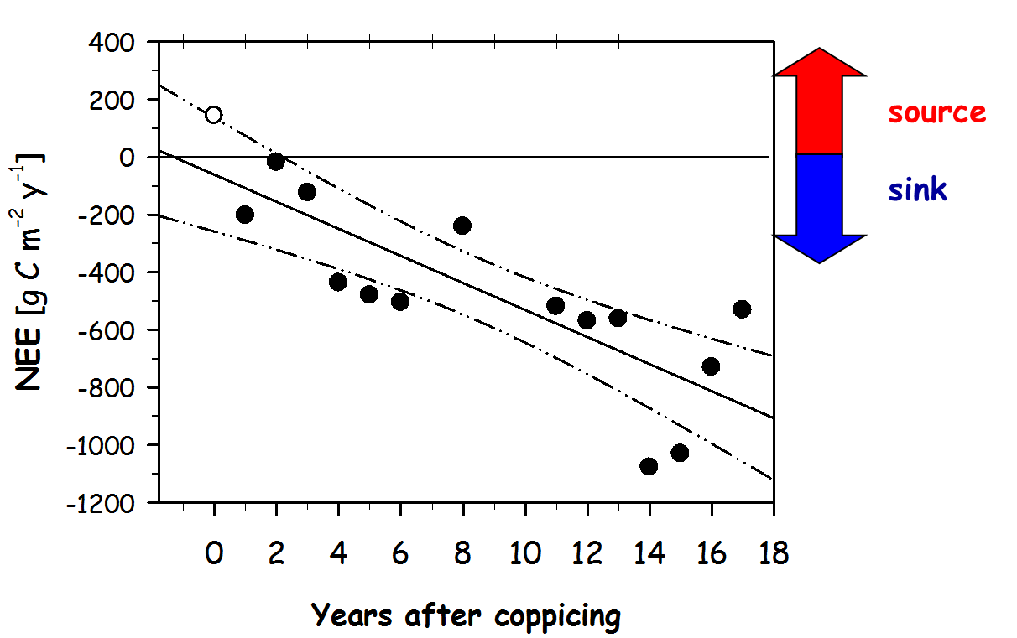
What are the eddy covariance data
The first two networks were composed by about 15 sites each (plus few others in Australia and Canada) but the data collected were unique and of high scientific relevance.

Slide 4
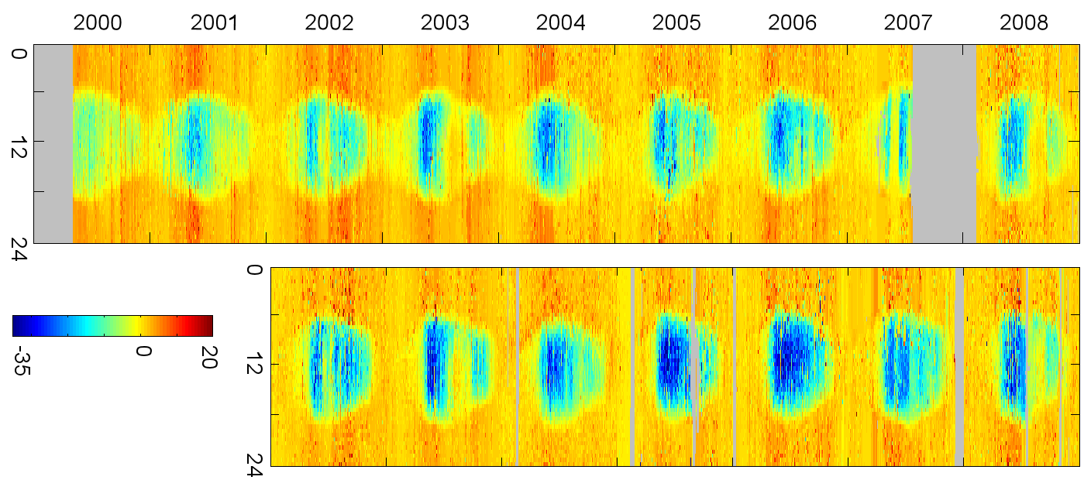
What are the eddy covariance data
The first two networks were composed by about 15 sites each (plus few others in Australia and Canada) but the data collected were unique and of high scientific relevance.
Time of
the day
IT-Ro1
-35
0
20
IT-Ro2
NEE (umol CO₂ m⁻² s⁻¹)

Slide 5
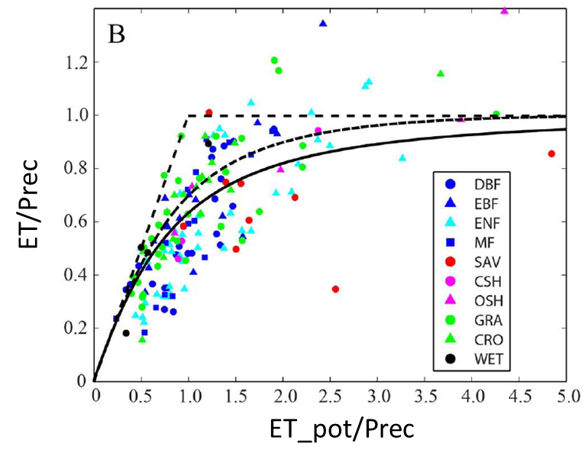
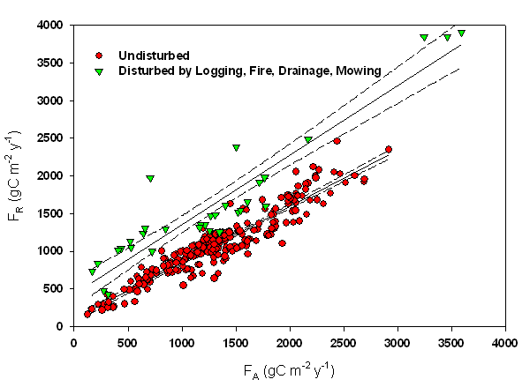
Together is better
In few years it was clear that these data could give much more if shared between groups to look at global patterns and mechanisms.

Slide 6
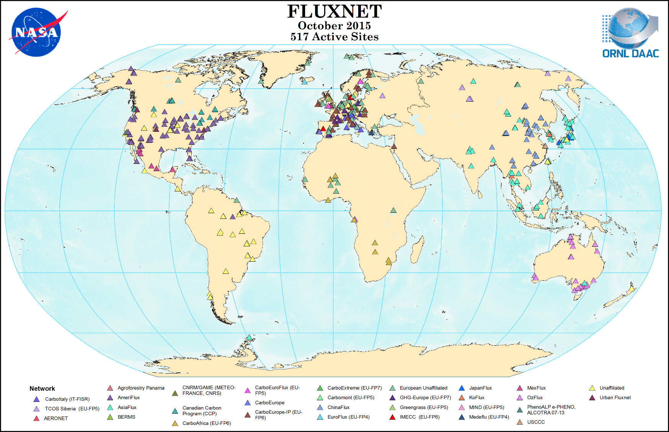
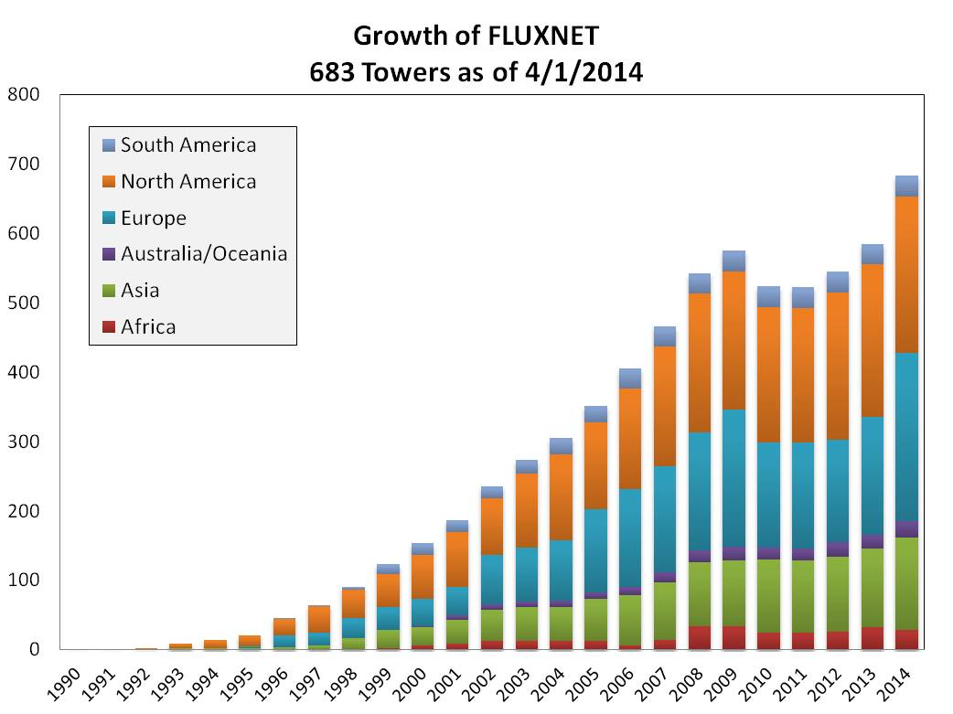
EuroFlux – AmeriFlux – FLUXNET!
Under the push of the EuroFlux and AmeriFlux community a global, self-organized network of sites has been created and is continuing growing

Slide 7

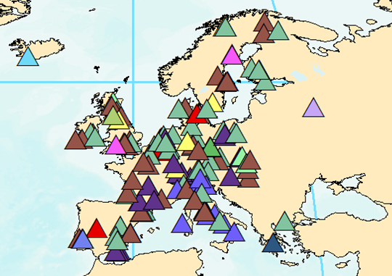



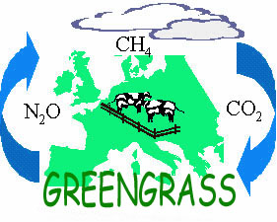




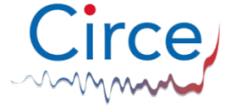
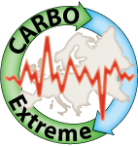
Why in ENVRIPLUS
In Europe the development of the network has been not properly “linear” since funded by different small-medium research projects, with years of gaps. All this ended in ICOS, part of ENVRI…

Slide 8
If you want to know more about recent developments in the FLUXNET community come to the session…
“20 years of eddy flux research in EuroFlux and AmeriFlux”
Oral: Room L1 from 13:30 to 17:00
Poster: Hall A from 17:30 to 19:00
I suggest also a visit to all the companies that produce and sell eddy covariance equipment that have a booth here at EGU!

