Slide 1

EPOS progress towards the construction of
a pan-European delivery framework
for solid Earth Science
Massimo Cocco, Lilli Freda,
& the EPOS Consortium
www.epos-eu.org
epos@ingv.it

Slide 2
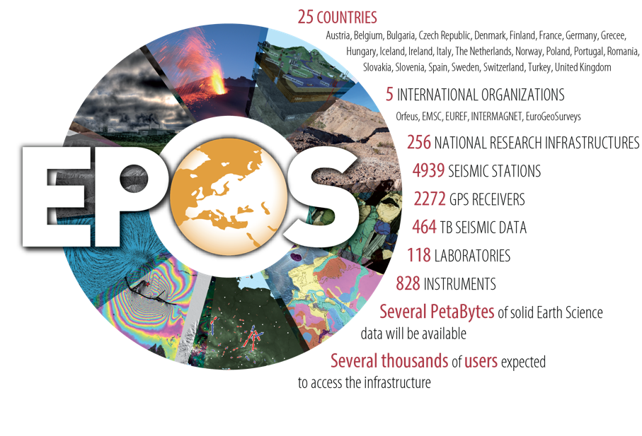
Pan-European dimension
A long-term plan for the integration
of research infrastructures for solid Earth Science in Europe
EPOS integrates the
existing and future advanced European facilities into
a single, distributed,
sustainable infrastructure
taking full advantage of new e-science opportunities
for Open Science

Slide 3
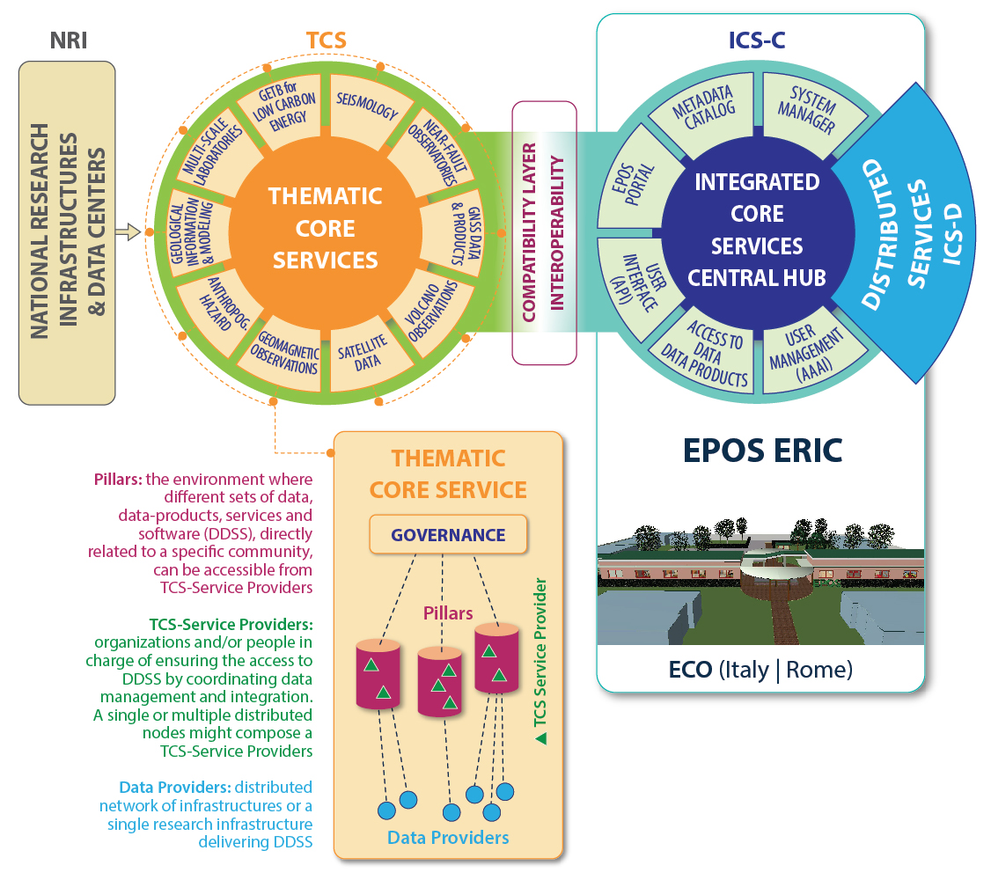
How EPOS work?

Slide 4
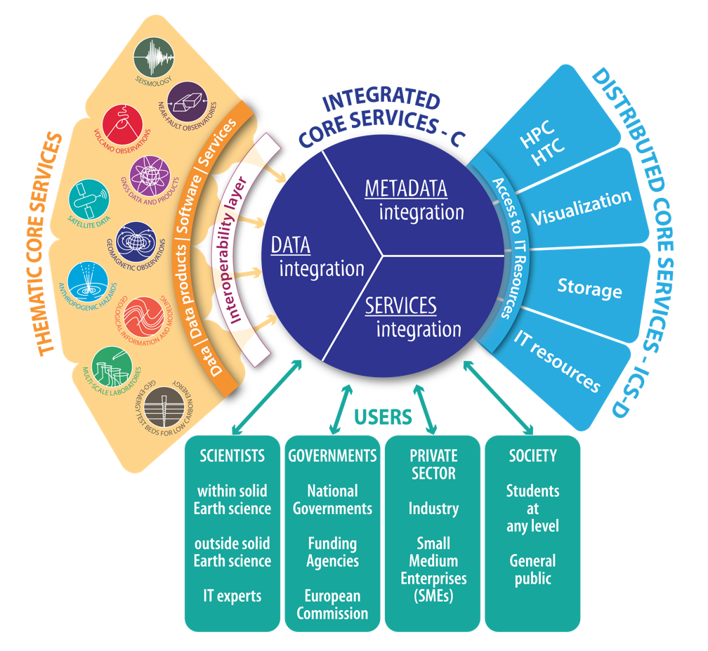
EPOS Architecture
EPOS
Integrates national and transnational RIs for solid Earth science to provide seamless access to pan-European data & services.
Guarantees open access to multi-disciplinary RIs for cross-disciplinary and transnational research.
Creates novel e-Is and integrated core services for a multidisciplinary community of users.
Fosters scientific, technological and ICT innovation for successfully addressing global grand challenges in Earth sciences.
Improve geo-hazard assessment and sustainable management of geo-resources for a safe and prosperous society.

Slide 5

1 - Community level integration
Multidisciplinary data &
services
Data Harmonization, to
foster standardization
Metadata standards
Data Management Plans
Interoperability
New products & services

Slide 6
2 – Data level integration

Slide 7
3 – Exploitation of Results & Impact Assessment

Slide 8
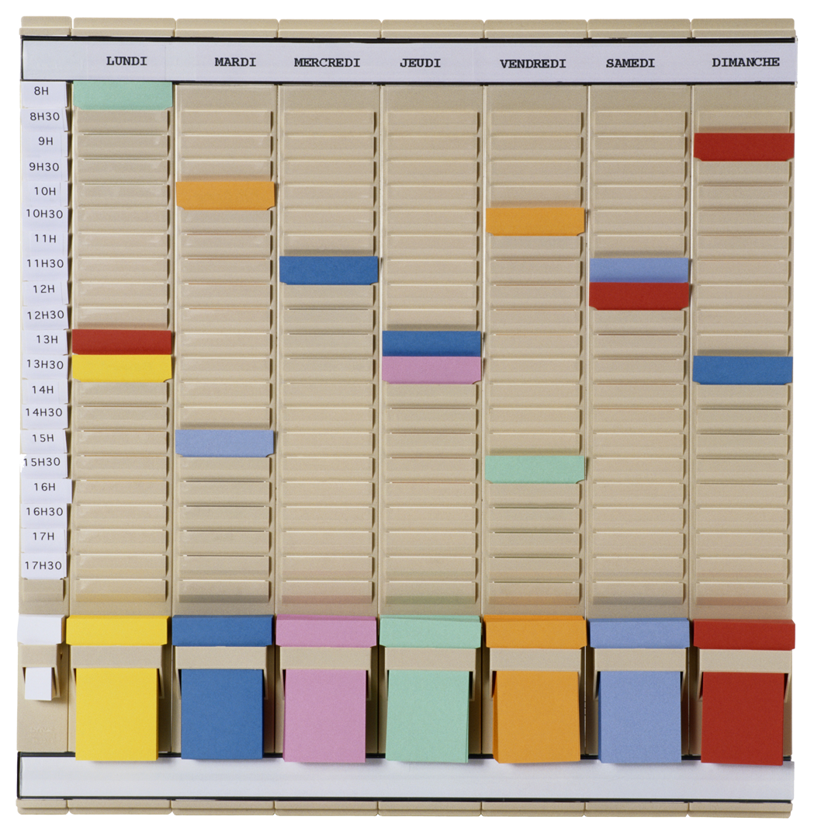
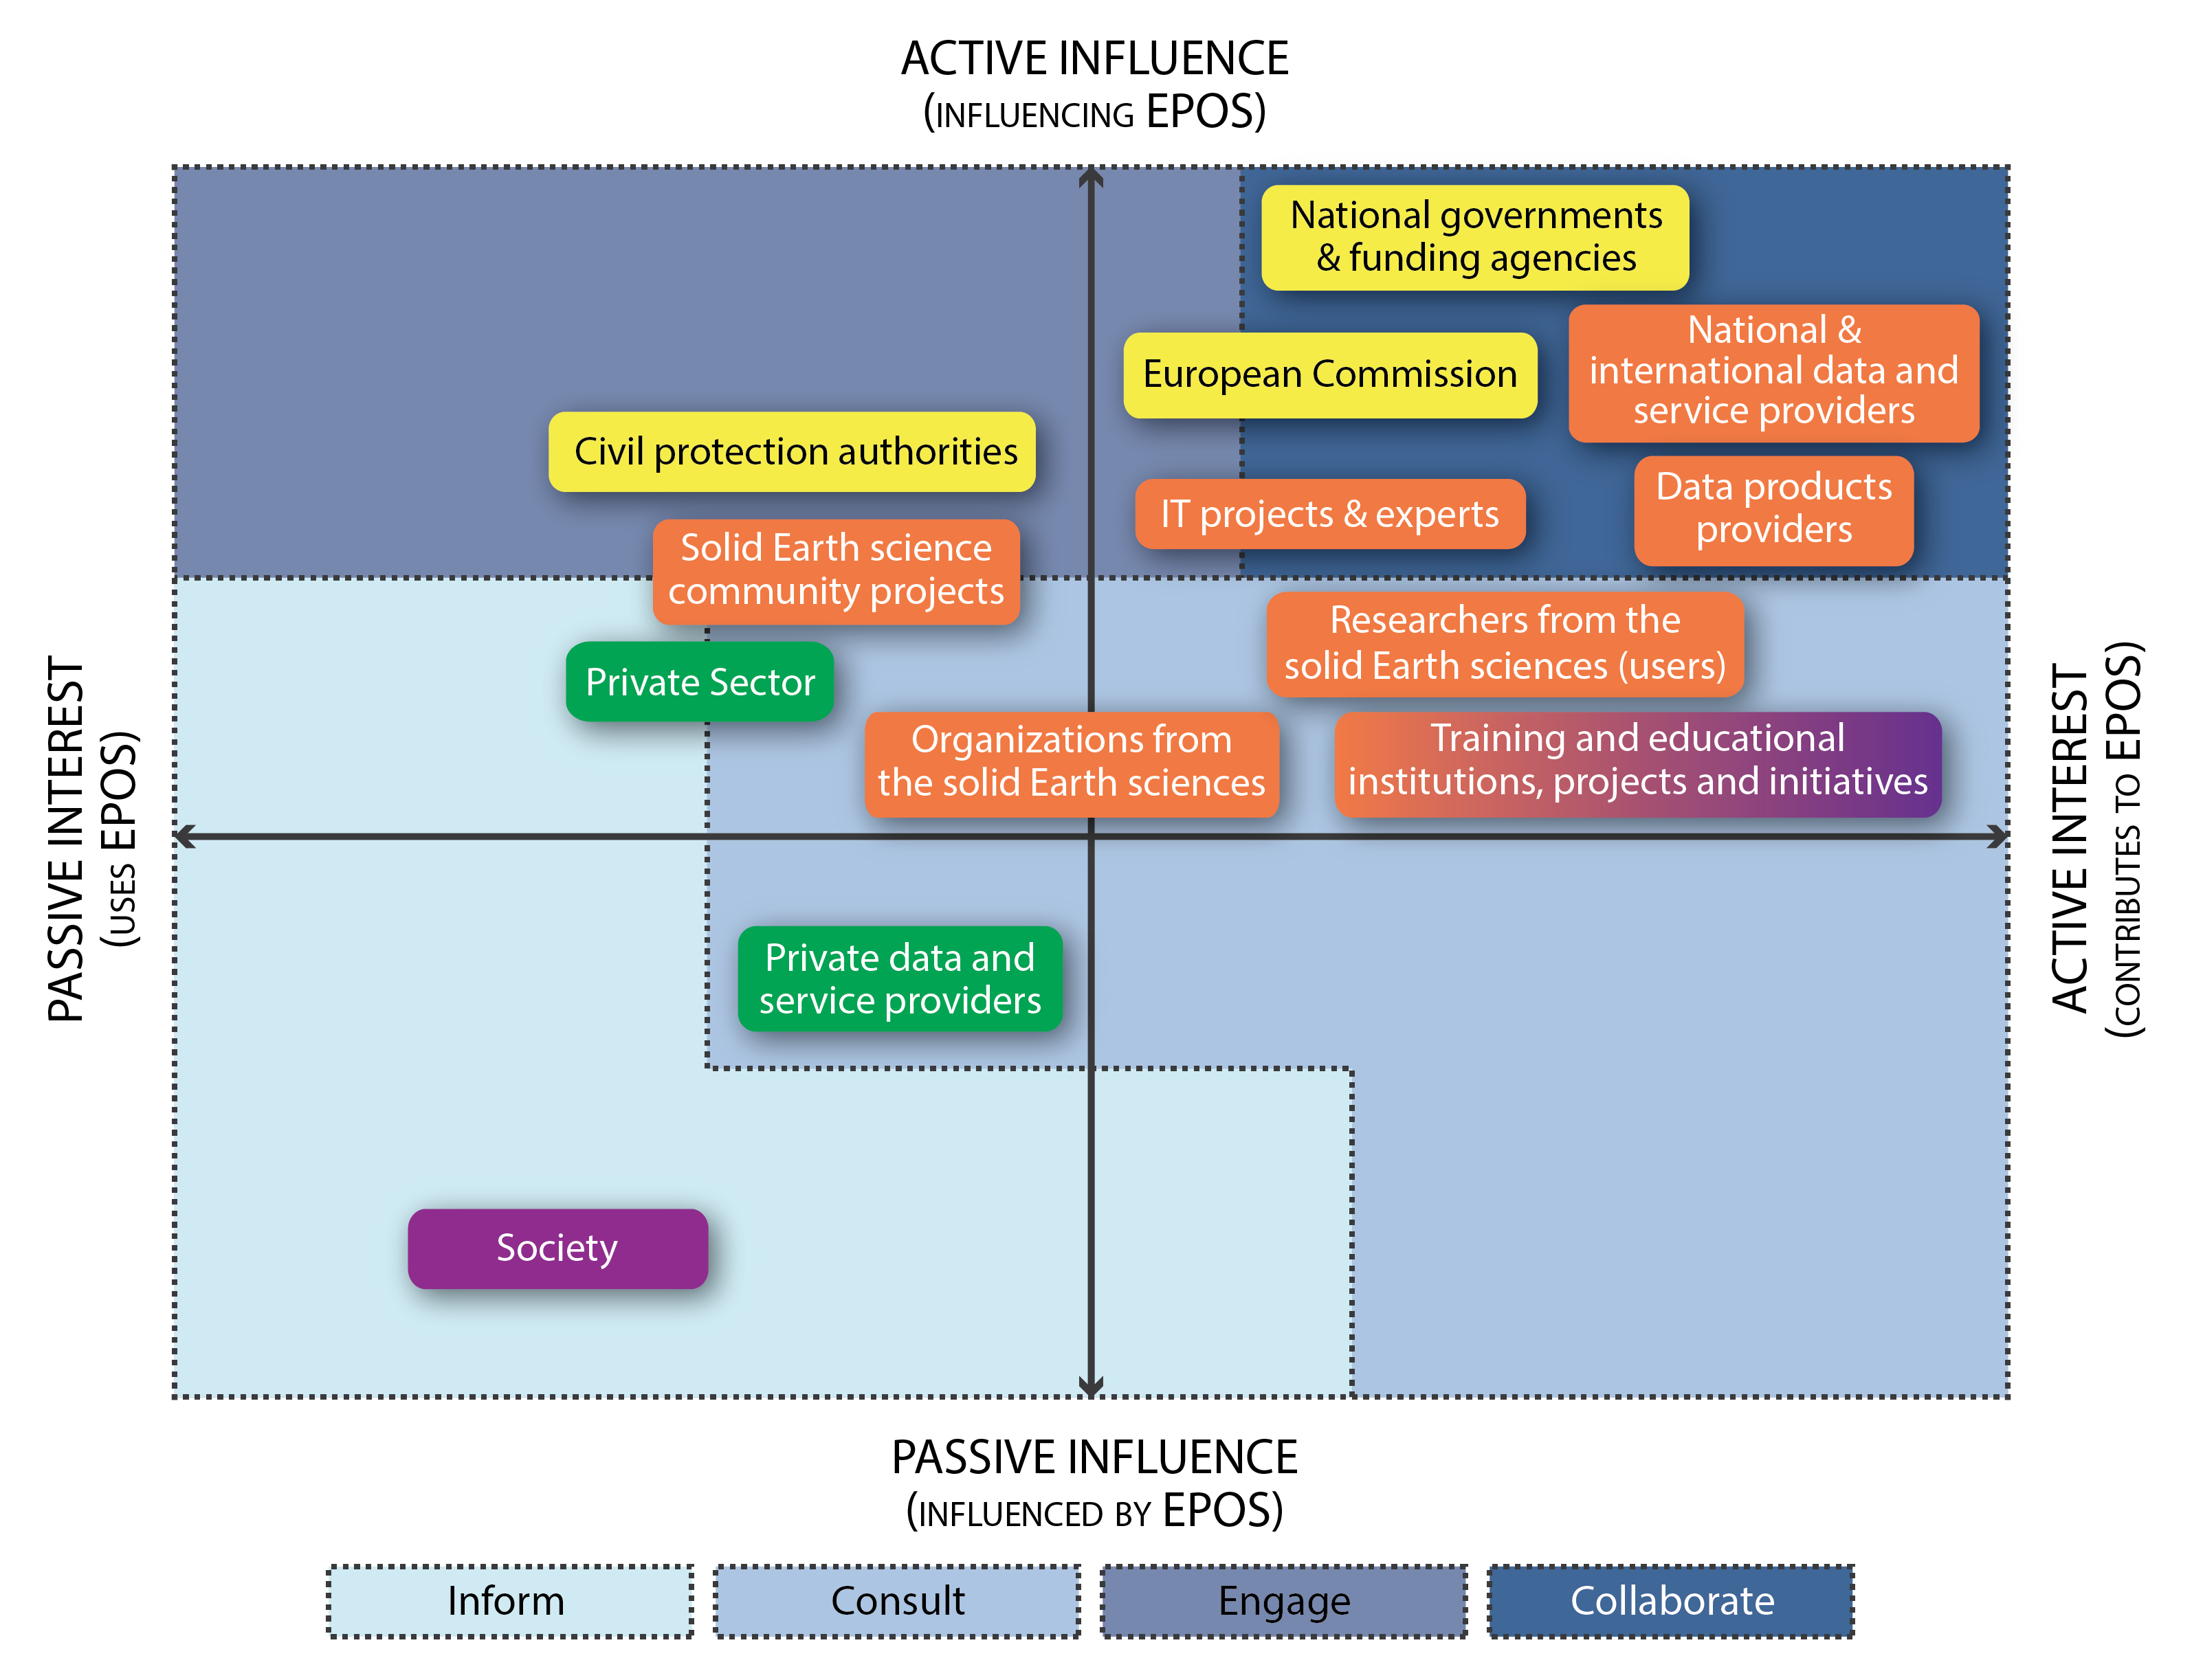
Target Audience
(EPOS IP stakeholders)
EPOS Communication Plan
SCIENTISTS
Data providers
Data users within the solid Earth community
Data users outside the solid Earth community
IT experts
GOVERNMENTS
National governments
Funding agencies
European Commission
PRIVATE SECTOR
Industry
Small Medium Enterprises
SOCIETY
Students at any level
General public
  Objectives Target audience Strategy Activity Plan Impact assessment
Notes:
Once defined the target audience and its categories and sub-groups it will be necessary to develop a strategy that will adopt appropriate actions and communication channels to effectively engage with them.
.

Slide 9
4 – Procurement of IT resources & services
Service
Portfolio

Slide 11
Conclusive Remarks
Key topics for discussion in ENVRIPlus
Synergies for representing ENV RIs
Cooperation within EOSC and e-science
Discussing Global perspectives

Slide 12
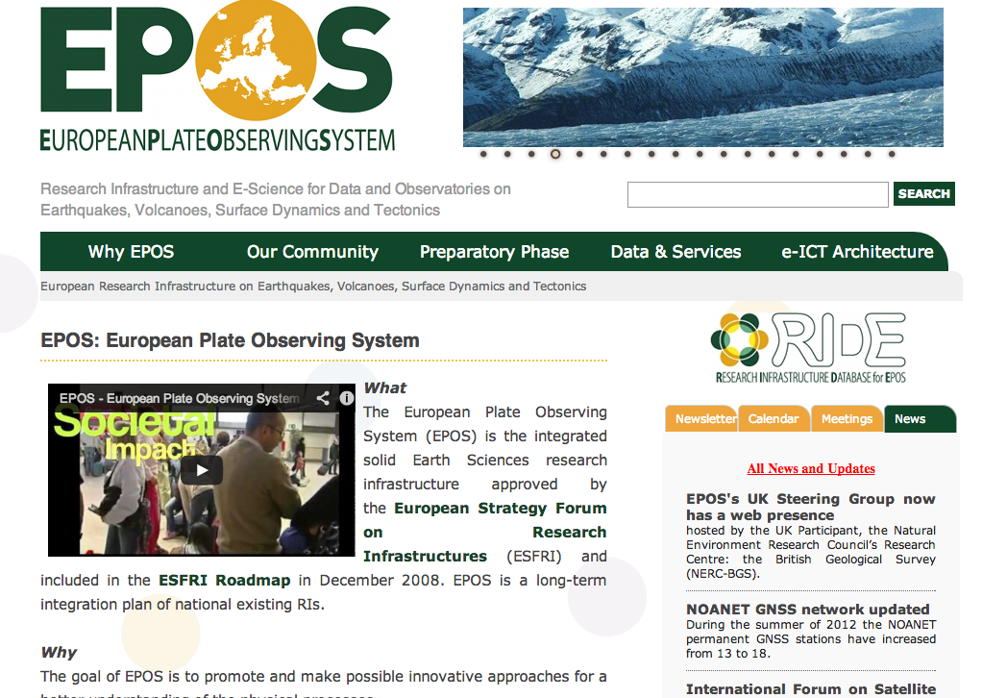
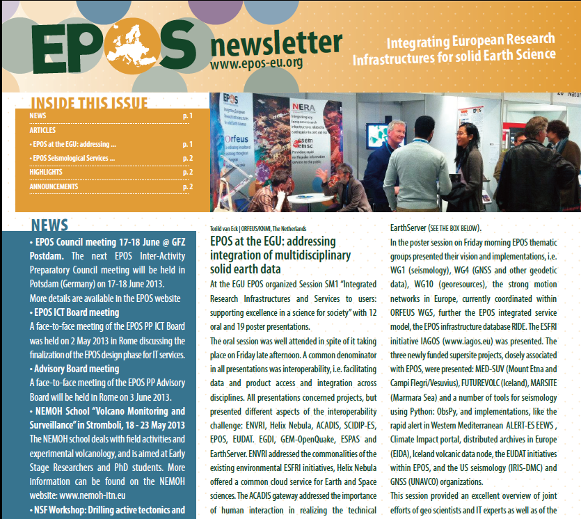
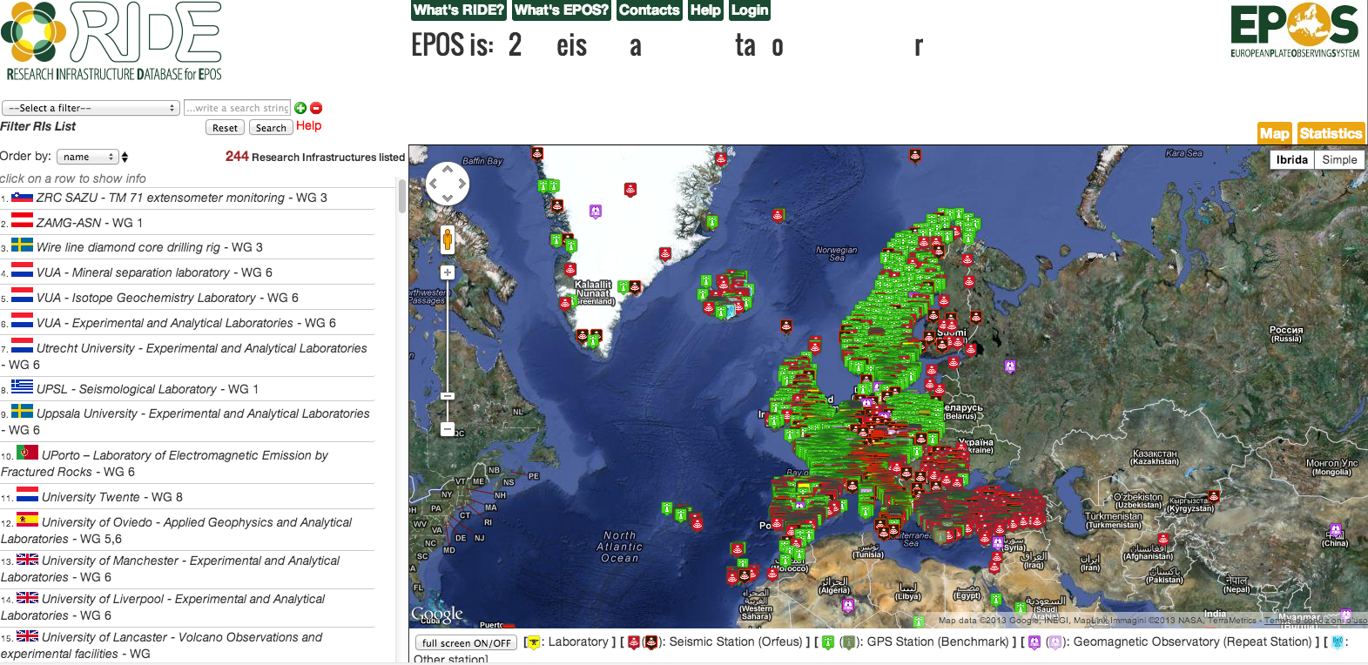



Thank You
WebSite
Newsletter
www.epos-eu.org
www.epos-eu.org/newsletter
R.I.D.E.
Epos Social
www.epos-eu.org/ride
www.epos-eu.org

Slide 13
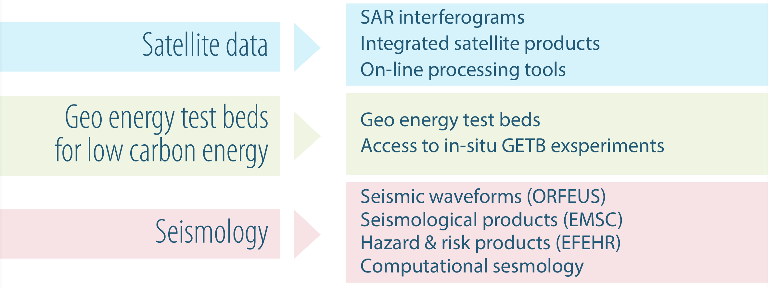
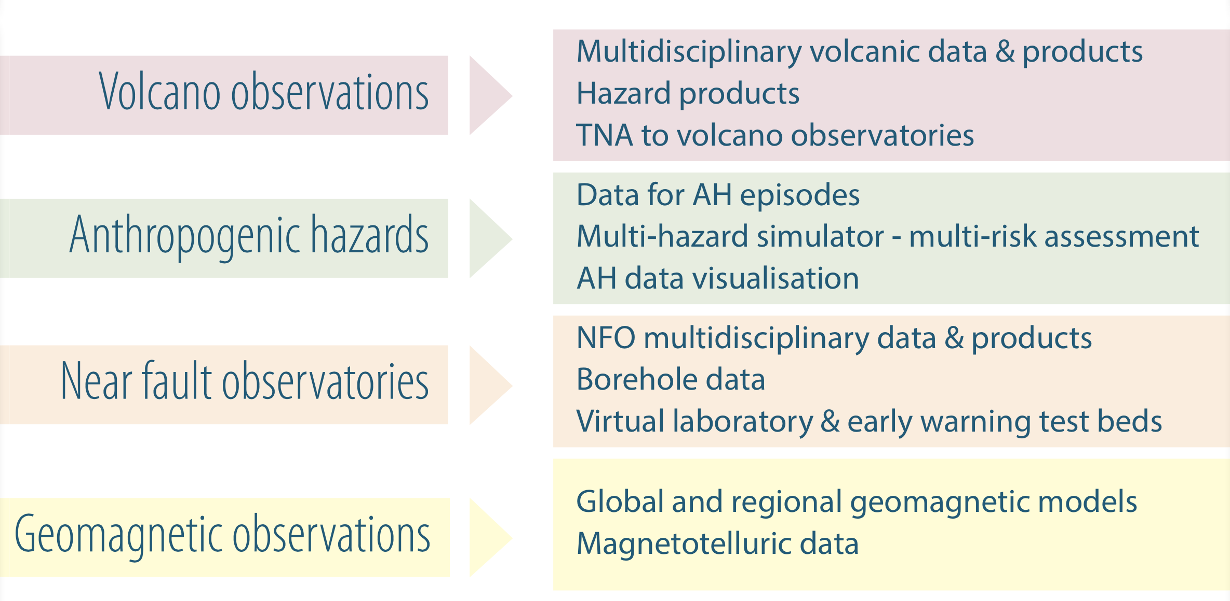
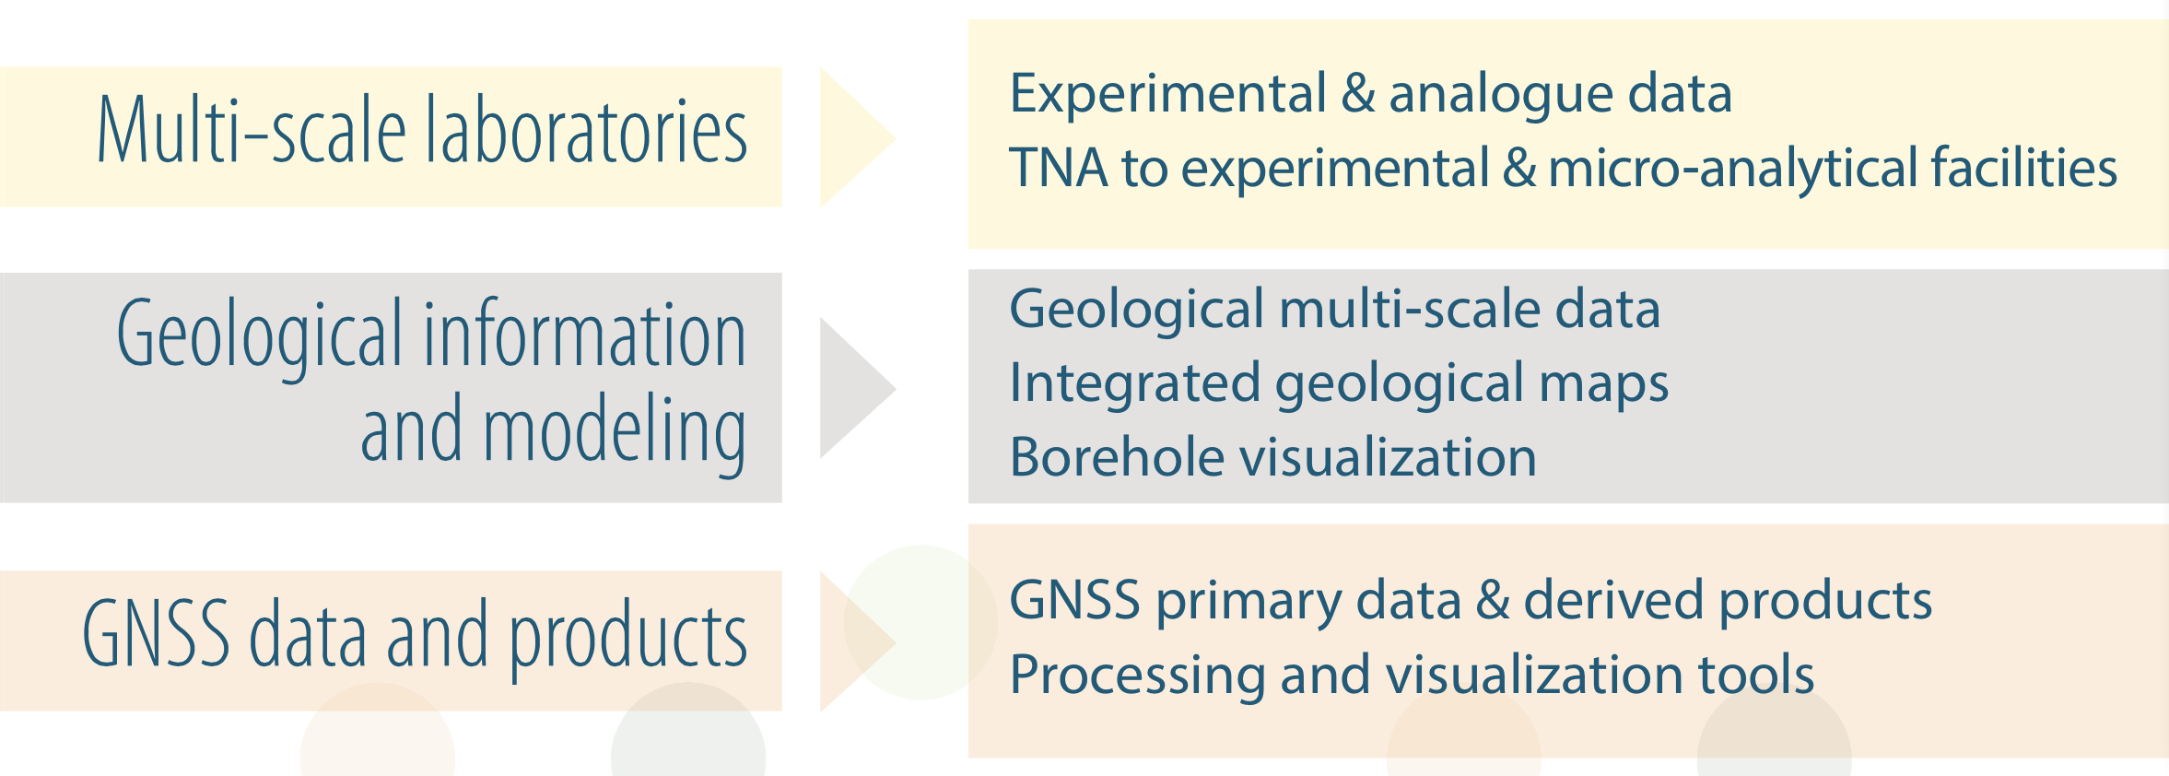
EPOS TC Services 1/2

Slide 14
EPOS TC Services 2/2

