Slide 1
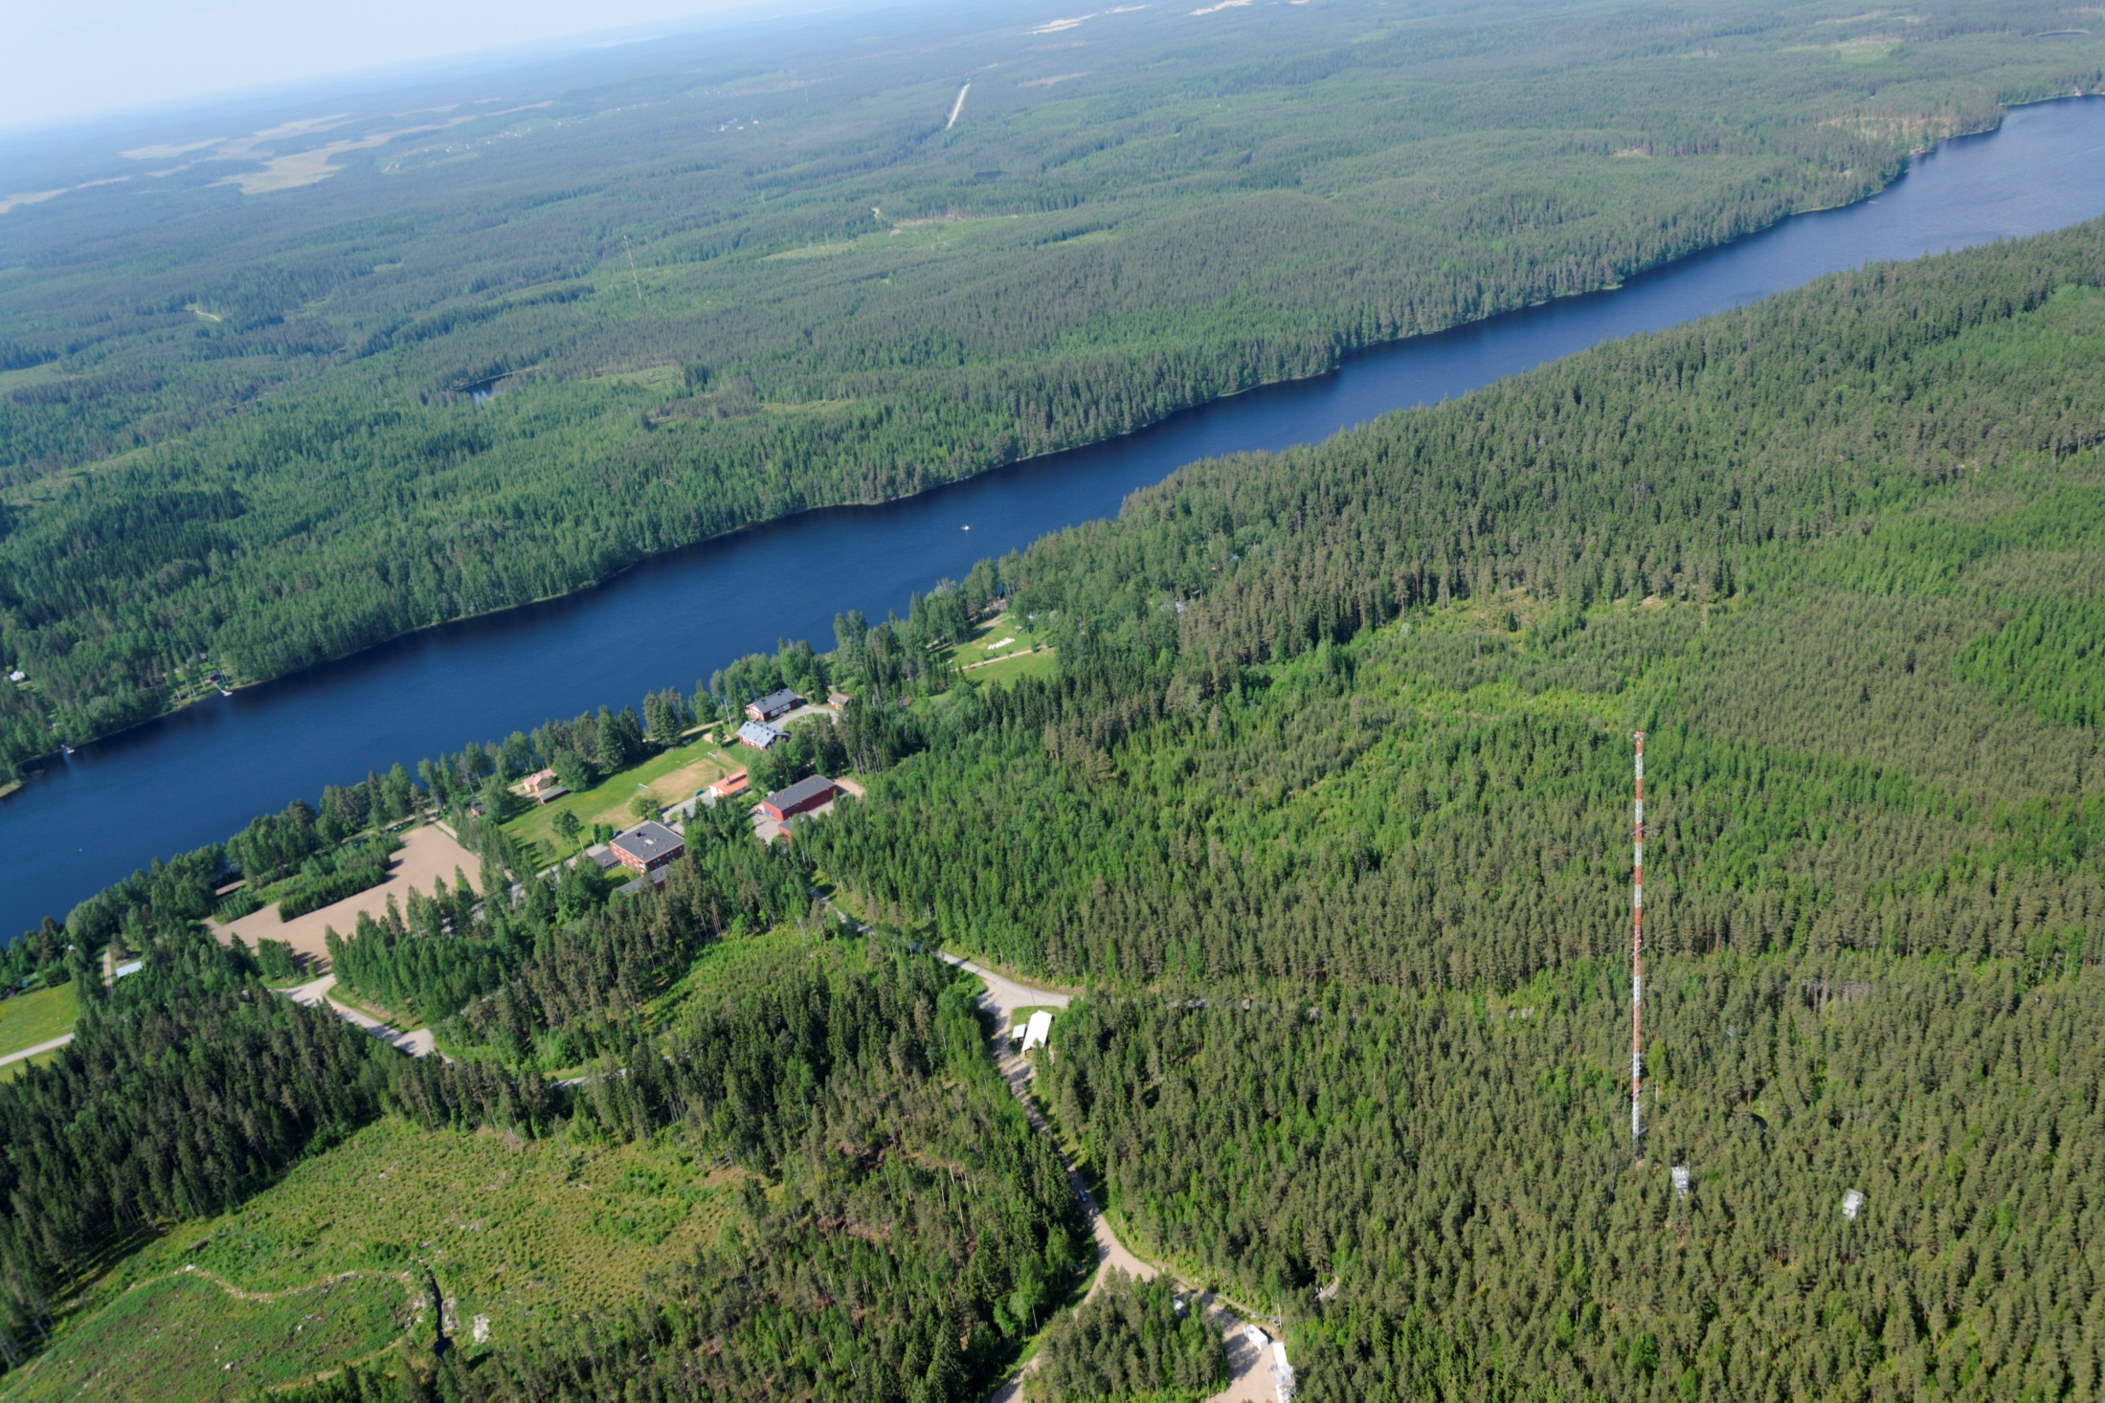
Concept for an Integrated Ecosystem and Environmental Research Infrastructure
Jaana Bäck et al.
University of Helsinki

Slide 2
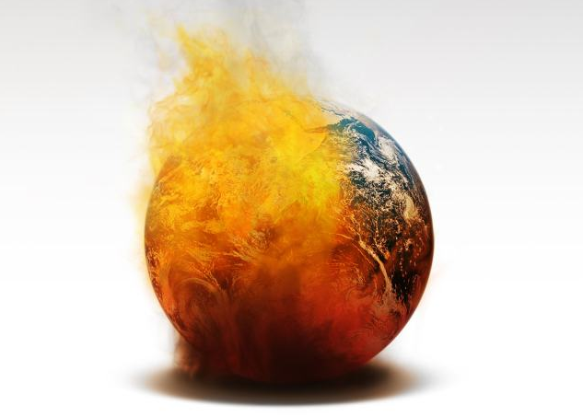
Global Grand Challenges addressed with environmental RIs
Global warming
Raw materials
Air quality
Climate change
Fresh water
Volcanoes,
earthquakes
IMPOSSIBLE TO ADDRESS WITHOUT A MULTIDISCIPLINARY RI CONCEPT
Ocean acidification
Deforestation
Energy resources
Biodiversity loss
Epidemic
diseases
Food supplies
Chemicalisation
Notes:
Changing earth system and unknown interactions
Feedback loops connect the atmosphere, vegetation, soil, cryosphere and aquatic systems with each other in a complicated manner
Multiple ecosystem types will be impacted across a range of interacting spatial and temporal scales
Need for long term observations is obvious
Challenges
Environmental RI field is still very fragmented (in many ways) and Ris often specialized

Slide 3
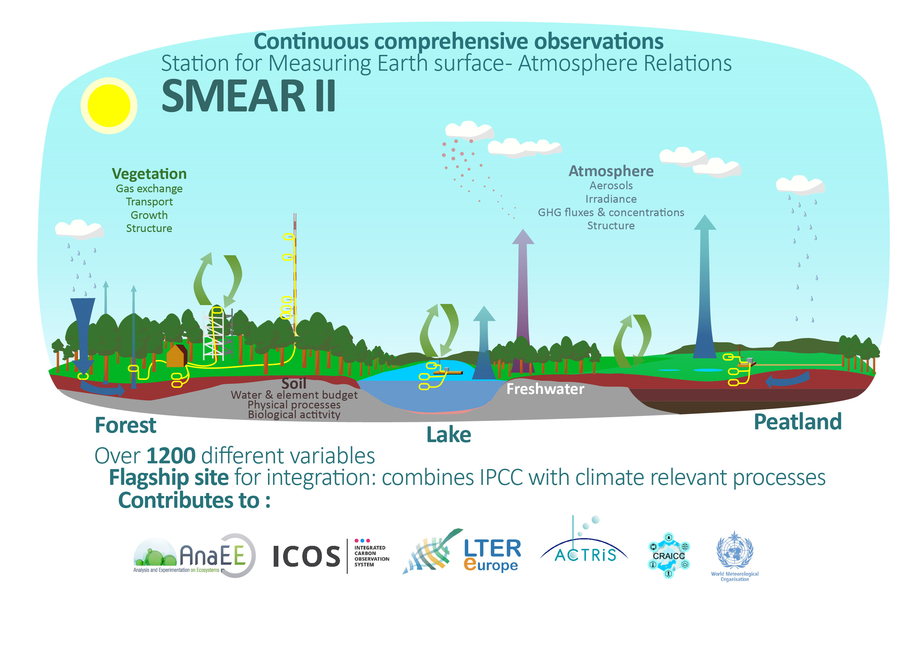
www.atm.helsinki.fi/SMEAR/index.php/smear-ii

Slide 4
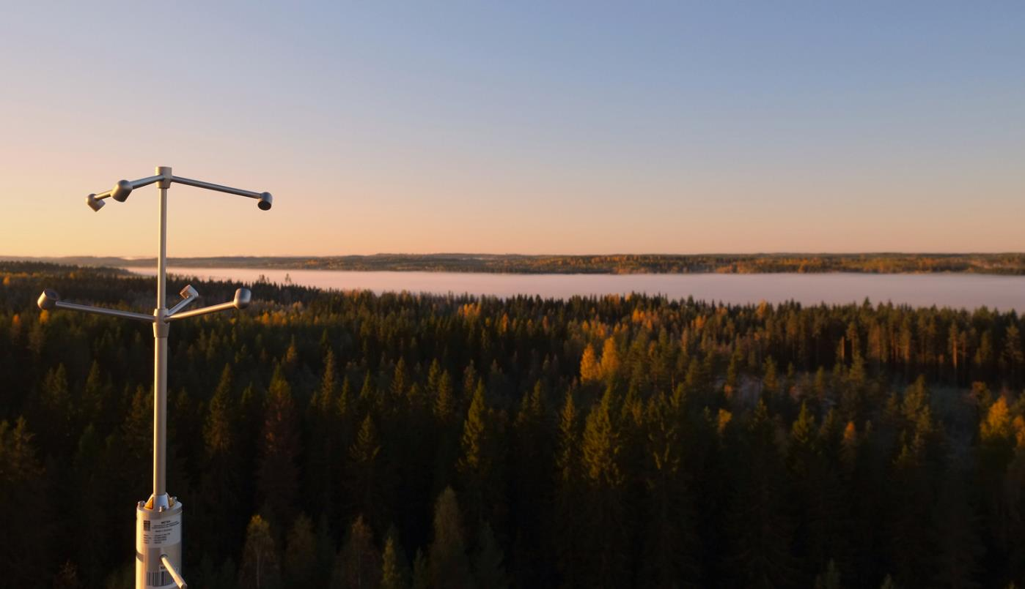
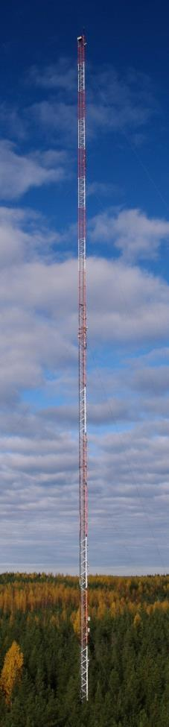
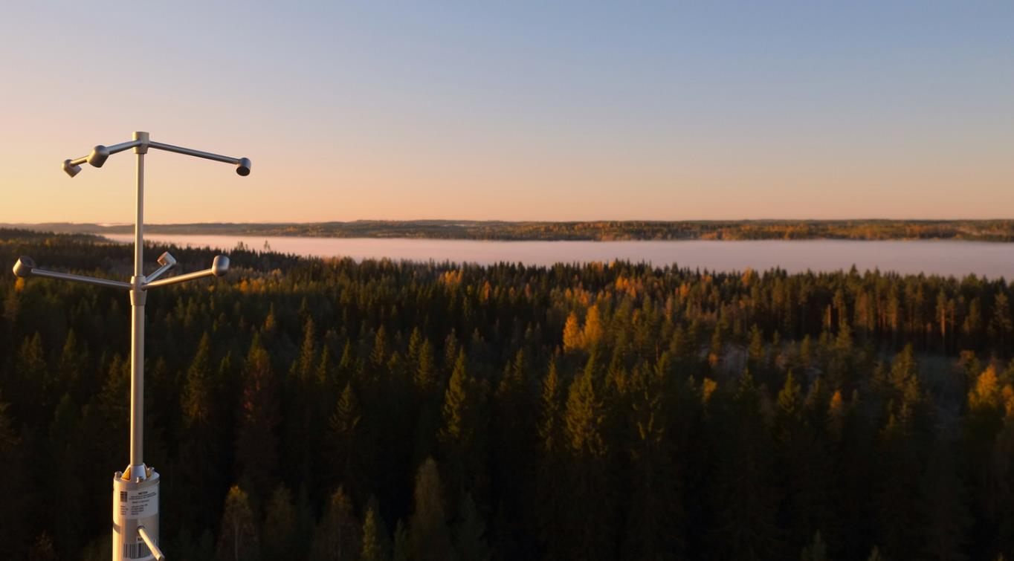
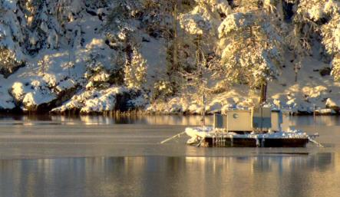
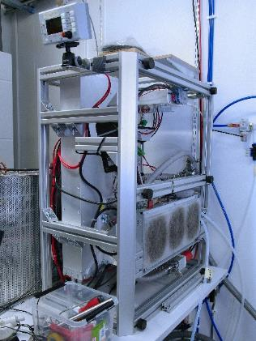
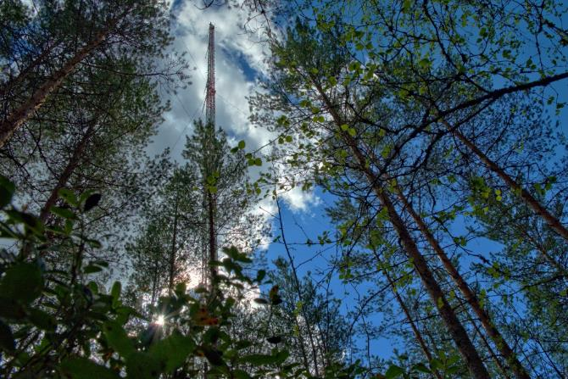
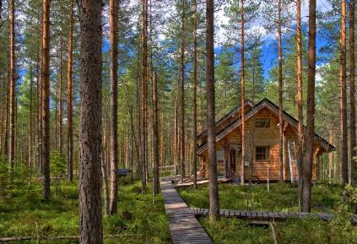
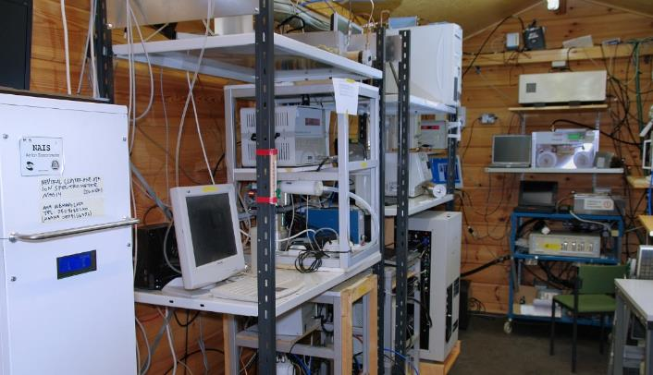
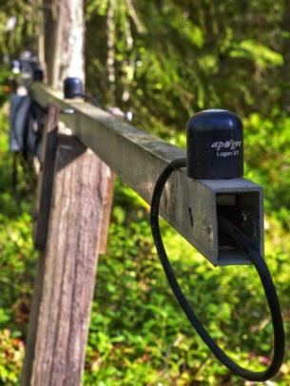
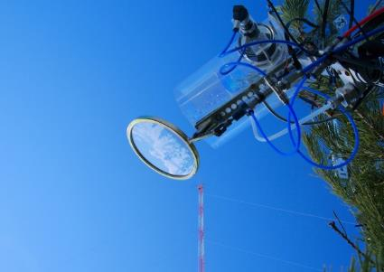
SMEAR II Hyytiälä

Slide 5
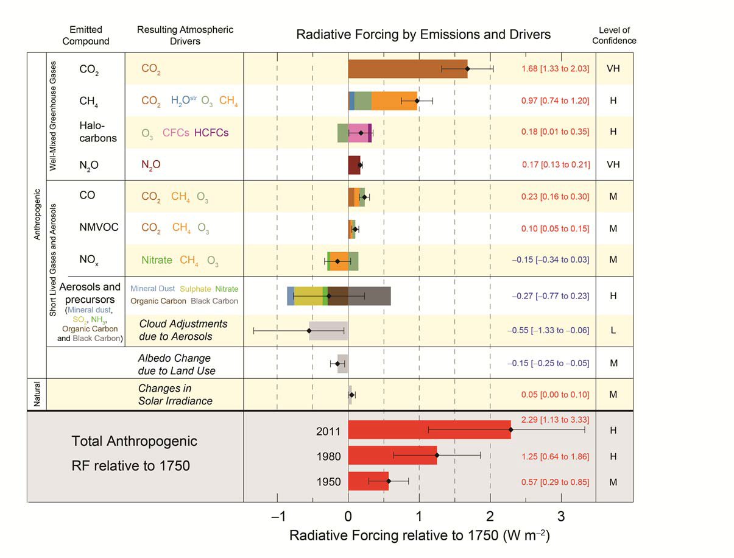
It did not happen by accident:
Fundamental concepts directing the development of the SMEAR RI
Mass, energy and momentum are being conserved
Metabolic, physical and chemical processes convert material and energy into other forms at molecular levels
These processes generate concentration, temperature and pressure differences
Concentration, temperature and pressure differences give rise to material and energy flows and structure of the system
Material and energy flows combine molecular phenomena to the behavior of larger-scale system
The flows change the material and energy pools in the atmosphere, vegetation, soil and water
Feedback loops → responses at global level
REQUEST: QUANTIFY THE CLIMATE-RELEVANT COMPONENTS

Slide 6

SMEAR integration concept includes:
Basic infrastructure:
  roads, electricity, internet connection, temperature controlled local data and instrument hub, centralized vacuum, pressurized air, towers/tall towers, lab facilities, storage and workshop
  Supporting background measurements (temperature, irradiation, moisture, wind, …)
Scientific measurement equipment, automated and on-line 24/7:
  Standard particulate and gas-phase pollutants and GHGs
  Aerosol number, size distribution, mass and chemistry
  Atmosphere - surface exchange (flux measurements) of climate-relevant compounds
  Ecosystem functions (continuous and campaigns/experiments): forest, agricultural, lake, peatland, urban …
  Structure variables: stand biomass and structure, growth, phenology …
Data infrastructure, software, quality assurance and control tools
Trained and skillful staff, working safety, support and management; continuous training in RI operations

Slide 7
What is the core in the integrated RI concept (=how we market it to our shareholders)?
Excellent science is our common vision – quality, critical mass and interdisciplinary research
World-class research infrastructures – an integrated network of RI’s where different users meet
Education and training – knowledge exchange at all career levels and also operations of sites
Innovations – new solutions to the grand challenges, startups
Science to society – continuous policy dialogue and outreach, more value for the investment

Slide 8
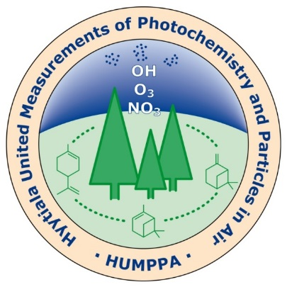
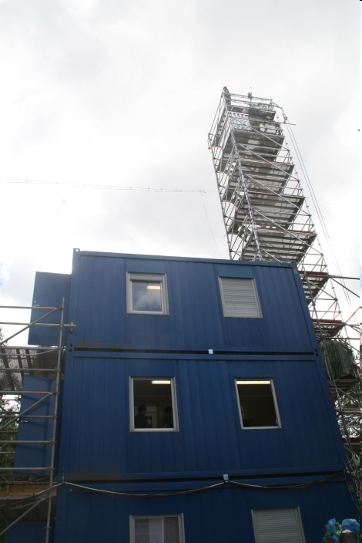
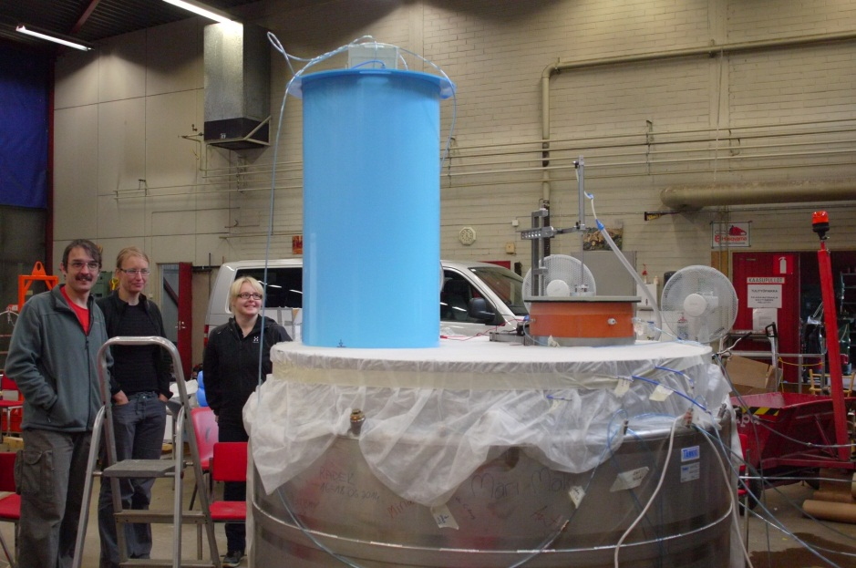
Fruits of integration, e.g.
Joint campaigns:
  2010 HUMPPA-COPEC with 40 visiting scientists from MPI → > 12 joint scientific papers, 5 PhD degrees using the data (so far)
  ’Pumpelointi’: CO₂, CH₄, N₂O calibration campaigns for chamber measurements; altogether >20 research teams involved → several baseline papers and recommendations for measurement systems
Carbon tree

Slide 9
Fruits of integration, e.g.
Improved science
  Experimentation ↔ monitoring
  Feedbacks between domains, lansdcape analysis, up- and downsacling
  Method development (measurements, models)
  Improved data flows and synergies in data use
Joint publications
Research visits:
  >200 researchers annually physically visiting
  40 000 - 84 000 hits by 250-300 different users to the SmartSMEAR database monthly

Slide 10
Global challenges require integrated, hierarchical station network
Flagship (master) sites
  comprehensive measurement strategy in different domains
  process studies, experimentation, long-term observations
  high cost, extensive services
Advanced (flux) sites
  e.g. Fluxnet, LTER regular, GAW stations
  average cost, comprehensive in some measurement type or services
Basic (standard) sites
  e.g. weather stations, LTER satellite, ICP –Forest-Waters-IM sites
  low cost, providing ‘background’ data and upscaling
  Hierarchical network is able to tackle problems related to large spatial scales, heterogeneity of ecosystems and their complexity in landscape
  A dense network of the flux and standard stations allows application and up-scaling of the results obtained from flagship stations to the global level
  Co-location of RI’s is crucial to provide enough integration!

Slide 11
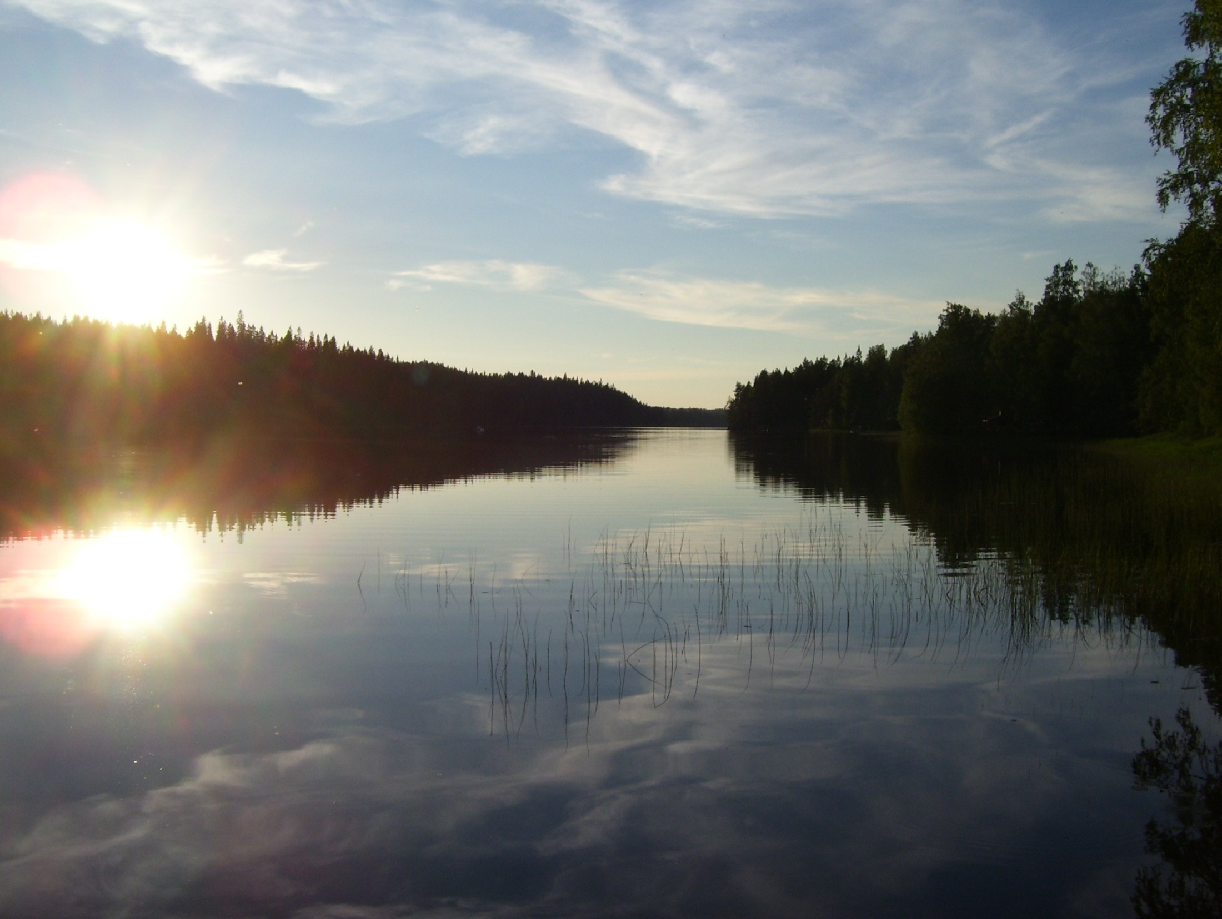
Thank you
for your attention
Notes:
So that’s it thank you for your attention.

Slide 12

Barriers of information
Unusable data
Wrong terminology
Data product
from a Research
infrastructure
Unknown data
No PIDs
Authorization problems
No discovery
Difficult licensing
Difficult documents
Discovery tools
No access
Assumptions of use
Discipline specific jargon
No understanding
No training
No trust
No interface
Standard names
RI product
Unable to open
Unknown format
Not understanding user needs
Lack of documentation
Standard licences

