Slide 1
Townhall
Eric A. Davidson AGU
Wolfgang Wagner GCOS
Barbara Ryan GEO
Johannes Fleming Copernicus
Conveners
Ari Asmi U.Helsinki / Cluster of European Research Infrastructures
Werner Kutsch, ICOS

Slide 2
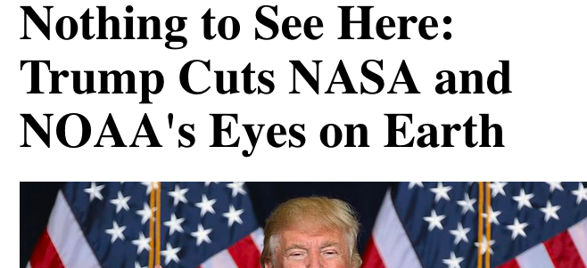
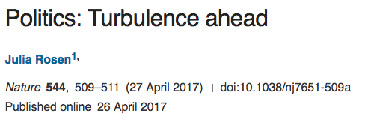
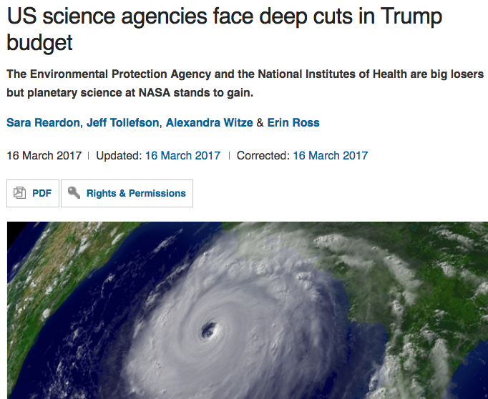
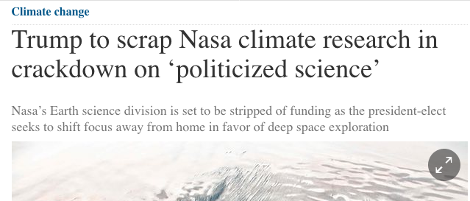
picture: TaxRebate.org.uk

Slide 3
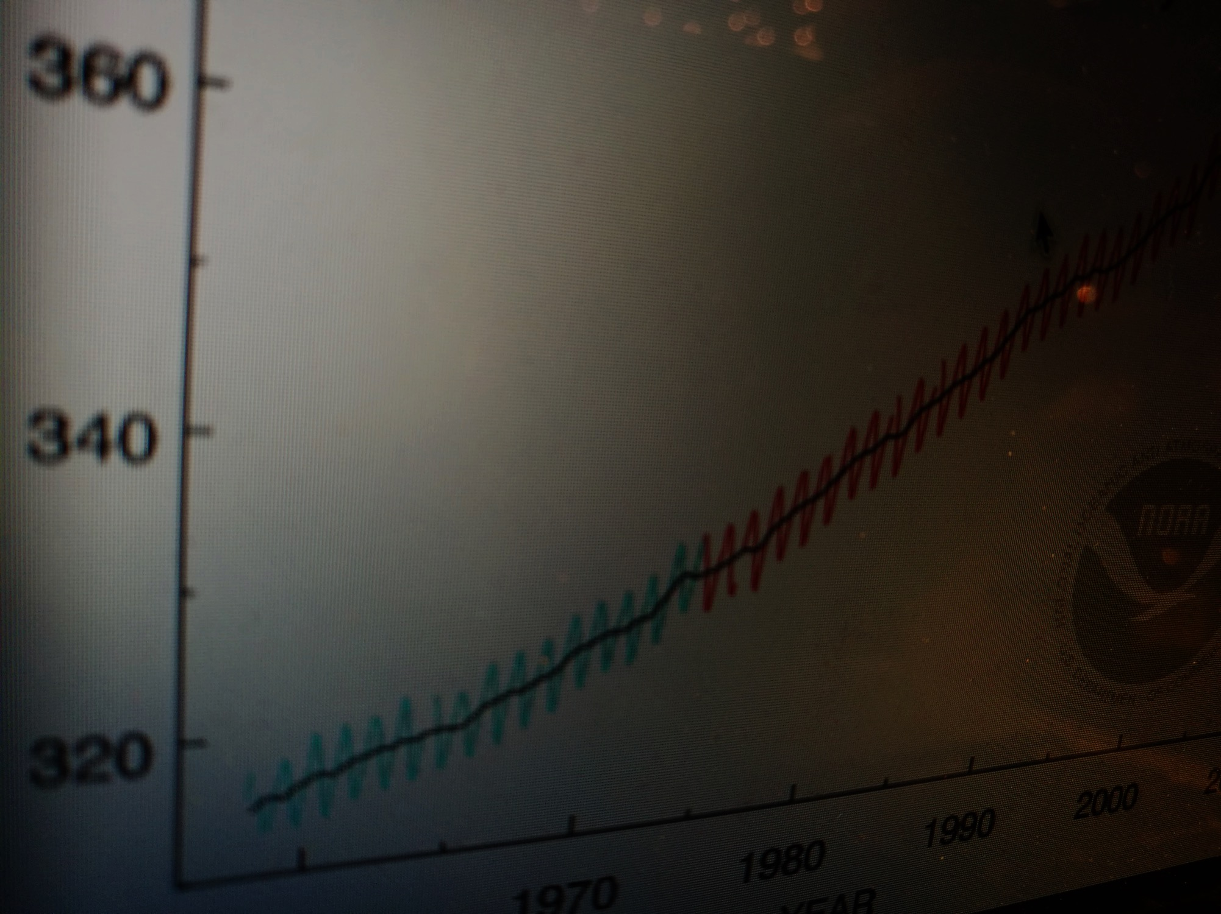
Global problems need global observations Long time series are needed to understand Earth Geographic or method gaps make solving global challenges will be very difficult
WHY?

Slide 4
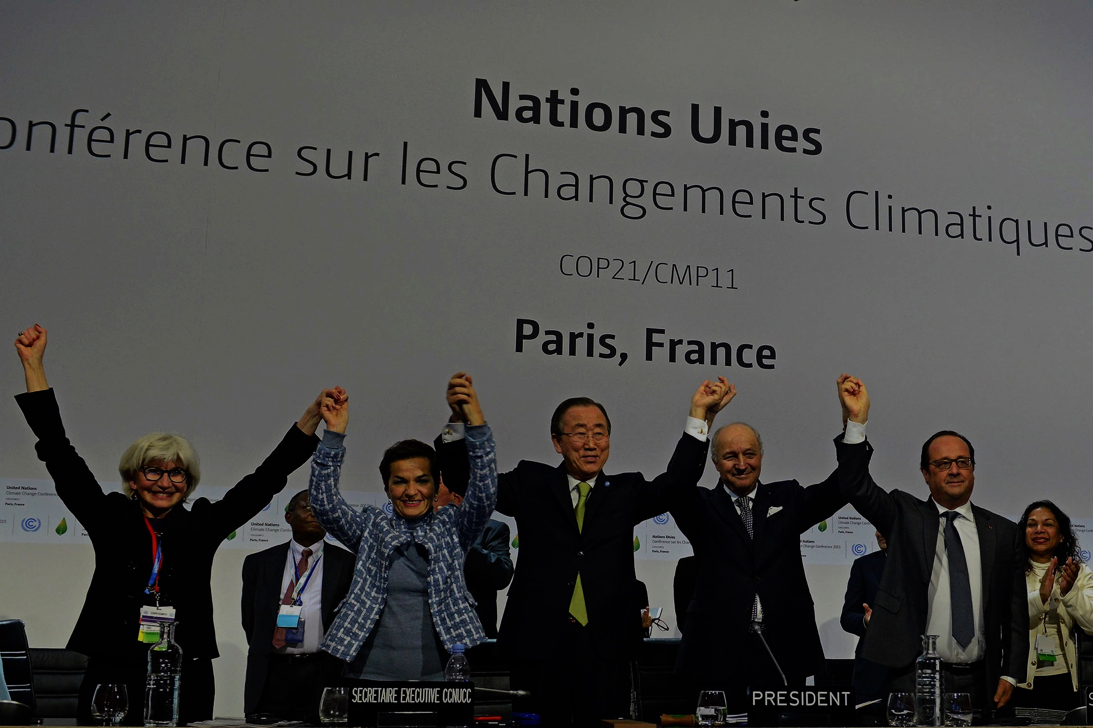
Sustainability of the observations Global responsibility for supporting Earth System observations Are there international actors who can help us with this?
Short term question

Slide 5
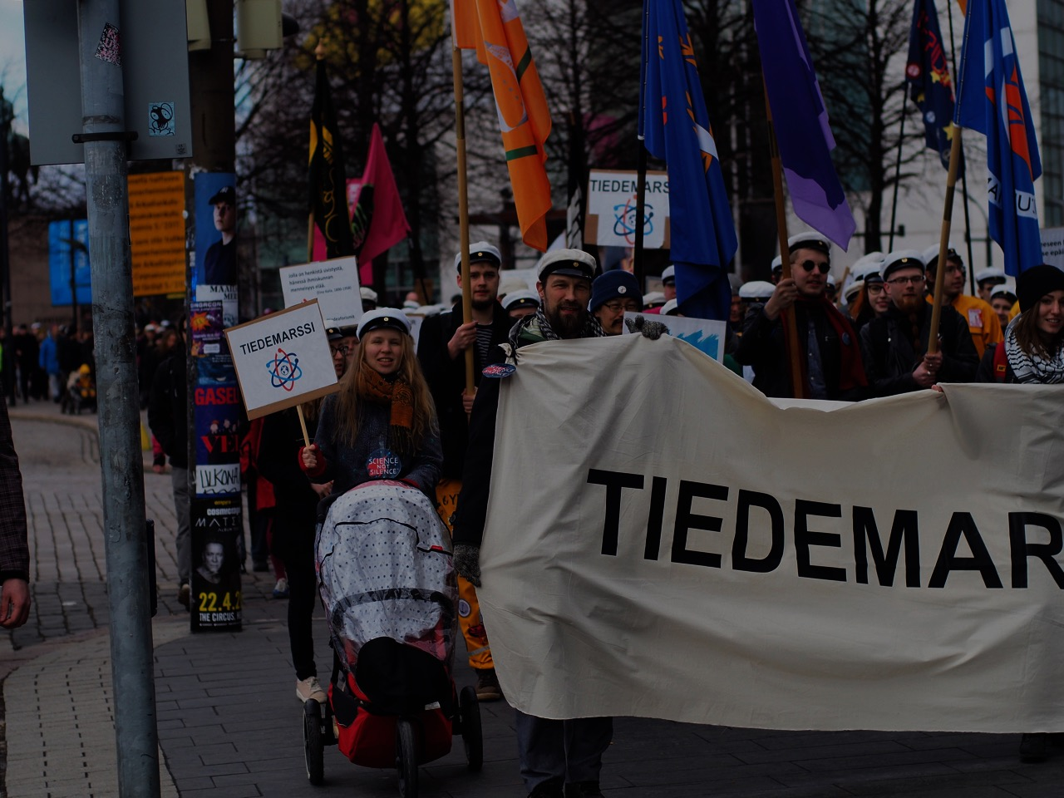
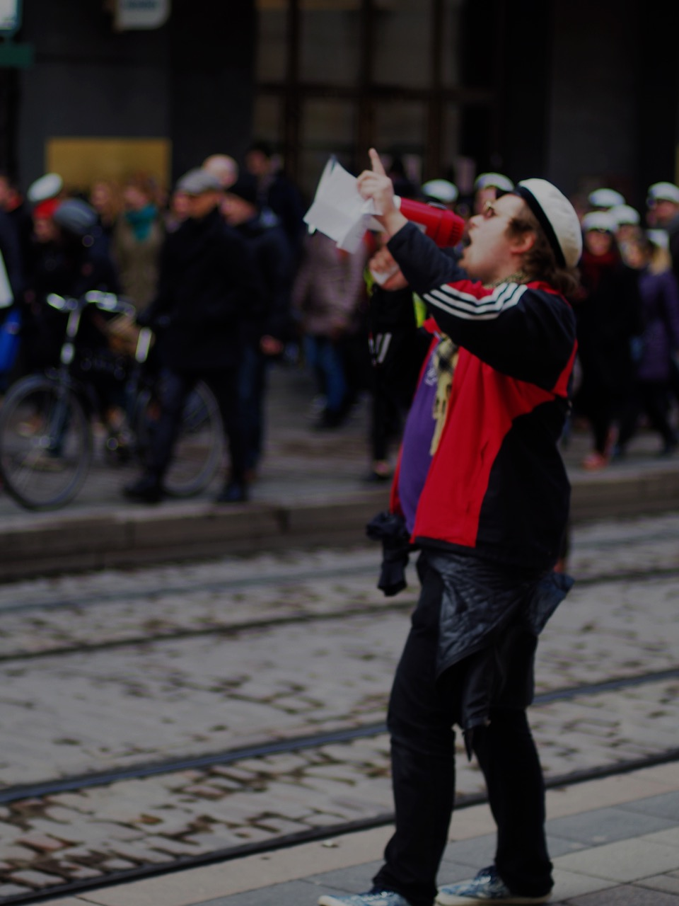
Long term question
Why it is easy to cut from EO?
Their value is not understood?
Communication of EO value to society

Slide 6
Townhall
Eric A. Davidson AGU
Wolfgang Wagner GCOS
Barbara Ryan GEO
Johannes Fleming Copernicus
Conveners
Ari Asmi U.Helsinki / Cluster of European Research Infrastructures
Werner Kutsch, ICOS

